Slide 1
Project Accelerate - Employer Onboarding Strategy
July 22, 2022

Slide 2


Agenda
Scope and Approach
Executive Summary
Target State and Implementation Roadmap
Appendix
Appendix A: Current State Assessment
Appendix B: Solution Prioritization
Appendix C: Approach
Appendix D: Glossary

Slide 3
Executive Summary: Case for Change
What we know today
In 5 short years, Equifax Workforce Solutions doubled in revenue not once but TWICE
Significant growth during this time was enabled by the Employer Onboarding Platform (originating from ADP TWN Partnership)
Employer Onboarding platform remains virtually unchanged limited to moving platform to cloud and expansion beyond ADP
Manual activities by operations can no longer be neglected - time to revenue is table stakes for EWS and Customer Experience
Applying same concepts to all EWS solutions at scale present greater revenue opportunities
Doubling in revenue again is in short reach but we need to ADAPT by scaling within every solution and channel of EWS
Driving Factors
Accelerators
Business Benefits
Organic Growth
New direct Employers
Automation Efficiency
Fit & Scalable
for Growth
Accelerated
M&A Onboarding
Inorganic Growth
InVerify, i2Verfiy, HireTech, Health e(fx), Efficient Hire
Process Optimization
Improved
Data Quality
Improved
User Experience
Volumetric Growth
New partners: Namely, PrimePay, iSolved, PeopleGuru, Asure, Humanic
Reduced
Operating Costs
Reduced
Cycle Time
Key Growth Drivers
Mortgage, Talent, I9, Government
Technology Enhancements

Slide 4
Key Strengths
For Alliance Channel, TWN product already has automation infrastructure in place to orchestrate Employer Onboarding
The Data Acquisition service and Data Xchange service platforms currently serve as the gateway for onboarding of new Employers
Cloud modernization and enablement is already underway
Equifax has planned CPQ integration in Q3/Q4 2022
Selective Automated Processes
Data Acquisition Service Platform
Cloud Adoption Strategy
Improved Data Quality
Accelerates the adoption of automated infrastructure for other products and channels
Continue to leverage existing capability for Data Acquisition service & Data Xchange service
Enables extension of platforms for partners at scale
Enhances quality of data related to product/service selection in the Opportunity (future state)

Slide 5
Key Drivers for Acceleration
In Flight Initiatives
UKG and One Source Virtual
Automate the duplicate Employer Check *
User Interface for Costa Rica Team for Employers needing Review
Add Unemployment Claims Management to Automated Boarding*
HIREtech and hireCREDITS
Convert 6000 HireTech Employer Codes to Equifax ER Codes
Automated Onboarding of all new hireCREDITS customers within EFX
Leverage matching logic for consistency of Employer Codes for all products
I9 for Alliances (Paylocity, ADP, and more)
Integration with DXS/ES Portal*
Leverage matching logic for consistency of Employer Codes for all products
Account for upgrade logic (example: I9 Standard to I9 advanced)
M&A
Automate the set up of M&A customers into EFX
Automate duplicate Employer Check*
Enable decommission of M&A systems
*Dependency on other teams

Slide 6
Key Opportunities and Solutions
Initiative: Enhanced Employer Onboarding Process - Multi-product/Multi-channel
 |  | Business Impact |  |  |  | Effort
 |  | Cycle Time | Operating Cost | Rework | Customer Experience | Level of Effort
Theme - Automation Efficiency, Process Optimization
Key Opportunities¹ | Key Solutions¹ | Benefits
Reduce 2+ weeks delay due to the manual setup of Employer authorization in SSS for TWN, UC, I9 Direct Onboarding | Extend existing platform to support all Employer products to set up authorization roles in SSS | Reduction in Cycle Time Reduction in Operating Cost Improved User experience during product implementation Initiative will enable: Faster time for customer boarding Onboarding for all Workforce Solution Products Partner implementations at scale for I9 and WOTC Integrate M&A Customers into EFX systems in an automated consistent fashion
Reduce 2+ days delay for UC onboarding, due to spreadsheet based manual process of generating UCX Inhouse Account ID | Implement an API-led solution for generation of UCX “Inhouse Account ID”
Reduce manual aggregation of data from Salesforce, AODocs & SOMA for ER Codes by Workflow Specialist and Implementation Specialist | Automate setup of default product configurations for a direct employer to reduce manual data entry by Implementation Specialist during product setup
Expand bulk Employer onboarding API beyond TWN product | Reuse the existing Employer Boarding SSS microservice to generate ER Codes. In addition, adopt an expanded ER code (beyond the current five digit constraint) for UC and I9
Reengineer process to scale existing email driven and human dependent process for TWN consortium (i.e. UKG/OSV) onboarding for anticipated increase in bulk volumes | Redesign existing Employer Onboarding API to support process orchestration based on Alliance and product specific parameters (beyond TWN) Onboard UKG/OSV Alliances in two phases Utilize the New Employer Onboarding platform Invoke name matching process before the flow starts and filter non matching codes for manual review
1 Selective high impact solutions and pain points. Please refer to Solutions Prioritization & Current State sections for details
Significant
Impact
High
Impact
Medium
Impact
Low
Impact

Slide 7
Key Opportunities and Solutions
Initiative: Automate Employer Duplication Check Procedures
 |  | Business Impact |  |  |  | Effort
 |  | Cycle Time | Operating Cost | Rework | Customer Experience | Level of Effort
Theme - Automation Efficiency
Key Opportunities¹ | Key Solutions¹ | Benefits
Re-engineer the process to enable scalability by eliminating existing manual and time consuming review of all new TWN onboarding data to identify a subset of duplicates | Enhance onboarding process by implementing a product agnostic automated duplication check before initiating Employer set up to enhance review quality and decrease cycle time | Improved Customer Experience Reduction in Operating Cost Enhanced Data Integrity Initiative will enable: Reduction of double billing of Verifiers due to duplicate records Moves resolution of duplicate employers to the front of the waterfall Holistic view of a customer and all of their EWS solutions within SalesForce
Reduce the probability of the potential data leak risk that is associated with the process of extracting employee data to identify duplicate TWN onboarding for Employers | Implement process controls solution around the Employee data to support a secure manual review of the potential duplicates
1 Selective high impact solutions and pain points. Please refer to Solutions Prioritization & Current State sections for details
Significant
Impact
High
Impact
Medium
Impact
Low
Impact

Slide 8
Key Opportunities and Solutions
Initiative: Improve quality of “Sales Opportunity Data”
 |  | Business Impact |  |  |  | Effort
 |  | Cycle Time | Operating Cost | Rework | Customer Experience | Level of Effort
Theme - Automation Efficiency
Key Opportunities¹ | Key Solutions¹ | Benefits
Decrease exceptions backlog by synchronization of Salesforce opportunity lifecycle and actual contract schedule approval; and standardizing implementation contact feature in Salesforce | Modify Salesforce to send Opportunity to Workfront after approval of contract schedule | Improved Customer Experience Reduction in Cycle Time Initiative will enable: Ensure the downstream data is accurate going into Employer Boarding Platform and subsequent systems Automation of contract schedule so billing is adaptable as clients switch between products (ie. I9 standard package to I9 advance package) Remove human error issues and make current data problems exception not the norm
Improve user experience for Account Executives, Operations, et al. by eliminating errors due to double data entry (i.e., contract specific data such as product/service/date) | Evaluate implementing additional data validation in Salesforce user interface to capture critical data fields required by the downstream processes Invest in CLM and CPQ to enhance boarding process by improving quality of sales data, automating generation of contract schedule & SoW, and then incrementally expand the platform’s capabilities across other enterprise processes
1 Selective high impact solutions and pain points. Please refer to Solutions Prioritization & Current State sections for details
Significant
Impact
High
Impact
Medium
Impact
Low
Impact

Slide 9
Key Opportunities and Solutions
Initiative: Extend Rev Share Model for Alliances Cross Product
 |  | Business Impact |  |  |  | Effort
 |  | Cycle Time | Operating Cost | Rework | Customer Experience | Level of Effort
Theme - Technology Enhancements
Key Opportunities¹ | Key Solutions¹ | Benefits
No standard data model, for tracking revenue share for all products for Alliances | Extend existing TWN Rev share model to support I9 Alliances | Reduction in Rework Reduction in Operating Cost Initiative will enable: Accurate reconciliation of partner revenue Identify Revenue Leakage Provide partners with a consistent user experience across all products
1 Selective high impact solutions and pain points. Please refer to Solutions Prioritization & Current State sections for details
Significant
Impact
High
Impact
Medium
Impact
Low
Impact

Slide 10
Key Opportunities and Solutions
Initiative: Establish Common Interaction Model For Employer Onboarding
 |  | Business Impact |  |  |  | Effort
 |  | Cycle Time | Operating Cost | Rework | Customer Experience | Level of Effort
Theme - Other Observations
Key Opportunities¹ | Key Solutions¹ | Benefits
Increase reuse and standardization opportunities across products/channels by transitioning away from a current organization matrix | Introduce a streamlined Interaction model with a cross product responsibility to replace current organization matrix | Reduction in Operating Cost Reduction in Rework Initiative will enable: Ability for platform to grow along with our revenue growth than behind it Measure future areas do drive more efficiencies Success of this overall project
Improve the current ad-hoc process of capturing, storing, and updating process documentation | Establish a centralized process documentation repository to maintain current state process documentation and implement versioning to track future iterations of it
Review the current approach to establish, track, report, and improve process metrics and SLAs (i.e. cycle time, root cause analysis) | Design a strategy to optimally establish, capture, and track process metrics and SLAs Establish process controls to track adherence to Process SLAs
Reduce potential errors resulting from manual replication of product setup configuration from Customer Acceptance to Production | Evaluate options to automate the promotion of configurations from Customer Acceptance to Production
* May be out of scope for this initiative
1 Selective high impact solutions and pain points. Please refer to Solutions Prioritization & Current State sections for details
Significant
Impact
High
Impact
Medium
Impact
Low
Impact

Slide 11
Key Opportunities and Solutions
Initiative: Define Common Employer Offboarding Process - Multi-product/Multi-channel
 |  | Business Impact |  |  |  | Effort
 |  | Cycle Time | Operating Cost | Rework | Customer Experience | Level of Effort
Theme - Automation Efficiency
Key Opportunities¹ | Key Solutions¹ | Benefits
Reduce 1+ week (s) delay caused in processing of bulk TWN cancellations, due to manual processes using spreadsheets for tracking and emails for coordination | Automate the Cancellation process to support near real time cancellations. Leverage Workfront or Salesforce to track manual activities for exception processes | Reduction in Data Leak Risk Reduction in Operating Cost Reduction in Cycle Time Initiative will enable: Address areas of potential sensitive data leaks Minimize focus cancellation process to allow for focus more on customer retention activities Replace legacy scripts with modern technology
Reduce 1+ month delay caused in identifying Employers to initiate “Cancellation Save” procedures, caused by manual, repetitive low value-add monthly activities of collating cancellation requests | Provide near real time notification to “Customer Relationship Managers” for Employers who meet the criteria of “Cancellation Save” procedures. Track the activity in Workfront or Salesforce
Reduce the probability of the potential data leak risk in I9 cancellation processes due to manual handling of Employee data extracts requested by Employers | For I9 Cloud product, automate extraction and sending of Employee data requested by Employer during Cancellation*
* May be out of scope for this initiative
1 Selective high impact solutions and pain points. Please refer to Solutions Prioritization & Current State sections for details
Significant
Impact
High
Impact
Medium
Impact
Low
Impact

Slide 12
Direct Employer Onboarding – The future state
Value chain
Sales Process
Customer Setup
Implementation
Client Testing
Production
Direct
Quote Generation
ER Code Generation
Product Specific Configuration
Implementation Specialist Assignment
Schedule and Coordinate Testing & Validation
Contract Generation
1
2
3
4
5
6
7
8
9
10
11
12
Approve Contract Schedule
Employer Authorization Configuration
Project Creation in Workfront
Welcome Call with Employer & Implementation Initiation
EWS Service Go-Live
Sync Opportunity Data
System
Process Change
Unique process for each product

Slide 13
Alliance Employer Onboarding – The future state
Value chain
Data Acquisition
Customer Setup
Implementation
Client Testing
Production
Alliance
New Employer/Product Event
ER Code Generation
Alliance/Product Specific Configuration
Implementation Specialist Interaction
1
2
3
4
5
6
7
8
9
10
11
Employer Authorization Configuration
Project Creation in Workfront
EWS Service Go-Live
EFX ID Validation & Duplication Check
Establish or Augment Customer in Salesforce
System
Process Change
Unique process for each alliance/product
As Required

Slide 14
Initiative Roadmap
From successful execution of similar engagements with other clients, our proposed timeline reflects our learnings to deliver on Equifax’s objectives
Start of the program
Initiative |  | Q1 | Q2 | Q3 | Q4
A | Enhanced Employer Onboarding Process - Multi-product/Multi-channel
B | Automate Employer duplication Procedures
C | Improve quality of “Sales Opportunity Data”
D | Extend Rev Share Model for Alliances cross product
E | Establish Common Interaction Model For Employer Onboarding
F | Define Common Employer Offboarding Process - Multi-product/Multi-channel
UC and I9 removed 5 digit ER Code constraint
CDH Temp EFX ID, Salesforce Service
Define a cross product API/MCIF Specification
Availability of product (TWN, I9….) specific services
Dependent on availability of Employee data
Dependent on changes in C2O/EWS/BRM/SUP
Is I9 Cloud product team dependent
Legend:
Dependency
Duration
Ongoing program

Slide 15
Interaction model
A cross functional structure where business, operations and technology work closely together
The approach encourages an overall agile development approach that drives collaboration and knowledge sharing across the teams.
Steering Committee
Steering Committee
Set direction and expected outcomes
Decide on organization choice points
Approve org recommendations and timing for implementation
Advisory Council
Design Authority
(Technology and Business)
Program Management
Advisory Council
Oversee and guide day to day the work
Engage critical stakeholders during the transformation
Provide executive leadership for business and IT decisions
Address both technical and functional obstacles
Stress test recommendations against overall solution impact
Evaluate architectural, financial and schedule impacts on any proposed change requests
Guide team on who to engage and how
Delivery Teams
Vertical Market Leaders
Technology
SGI & BE
Operations
Finance
TWN
Core Team
Salesforce
Implementation
Rev Share
Delivery team
Employer Onboarding
Onboarding
(I9, CC, WOTC)
Data Exchange
Service
Data Acquisition
Service
Approach is based on a mix of agile and waterfall approach, for implementation of major projects
Delivery teams will be per initiative with Process Governance team proving guard rails for rest of the delivery teams
M&A Integrations
UC
Support Team
Workflow
Billing
ACA
I9
WOTC
UC
Business Excellence
Compliance Center

Slide 16

Next Steps
Accelerate Inflight Initiatives
UKG and One Source Virtual
HIRETech and hireCREDITS
We need to continue with the phased approach to enhance employer onboarding" as there is an expected loss of opportunity between 300 to 500K a month
HIRETech and hireCREDITS - leadership guidance to move forward to align to a common goal as appropriate
Embark on Immediate Initiatives (30 days)
Finish Solutioning of Initiatives
Funding request and prioritization
Activate Interaction Model
Allocate Funding
Agreement and sponsorship on the Interaction Model
Plan Short term Initiatives (31-90 days)
I9 Partner adoption (Q4) for potential Q1 rollout of I9 Cloud
Continue contribution to the support of CLM/CPQ roll out

Slide 17
Target State and Implementation Roadmap
DRAFT

Slide 18
Recommended Major Projects
Executive Summary
Target State and Implementation Roadmap
Baseball Card
Process Context
Architecture
Design
Plan
A
Initiative | Enhanced Employer Onboarding Process (Multi-product/Multi-channel)
Timeframe | 6+ months |  | Resource | High
Summary of Recommended Solutions | Extend existing TWN Employer Onboarding API to support to support all products and for all channels (Direct & Alliance) Automate setup of default product configurations for a direct employer to reduce manual data entry by Implementation Specialist during product setup Reuse the existing Employer Boarding SSS microservice to generate ER Codes. In addition, adopt an expanded ER code (beyond the current five digit constraint) for UC and I9 Multi phase onboarding of UKG/OSV Alliances using the new enhanced employer onboarding process Supporting a Admin UI to setup Alliance Configuration for Employer Onboarding Extend existing platform to support set up of Employer authorization roles in SSS/AMS for all products Implement an API-led solution for generation of UCX “Inhouse Account ID”
Category/Theme | Automation Efficiency
Initiative In-Flight? | No |  | N/A
Description | Establish a common onboarding process for all channels and products
Initiative ID
Benefits
Dependencies/Considerations
Stakeholders
Reduce Cycle time
2+ weeks of savings in TWN & UC onboarding by automating Employer Authorization update in SSS
2+ days of savings for UC product onboarding by automating “Inhouse Account ID” generation
Improves user experience during product implementation
Reduce manual data entry by Workflow Specialist and Implementation Specialist
The UCX team receives a Workfront project on Contract Schedule approval. The current state process requires daily manual checks in AODocs for new contracts.
Reuse
A common Employer Onboarding process for bulk onboarding and direct channels for all products.
Dependent on the Initiatives
Automate Employer Deduplication Procedure
Improve quality of “Sales Opportunity Data” (Enables the data needed by “Common Employer Onboarding Process”)
Removal of 5 digit ER Code constraint in UC & I9
Generation of UC Inhouse Number
CDH Temp EFX ID match change
TBD (Discussion with Stephanie)

Slide 19
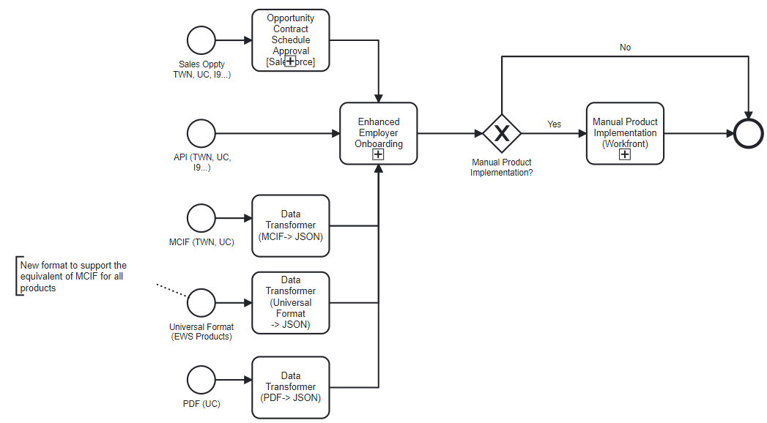
Enhanced Employer Onboarding Process
Process Context
Executive Summary
Target State and Implementation Roadmap
Baseball Card
Process Context
Architecture
Design
Plan
"Universal Format will support an extensible data structure to support additional products as needed"

Slide 20
Enhanced Employer Onboarding Process
Logical Architecture
Executive Summary
Target State and Implementation Roadmap
Baseball Card
Process Context
Architecture
Design
Plan
Direct Customers
EFX Sales
Alliance (I9 Cloud)
Alliance (ADP, UKG, OSV, Paychex….)
Highlights the current focus area
Allow for product specific payload
Integration
Channel
API Gateway
Data
Xchange
Services
API Gateway
Email
Secure File Share
Data
Acquisition
Services
Salesforce
MCIF File (csv, json)
PDF File (UC)
Universal File Format (csv, json)
Employer Onboarding/
OffBoarding Services
Employer
Onboarding
Employer
Offboarding
Employer Setup
Lookup EFX_ID (Employer Name Matching & Multiple match Review Process)
Product Duplication Check & Review Process
Setup Employer CDH
Setup Salesforce Account
Get/Create Employer ES Portal
*Note 1
Product Setup - Common
ERCode Generation (support ERCode sharing cross product)
Link ERCode to EFX_ID & Alliance (CDH, Salesforce)
Product Default Config Manager (Alliance/Direct)
Employer Authorization Setup (SSS,AMS)
Product Cancellation - Common
Cancel Product (CDH)
Cancel Product (Salesforce)
Alliance
Setup
Reports
Alliance
Setup
Process Visibility Reports
Data Transformers
MCIF Transformer
PDF Transformer
Product Setup - (TWN, I9, UC…..)
UCX “Inhouse Account ID” generation
Product Specific Config Setup
Data Transformers
MCIF Transformer
Product Cancellation - (TWN, I9, UC…..)
Product specific cancellation
Secure Data Extract transfers (I9)
Metrics Reports
Operations
Portal
Cancellation Report
Systems
Core Systems (Common across products)
Dependent Systems (Products)
Work Management Platforms
Analytics
CDH
Salesforce
SSS (ERCode Generation)
Billing
TWN
UCX
V5 Config
SSS (Employer Authorization)
AMS (Employer Authorization)
I9 Cloud
ES Portal
ACA
WOTC
CC
Workfront
Salesforce
*Note 1:
Using “Customer Commerce Account” services is pending technical discussion by Equifax team

Slide 21
Enhanced Employer Onboarding Process
Logical Architecture
Executive Summary
Target State and Implementation Roadmap
Baseball Card
Process Context
Architecture
Design
Plan
Component Type | Description
Integration Channel | The gateway layer for employer onboarding to interface with Alliances and Salesforce
Employer Onboarding | Serves as product and channel agnostic platform for onboarding employers and their product subscriptions. Alliance Setup - capability to set up default product configurations specific to an Alliance in preparation for bulk onboarding employers. A default configuration for Direct Onboarding will also be supported. Operations Portal - a user interface to enable Operations to Complete the Alliance configuration setup Initiate an onboarding request as an alternative to current process of manually creating an MCIF Employer Setup - implements product agnostic functions related to setting up of an Employer Product Setup Common - implements functions that are common across products Product Setup (TWN, I9 Cloud, UC…) - implements functions specific to setting up a product
Reports | Supports logging metrics and other process data for analytics
Core Systems | Systems setup common to all products
Dependent Platforms | Product specific systems requiring setup during product onboarding
Work Management Platforms | Systems responsible for managing work queues for manual work activities
Analytics | System for generating analytical reports

Slide 22
Enhanced Employer Onboarding Process
Logical Architecture - Information Flow Diagram for Direct Onboarding (TWN, I9 Cloud, UC Data, UCX)
Executive Summary
Target State and Implementation Roadmap
Baseball Card
Process Context
Architecture
Design
Plan
Information Flow Diagram
AO Docs
5
Process Improvements by Process Role
1
2
Contract Schedule Approved
Workflow Specialist
Project in workfront is received post Contract Schedule Approval.
Workfront project will be initialized with Sales Opportunity data
UCX Implementation consultant
Automated generation of ER Codes and UCX “Inhouse Account ID”. This data is preloaded into Workfront Project
Automated creation of Workfront project for UCX team
Implementation Specialist
Reduce manual data entry during product setup, by preloading default product configurations
Automated setup of Employer Authorization in SSS/AMS in both “Customer Acceptance” and Production environments.
Single click promotion of product configurations from Customer Acceptance to Production environments
Salesforce Opportunity
6
3
Opportunity “Closed Won”
5
Create Project in Workfront for product implementation
TWN + UC Data
Employer
Onboarding
*Employer Setup
Get/Create Employer ES Portal
*Note 1
Product Setup - Common
ERCode Generation (support ERCode sharing cross product)
Link ERCode to EFX_ID (CDH, Salesforce)
Product Default Config Manager (Direct)
Employer Authorization Setup (SSS, AMS)
5
Create Project in Workfront for product implementation
UCX Service
Salesforce/ Mulesoft
Product Setup - (TWN, I9, UC…..)
5
Create Project in Workfront for product implementation
I9 Cloud
4
Note
Employer setup is primarily for I9 Cloud.
In the future this will also be relevant for other products enabled in ESP Portal
TWN/I9/UC Data/UCX product specific default configuration setup
*Note 1:
Using “Customer Commerce Account” services is pending technical discussion by Equifax team

Slide 23
Enhanced Employer Onboarding Process
Logical Architecture - Information Flow Diagram for Alliance Bulk Onboarding (without manual product implementation)
Executive Summary
Target State and Implementation Roadmap
Baseball Card
Process Context
Architecture
Design
Plan
Information Flow Diagram
API Gateway
Universal File Format
Legacy MCIF Schema
4
Process Improvements by Process Role
All products (csv, json)
TWN MCIF File (csv, json)
Costa Rica & SIPI Process Team (TWN)
Automated identification of employers with potential duplicate product subscriptions
Ability in Salesforce to track and manage the manual review of employers with potential duplicate product subscriptions
CRM (TWN) - Processing Cancellations
Automated exclusion of Alliance switches from cancellation “Save Procedures”
1
2
5
Employer
Onboarding
Employer Setup
Lookup EFX_ID (Employer Name Matching & Multiple match Review Process)
Duplication Check & Review Process
Setup Employer CDH
Setup Salesforce Account
Get/Create Employer ES Portal
*Note 1
Product Setup - Common
ERCode Generation (support ERCode sharing cross product)
Link ERCode to EFX_ID & Alliance (CDH, Salesforce)
Product Default Config Manager (Alliance)
Employer Authorization Setup (SSS, AMS)
4
Create Project in Workfront for reporting only for all products
Salesforce/ Mulesoft
Data Transformers
MCIF Transformer
Product Setup - (TWN, I9, UC…..)
3
Product specific default configuration setup TWN, UC, I9 Cloud…
Product Specific Default Config Setup
*Note 1:
Using “Customer Commerce Account” services is pending technical discussion by Equifax team

Slide 24
Enhanced Employer Onboarding Process
Logical Architecture - Information Flow Diagram for Alliance Bulk Onboarding UKG/OSV (TWN)
Executive Summary
Target State and Implementation Roadmap
Baseball Card
Process Context
Architecture
Design
Plan
Information Flow Diagram
MCIF File (csv, json)
Legacy Generic MCIF Schema
4
Process Improvements by Process Role
Workflow Specialist
Same as direct onboarding
Implementation Specialist
Same as direct onboarding
CRM and Costa Rica Team
Automated identification of Employers with potential duplicate product onboarding.
Replace current SIPI process with a targeted review process in Salesforce.
1
5
2
Employer
Onboarding
Employer Setup
Lookup EFX_ID (Employer Name Matching & Multiple match Review Process)
Duplication Check & Review Process
Setup Employer CDH
Setup Salesforce Account
Product Setup - Common
ERCode Generation (support ERCode sharing cross product)
Link ERCode to EFX_ID & Alliance (CDH, Salesforce)
Product Default Config Manager (Alliance)
Employer Authorization Setup (SSS)
4
Create Project in Workfront for product implementation
Salesforce/ Mulesoft
Data Transformers
MCIF Transformer
Product Setup - (TWN, I9, UC…..)
3
TWN product specific default configuration setup

Slide 25
Enhanced Employer Onboarding Process
Logical Architecture - Information Flow Diagram for Alliance Onboarding UKG/OSV (TWN + UC) Long term Proposal
Executive Summary
Target State and Implementation Roadmap
Baseball Card
Process Context
Architecture
Design
Plan
Information Flow Diagram
EFX Operations
Operations Portal
** MCIF support limited to existing MCIF Alliances
API Gateway json)
4
Process Improvements by Process Role
Workflow Specialist & Implementation Consultant (UCX)
Same as direct onboarding
Implementation Specialist
Same as direct onboarding
1
5
1
5
2
4
Create Project in Workfront for product implementation
TWN + UC Data
Employer
Onboarding
Employer Setup
Lookup EFX_ID (Employer Name Matching & Multiple match Review Process)
Duplication Check & Review Process
Setup Employer CDH
Setup Salesforce Account
Product Setup - Common
ERCode Generation (support ERCode sharing cross product)
Link ERCode to EFX_ID & Alliance (CDH, Salesforce)
Product Default Config Manager (Alliance)
Employer Authorization Setup (SSS)
Salesforce/ Mulesoft
Product Setup- (TWN, I9, UC…..)
4
Create Project in Workfront for product implementation
UC Service Only
3
UC Data & UCX product specific default configuration setup
UCX “Inhouse Account ID” generation
TWN & UC Default Product Config
Note:
TWN & UC will share an ERCode and will be associated with the same Alliance

Slide 26
Enhanced Employer Onboarding Process
Logical Architecture - Information Flow Diagram for Alliance Bulk Onboarding (I9 Cloud)
Executive Summary
Target State and Implementation Roadmap
Baseball Card
Process Context
Architecture
Design
Plan
Information Flow Diagram
APIGEE
Data Exchange Service API
Asynchronous
{ Partner Employer
Primary User Details}
1
2
Employer
Onboarding
Employer Setup
Lookup EFX_ID (Employer Name Matching & Multiple match Review Process)
Product Duplication Check & Review Process
Setup Employer CDH
Setup Salesforce Account
Get/Create Employer ES Portal
*Note1
Product Setup - Common
ERCode Generation (support ERCode sharing cross product)
Link ERCode to EFX_ID & Alliance (CDH, Salesforce)
Product Default Config Manager (Alliance/Direct)
Employer Authorization Setup (SSS,AMS)
4
Setup Workfront Project for Reporting Only
Salesforce/ Mulesoft
Product Setup- (I9 Cloud)
3
I9 Cloud product specific default configuration setup
[**Pending Discussion by Equifax Tech team - Under discussion for partner setup for ES Portal]
*Note 1:
Using “Customer Commerce Account” services is pending technical discussion by Equifax team
Manual Review performed by Equifax Operations:
Multiple EFX_ID Matches → Does not impact cycle time for onboarding
Duplication check & Review → Will impact cycle time. Process put on hold till review is complete

Slide 27
Enhanced Employer Onboarding Process
Logical Architecture - Information Flow Diagram - Alliance Bulk Onboarding (I9 Cloud) Details
Executive Summary
Target State and Implementation Roadmap
Baseball Card
Process Context
Architecture
Design
Plan
Information Flow Diagram
Step | Details
 | Data XChange Services – will send a request to Employer Onboarding with Alliance (Partner) Code, Employer Name, Address, Web Domain, Primary User Details
 | Lookup EFX_ID using Employer Name, Address, Web Domain Product Duplication check for existing active I9 ERCode. Existing active ER Code will trigger manual review process Setup Employer in CDH,for new Employer Setup Employer in ESP Portal for new Employer | Generate ERCode and associate with EFX_ID in CDH Lookup Alliance specific default product setup configuration, including I9 SKU Set up Employer Authorization in AMS Setup Account in Salesforce, for new Employer Associate ERCode with Salesforce Account
 | Invoke an I9 provided service to setup a I9 SKU for Employer in I9 Cloud
 | Create a Workfront project for Reporting purposes only
1
2
3
4
Manual review performed by Equifax Operations
Name Match functionality returns multiple EFX_ID’s, Employer Onboarding will select the highest match score EFX_ID and proceed with the onboarding. Perform an offline manual review for the multiple matches found in CDH. The resolution process is outside the scope of this design
Duplication Check Detects a potential duplicate
I9 Onboarding for employer will be paused, till a manual review is complete
If review identifies a true duplicate then either terminate the current request or deactivate the existing active ERCode and resume processing of request

Slide 28
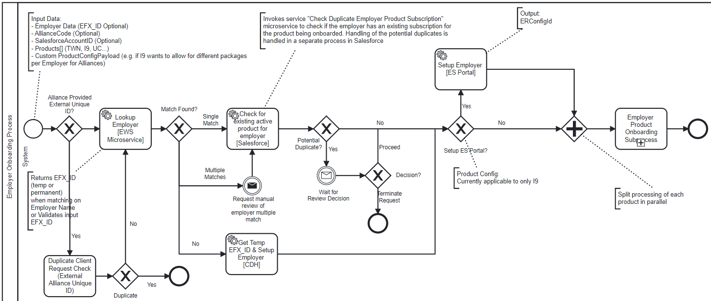









Enhanced Employer Onboarding Process
Main Process (Employer Onboarding Process)
Executive Summary
Target State and Implementation Roadmap
Baseball Card
Process Context
Architecture
Design
Plan
Employer Setup
Product Setup - Common
Product Setup Config
Exception Processes
Scenarios
Summary of Changes
Process Changes
Potential Duplicate
Phase 1 - Do not block for potential duplicate
Phase 2 - Implement a block only for a limited scenarios
New
Automated
Enhancement
Implementation details in subsequent slides
ES Portal
Product setup details are described a nested process flow
Process Start
Send Message
Employer Boarding
Manual Activity
Salesforce
Process End
Receive Message
System Integration
If else decision
Parallel activities
Manual Review performed in Salesforce
Local scripts
CDH
Send to “Exception Process - EFX_ID Matching” process to manually review
Employer Boarding

Slide 29
Enhanced Employer Onboarding Process
Main Process (Employer Onboarding Process) - Implementation Details
Executive Summary
Target State and Implementation Roadmap
Baseball Card
Process Context
Architecture
Design
Plan
Employer Setup
Product Setup - Common
Product Setup Config
Exception Processes
Scenarios
Summary of Changes
Executive Summary
Target State and Implementation Roadmap
Baseball Card
Process Context
Architecture
Design
Plan
Employer Setup
Product Setup - Common
Product Setup Config
Exception Processes
Scenarios
Summary of Changes
Process Step | Implementation Details | Component Mapping | Systems
Process Start | Start of service | Not applicable | Not applicable
Duplicate Client Request Check (External Alliance Unique ID) | Perform duplicate check on Client Unique External ID (e.g. OOID for ADP) | No changes | Employer Boarding
Lookup Employer | Fetch an Employer EFX_ID using Employer Name and Address or validate a received EFX_ID | Enhance Existing Service: Lookup Employer Service | Employer Boarding
Check for existing active product for Employer | Checks if there is an existing active subscription for the product for the Employer. Delegate ER Code duplicate check to Salesforce Dependency on initiative “Automate Employer Deduplication Procedures” | New Service: Check Duplicate Employer Product Subscription | Salesforce
Get Temp EFX_ID & Setup Employer [CDH] | Setup a new Employer in CDH and return a temp EFX_ID | Existing Service: CDH Account Creation | CDH
Request Manual review of Employer multiple match | If the “Lookup Employer” returns multiple EFX_ID with a match score >=90%, initiate an offline manual review for the multiple EFX_ID matches. Do not wait for completion of manual review. Continue processing with the first highest score EFX_ID. | New Process: Exception Process - EFX_ID Matching | CDH
Wait For Review Decision | For a potential duplicate wait for the output of the decision from manual review. | New Message Event: Receive a message event from the manual review activity | Salesforce
Setup Employer [ES Portal] | Setup Employer in ES Portal, if it does not exist, for products enabled on ESP Portal e.g. I9 | Existing Service: in ESP Portal | ES Portal
Employer Product Onboarding Subprocess | Initiate a separate instance of “Employer Product Onboarding Subprocess” for each product. All the subprocesses are linked to the parent “Enhanced Employer Onboarding Process” | New Process: Employer Product Onboarding Subprocess | Employer Boarding

Slide 30
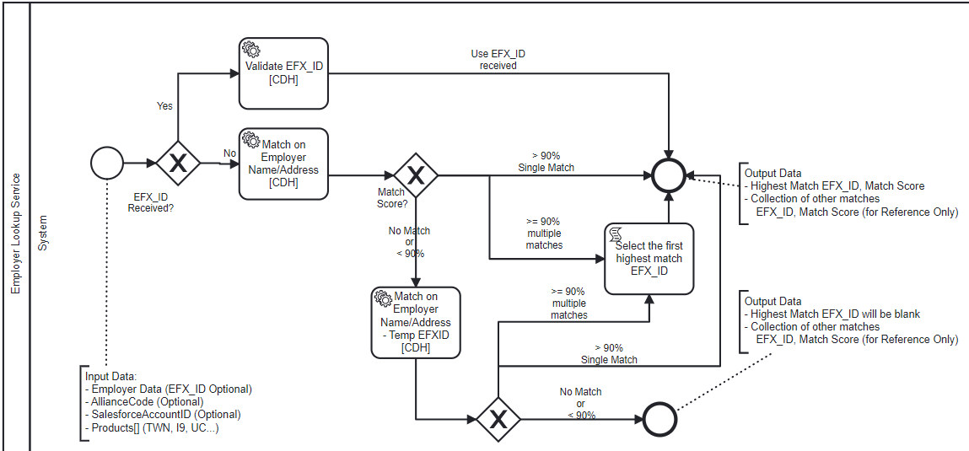
Enhanced Employer Onboarding Process
Main Process (Employer Onboarding Process) - Process Step (Lookup Employer)
Executive Summary
Target State and Implementation Roadmap
Baseball Card
Process Context
Architecture
Design
Plan
Employer Setup
Product Setup - Common
Product Setup Config
Exception Processes
Scenarios
Summary of Changes
Employer Lookup
Pending discussion by Equifax Team with CDH team.
Process Changes
New
CDH
Automated
Enhancement
CDH
CDH

Slide 31
Enhanced Employer Onboarding Process
Main Process (Employer Onboarding Process) - Process Step (Lookup Employer) - Implementation Details
Executive Summary
Target State and Implementation Roadmap
Baseball Card
Process Context
Architecture
Design
Plan
Employer Setup
Product Setup - Common
Product Setup Config
Exception Processes
Summary of Changes
Employer Lookup
Process Step | Implementation Details | Component Mapping | Systems
Process Start | Synchronous microservice interface called from the process step “Lookup Employer” in the main process | Not applicable | Not applicable
Match on Employer Name/Address[CDH] | Lookup the Employer using the Employer Name and Address in CDH. To increase the accuracy of matching result also use: Employer Web domain name Future consideration Increase accuracy of match using Employer FEIN. To address the security concern with persisting FEIN recommend storing the FEIN as a one way encrypted key, similar to handling of passwords. | Existing Service: Employer Name Matching Description: Matches Employer on Name and Address | CDH
Match on Employer Name/Address - Temp EFXID [CDH] | Lookup the Employer using Employer Name and Address in CDH temporary area. The existing “Employer Name and Address in CDH” service only searches CDH permanent area for a match | New Service: Employer Name Matching - Temp EFXID Description: Matches Employer on Name and Address to an existing Temp_EFXID in CDH. | CDH
Validate EFX_ID [CDH] | Validate the received EFX_ID against CDH e.g. validate EFX_ID for duplicate checks | No existing service available in CDH [Nice to have] - "Pending discussion by Equifax Team with CDH" | CDH
Select the first highest match EFX_ID | When the Employer Name/Address match returns multiple results with a score >90% then return the first EFX_ID with the highest score. | Not applicable | None

Slide 32
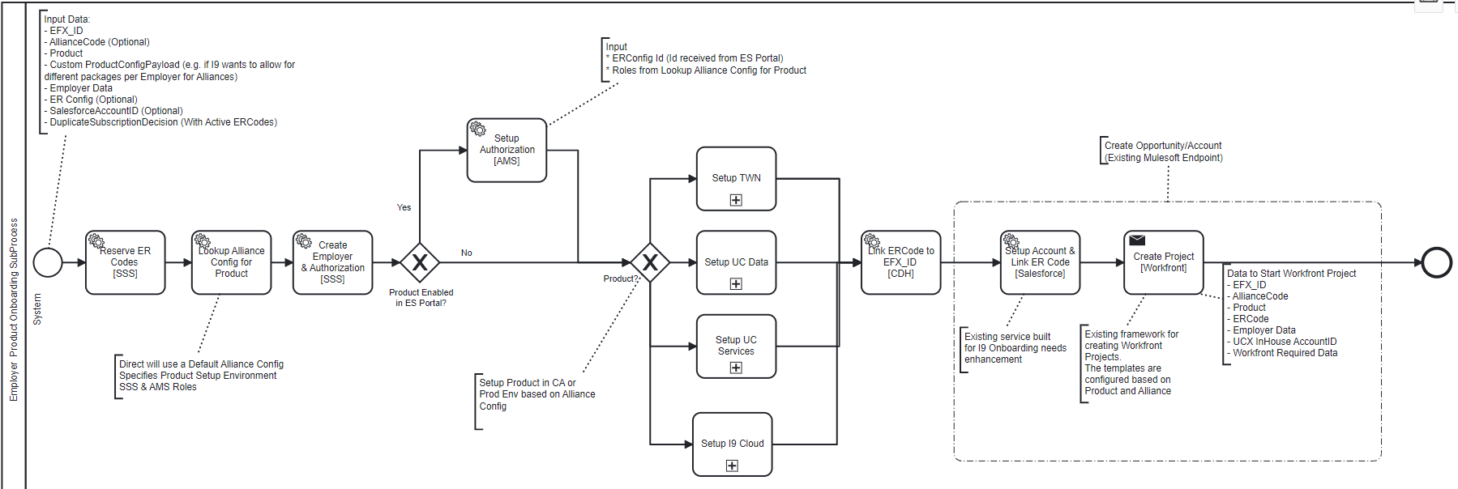
Enhanced Employer Onboarding Process
Product Setup Common
Executive Summary
Target State and Implementation Roadmap
Baseball Card
Process Context
Architecture
Design
Plan
Employer Setup
Product Setup - Common
Product Setup Config
Exception Processes
Scenarios
Summary of Changes
Executive Summary
Target State and Implementation Roadmap
Baseball Card
Process Context
Architecture
Design
Plan
Employer Setup
Product Setup - Common
Product Setup Config
Exception Processes
Scenarios
Summary of Changes
Process Changes
New
Automated
Enhancement
AMS
Mulesoft
Process Start
Send Message
SSS
SSS
CDH
Salesforce
Workfront
Manual Activity
Employer Boarding
Process End
Receive Message
System Integration
If else decision
Parallel activities
Local scripts

Slide 33
Enhanced Employer Onboarding Process
Product Setup Common - Implementation Details
Executive Summary
Target State and Implementation Roadmap
Baseball Card
Process Context
Architecture
Design
Plan
Employer Setup
Product Setup - Common
Product Setup Config
Exception Processes
Scenarios
Summary of Changes
Process Step | Implementation Details | Component Mapping | Systems
Get New ER Code | Reuse existing microservice to request a new ER Code | Existing Service: SSS Microservice | SSS
Get New ER Code for UC | Enhance UC to remove the 5 digit constraint on ER Codes | Existing Service: SSS Microservice Note: UC systems to remove the 5 digit constraint for ER Codes planned for 2022 Q4 | UCX Systems
Link ERCode to EFX_ID [CDH] | Link the ER Code to EFX_ID in CDH | Existing Service: Account Subscription Service | CDH
Lookup Alliance Config for Product | A generic service to maintain configuration information for Alliances across products. The configuration information maintained will be The environment where the product should be set up The default configuration for a product for a Alliance. The configuration will maintained as a generic payload, defined by each product The Grants and Roles specific to a product for setup in SSS or AMS Configuration will be setup when onboarding the Alliance A default configuration will be maintained for Direct Onboarding | Existing Feature in Employer Onboarding: Exists for TWN Enhancements: Enhance to support multiple products. | Employer Boarding
Create Employer & Authorization [SSS] | The configuration details will be available from the “Lookup Alliance Config for Product” | Existing Service: Enhancements: Invoking of service based on the Alliance configuration setup | Employer Boarding
Setup Authorization [AMS] | Setting up of product specific authorization roles in AMS, for products available in ESP Portal e.g. I9 The roles are configured in “Lookup Alliance Config for Product” | Existing Service: Is an existing service provided by ESP Portal | ESP Portal
Product? | The decision routes the process to a product specific subprocess. The implementation of the product specific subprocess will be owned by the respective product application owners. | Specific to each product implementation | TWN, UCX, UC Data or I9

Slide 34
Enhanced Employer Onboarding Process
Product Setup Common - Implementation Details
Executive Summary
Target State and Implementation Roadmap
Baseball Card
Process Context
Architecture
Design
Plan
Employer Setup
Product Setup - Common
Product Setup Config
Exception Processes
Scenarios
Summary of Changes
Process Step | Implementation Details | Component Mapping | Systems
Mulesoft Create Opportunity/Account | Switch existing file based implementation to an API | New Service - Create Opportunity/Account | Mulesoft
Setup Account & Link ER Code [Salesforce] | To set up a Salesforce Account and to link the ER Code to the Salesforce Account. If the Salesforce account exists then link the ER Code to the existing account. | Existing Service: “Create Opportunity/Account” Is an existing Mulesoft service, used by I9 Onboarding. It supports an upsert logic for Salesforce Account creation based on EFX_ID. It then associates the ERCode with the Salesforce Account. Enhancement Expand the functionality to all products. | Mulesoft Salesforce
Create Project [Workfront] | Trigger a Workfront project. The project template used in Workfront must be product specific Enhance existing setup to create a Workfront project For UCX Services also. Pass default data like ERCode, UCX Inhouse Account ID to Workfront. Pass additional data like client contact e.t.c needed in Workfront. Future decisions Reevaluate the list of fields needed in the Enter Project Details screen based on proposed future state. Review options to define a generic template for all products for Enter Project details. Review the option to combine the process flow for UC Data and UC Services Evaluate replacing Workfront with a BPMS platform to get the out of the box benefits: Work queue management Automating the flow of information between manual activity handoffs Process metrics and dashboard reporting Better UI Development capabilities for manual activities | Service: “Create Opportunity/Account” This service is available in Mulesoft and has nested Config Service which maintains the rules/mapping of Project Templates and Products. Enhancement Expand the functionality to all products. Enhance the existing Mulesoft End point to support the specified implementation details. | Mulesoft Workfront
Note -
When setting up SSS authorizations requiring Customer Acceptance testing, Employer Onboarding will first create the setup in “Customer Acceptance” (CA).
An Admin UI will be built to enable Implementation Specialist to push this configuration from CA to Prod.
EFX Security team has provided a verbal security approval for the approach as CA and Prod are co-located in the production subnet.
Recommend, extending this solution for other product configurations

Slide 35
Enhanced Employer Onboarding Process
Product Setup Common - Workfront Fields, Data Feed Changes
Executive Summary
Target State and Implementation Roadmap
Baseball Card
Process Context
Architecture
Design
Plan
Employer Setup
Product Setup - Common
Product Setup Config
Exception Processes
Scenarios
Summary of Changes
Field Name with description | Source of Data | Data Feed change details
ER Code | Generated ER Code using SSS microservice | Provided to the Mulesoft endpoint (Create Opportunity/Account)
PartnerCode | Received as part of Employer onboarding request
UCX Inhouse Account Id | Generated by the UCX product specific setup within Employer Onboarding
The fields indicated in the attached spreadsheet are a set of Workfront fields for TWN, UC & I9, that Workflow Specialist requested to be defaulted or corrected. This spreadsheet would serve as an input for the analysis effort to improve the quality of data sent from Salesforce to Workfront as part of the initiative “Improve quality of Sales Opportunity Data” initiative.

Slide 36
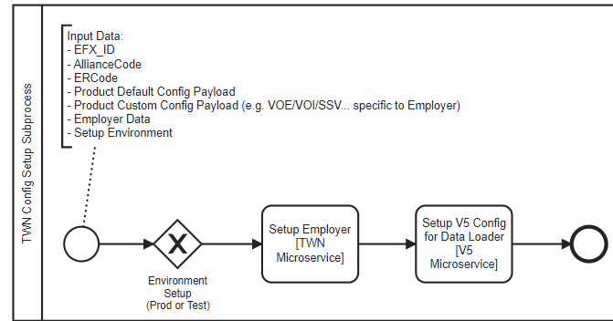
Enhanced Employer Onboarding Process
Product Setup - TWN Cloud Default Config
Executive Summary
Target State and Implementation Roadmap
Baseball Card
Process Context
Architecture
Design
Plan
Employer Setup
Product Setup - Common
Product Setup TWN
Exception Processes
Scenarios
Summary of Changes
Process Changes
New
Automated
Enhancement
Process Start
Send Message
Manual Activity
Process End
TWN
Microservice
Receive Message
V5 Config
Microservice
System Integration
If else decision
Parallel activities
Local scripts

Slide 37
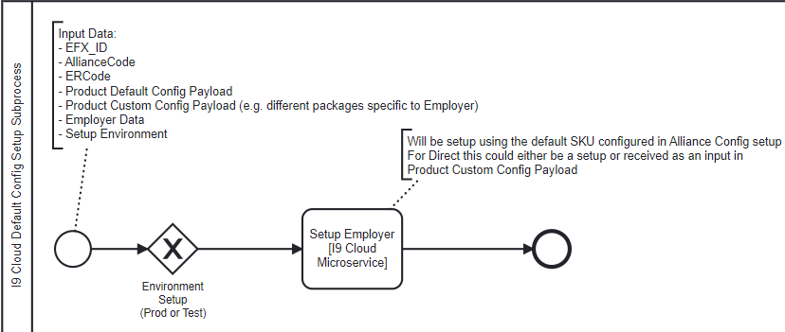
Enhanced Employer Onboarding Process
Product Setup - I9 Cloud Default Config
Executive Summary
Target State and Implementation Roadmap
Baseball Card
Process Context
Architecture
Design
Plan
Employer Setup
Product Setup - Common
Product Setup Config I9 Cloud
Exception Processes
Scenarios
Summary of Changes
Process Changes
New
Automated
Enhancement
Process Start
Send Message
Manual Activity
Process End
I9 Cloud
Receive Message
System Integration
Pending Discussion by Equifax tech team - on when this setup happens.
If else decision
Parallel activities
Local scripts

Slide 38
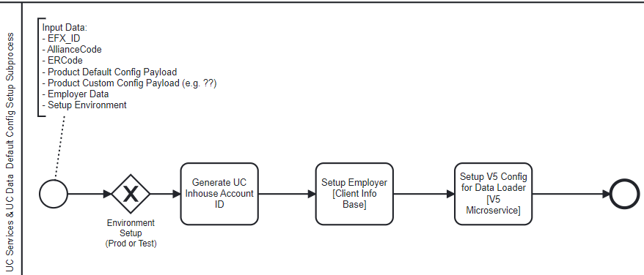
Enhanced Employer Onboarding Process
Product Setup - UC Service & UC Data Default Config
Executive Summary
Target State and Implementation Roadmap
Baseball Card
Process Context
Architecture
Design
Plan
Employer Setup
Product Setup - Common
Product Setup Config - UC
Exception Processes
Scenarios
Summary of Changes
The tech team has indicated there are other databases which need to updated.
Client Info Base is currently migrating from Postgres to Oracle which is planned for completion in Q3 2022
Process Changes
New
Automated
Enhancement
Process Start
Send Message
Manual Activity
Client Info Base
V5 Config
Process End
Receive Message
System Integration
If else decision
The business rules for generation of UCX Inhouse Account ID are:
It is a 4 digit alphanumeric unique code
Second letter should be P for ADP accounts
To ensure uniqueness use the existing excel or request a data extract from UCX to identify “UCX Account Id” currently in use.
Do not reuse cancelled “UCX Account Id's”
Parallel activities
Local scripts

Slide 39
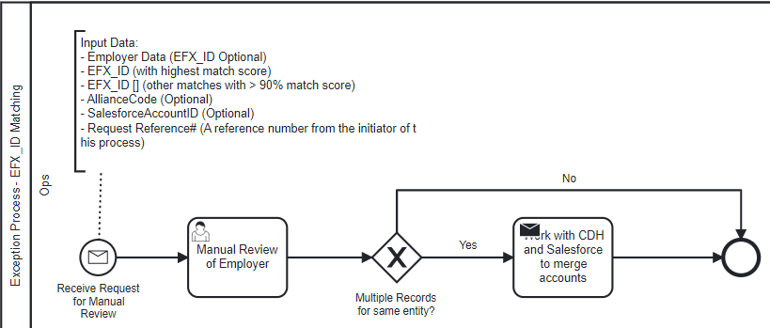
Enhanced Employer Onboarding Process
Exception Process (EFX_ID Multiple Matches)
Executive Summary
Target State and Implementation Roadmap
Baseball Card
Process Context
Architecture
Design
Plan
Employer Setup
Product Setup - Common
Product Setup Config
Exception Processes
Scenarios
Summary of Changes
Process Changes
New
Automated
Enhancement
Process Start
Send Message
Manual Activity
Process End
Receive Message
System Integration
If else decision
Triggered from “Enhanced Employer Onboarding Process”
Parallel activities
Local scripts

Slide 40
Enhanced Employer Onboarding Process
Exception Process (EFX_ID Multiple Matches) - Implementation Details
Executive Summary
Target State and Implementation Roadmap
Baseball Card
Process Context
Architecture
Design
Plan
Employer Setup
Product Setup - Common
Product Setup Config
Exception Processes
Scenarios
Summary of Changes
Process Step | Implementation Details | Component Mapping | Systems
Process Start | Starts the process to manually review Employers with multiple records in CDH. | Not applicable | Not applicable
Manual Review of Employer | Review the Employer data in Salesforce and CDH to determine the reason for multiple records. Track the reasons for duplicate records, to assist with root cause analysis for future process improvements | None | None
Work with CDH and Salesforce to merge accounts | A manual process to consolidate multiple records in Salesforce, CDH, product applications and other dependent systems. | None | None

Slide 41
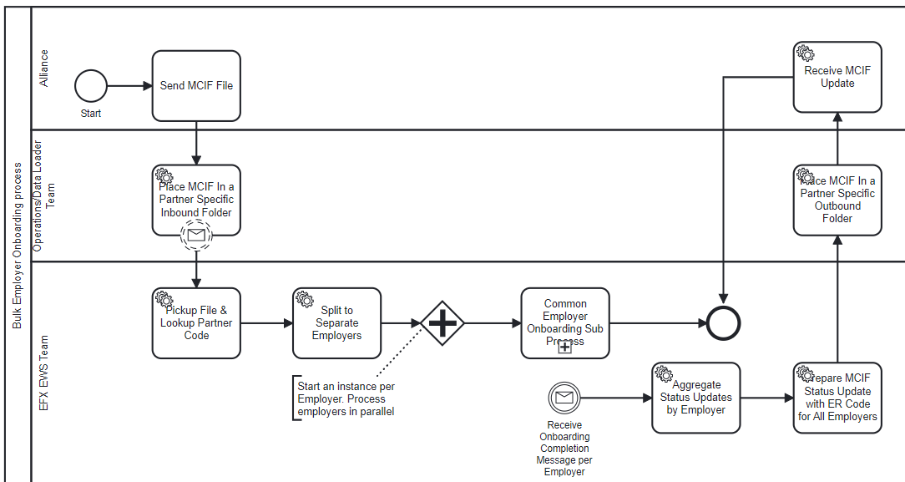
Enhanced Employer Onboarding Process
Alliance MCIF (ADP - TWN) Execution flow - Main Process
Executive Summary
Target State and Implementation Roadmap
Baseball Card
Process Context
Architecture
Design
Plan
Employer Setup
Product Setup - Common
Product Setup Config
Exception Processes
Scenarios
Summary of Changes
Summary of Changes
Summary of Changes
MCIF Process Execution
Process Start
Send Message
Manual Activity
Process End
Receive Message
System Integration
If else decision
Parallel activities
Local scripts
Indicates flow of execution before transitioning to the next level of process in the Process Architecture.
Indicates flow of execution before transitioning to the next level of process in the next slide

Slide 42
Enhanced Employer Onboarding Process
Alliance MCIF (ADP - TWN) Execution flow - Employer Setup
Executive Summary
Target State and Implementation Roadmap
Baseball Card
Process Context
Architecture
Design
Plan
Employer Setup
Product Setup - Common
Product Setup Config
Exception Processes
Scenarios
Summary of Changes
Summary of Changes
Summary of Changes
MCIF Process Execution
Indicates flow of execution before transitioning to the next level of process in the next slide

Slide 43
Enhanced Employer Onboarding Process
Alliance MCIF (ADP - TWN) Execution flow - Product Set up Common
Executive Summary
Target State and Implementation Roadmap
Baseball Card
Process Context
Architecture
Design
Plan
Employer Setup
Product Setup - Common
Product Setup Config
Exception Processes
Scenarios
Summary of Changes
Summary of Changes
Summary of Changes
MCIF Process Execution
Indicates flow of execution before transitioning to the next level of process in the Process Architecture.
Indicates flow of execution before transitioning to the next level of process in the next slide

Slide 44
Enhanced Employer Onboarding Process
Alliance MCIF (ADP - TWN) Execution flow - Product Setup Config (TWN)
Executive Summary
Target State and Implementation Roadmap
Baseball Card
Process Context
Architecture
Design
Plan
Employer Setup
Product Setup - Common
Product Setup Config
Exception Processes
Scenarios
Summary of Changes
Summary of Changes
MCIF Process Execution
Indicates flow of execution before transitioning to the next level of process in the Process Architecture.
Indicates flow of execution before transitioning to the next level of process in the next slide

Slide 45
Enhanced Employer Onboarding Process
Alliance MCIF (ADP - TWN) Execution flow - Product Setup Common
Executive Summary
Target State and Implementation Roadmap
Baseball Card
Process Context
Architecture
Design
Plan
Employer Setup
Product Setup - Common
Product Setup Config
Exception Processes
Scenarios
Summary of Changes
Summary of Changes
MCIF Process Execution
For Reporting Only
Indicates flow of execution before transitioning to the next level of process in the Process Architecture.
Indicates flow of execution before transitioning to the next level of process in the next slide

Slide 46
Enhanced Employer Onboarding Process
Alliance MCIF (ADP - TWN) Execution flow - Employer Set up
Executive Summary
Target State and Implementation Roadmap
Baseball Card
Process Context
Architecture
Design
Plan
Employer Setup
Product Setup - Common
Product Setup Config
Exception Processes
Scenarios
Summary of Changes
Summary of Changes
MCIF Process Execution
Indicates flow of execution before transitioning to the next level of process in the Process Architecture.
Indicates flow of execution before transitioning to the next level of process in the next slide

Slide 47
Enhanced Employer Onboarding Process
Alliance MCIF (ADP - TWN) Execution flow - Main Process End
Executive Summary
Target State and Implementation Roadmap
Baseball Card
Process Context
Architecture
Design
Plan
Employer Setup
Product Setup - Common
Product Setup Config
Exception Processes
Scenarios
Summary of Changes
MCIF Process Execution
Duplicate check blocking will impact the aggregation logic
Indicates flow of execution before transitioning to the next level of process in the Process Architecture.
Indicates flow of execution before transitioning to the next level of process in the next slide

Slide 48
Enhanced Employer Onboarding Process
Alliance MCIF Execution flow (UKG/OSV - TWN) - Main Process
Executive Summary
Target State and Implementation Roadmap
Baseball Card
Process Context
Architecture
Design
Plan
Employer Setup
Product Setup - Common
Product Setup Config
Exception Processes
Scenarios
Summary of Changes
MCIF Process Execution (UKG/OSV)
Indicates flow of execution before transitioning to the next level of process in the Process Architecture.
Indicates flow of execution before transitioning to the next level of process in the next slide

Slide 49
Enhanced Employer Onboarding Process
Alliance MCIF Execution flow (UKG/OSV - TWN) - Employer Setup
Executive Summary
Target State and Implementation Roadmap
Baseball Card
Process Context
Architecture
Design
Plan
Employer Setup
Product Setup - Common
Product Setup Config
Exception Processes
Scenarios
Summary of Changes
MCIF Process Execution (UKG/OSV)
Indicates flow of execution before transitioning to the next level of process in the Process Architecture.
Indicates flow of execution before transitioning to the next level of process in the next slide

Slide 50
Enhanced Employer Onboarding Process
Alliance MCIF Execution flow (UKG/OSV - TWN) - Product Setup Common
Executive Summary
Target State and Implementation Roadmap
Baseball Card
Process Context
Architecture
Design
Plan
Employer Setup
Product Setup - Common
Product Setup Config
Exception Processes
Scenarios
Summary of Changes
MCIF Process Execution (UKG/OSV)
Indicates flow of execution before transitioning to the next level of process in the Process Architecture.
Indicates flow of execution before transitioning to the next level of process in the next slide

Slide 51
Enhanced Employer Onboarding Process
Design - Alliance MCIF Execution flow (UKG/OSV - TWN) - Product Config Setup (TWN)
Executive Summary
Target State and Implementation Roadmap
Baseball Card
Process Context
Architecture
Design
Plan
Employer Setup
Product Setup - Common
Product Setup Config
Exception Processes
Scenarios
Summary of Changes
MCIF Process Execution (UKG/OSV)
Indicates flow of execution before transitioning to the next level of process in the Process Architecture.
Indicates flow of execution before transitioning to the next level of process in the next slide

Slide 52
Enhanced Employer Onboarding Process
Alliance MCIF Execution flow (UKG/OSV - TWN) - Product Setup Common
Executive Summary
Target State and Implementation Roadmap
Baseball Card
Process Context
Architecture
Design
Plan
Employer Setup
Product Setup - Common
Product Setup Config
Exception Processes
Scenarios
Summary of Changes
MCIF Process Execution (UKG/OSV)
Creates Enter Project Details for Workflow Specialist
Indicates flow of execution before transitioning to the next level of process in the Process Architecture.
Indicates flow of execution before transitioning to the next level of process in the next slide

Slide 53
Enhanced Employer Onboarding Process
Alliance MCIF Execution flow (UKG/OSV - TWN) - Employer Setup
Executive Summary
Target State and Implementation Roadmap
Baseball Card
Process Context
Architecture
Design
Plan
Employer Setup
Product Setup - Common
Product Setup Config
Exception Processes
Scenarios
Summary of Changes
MCIF Process Execution (UKG/OSV)
Indicates flow of execution before transitioning to the next level of process in the Process Architecture.
Indicates flow of execution before transitioning to the next level of process in the next slide

Slide 54
Enhanced Employer Onboarding Process
Alliance MCIF (UKG/OSV - TWN) Execution flow - Main Process End
Executive Summary
Target State and Implementation Roadmap
Baseball Card
Process Context
Architecture
Design
Plan
Employer Setup
Product Setup - Common
Product Setup Config
Exception Processes
Scenarios
Summary of Changes
MCIF Process Execution (UKG/OSV)
Indicates ready in CA to start Welcome call.
Indicates flow of execution before transitioning to the next level of process in the Process Architecture.
Indicates flow of execution before transitioning to the next level of process in the next slide

Slide 55
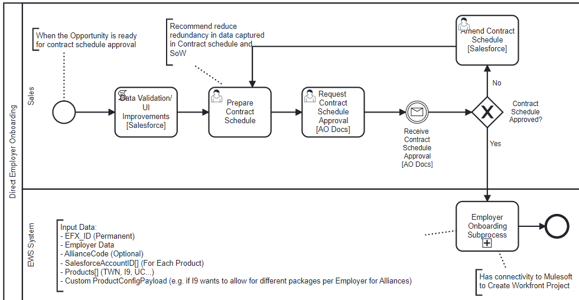
Enhance Common Employer Onboarding Process
Direct Processing TWN Execution flow - Main Process
Executive Summary
Target State and Implementation Roadmap
Baseball Card
Process Context
Architecture
Design
Plan
Employer Setup
Product Setup - Common
Product Setup Config
Exception Processes
Scenarios
Summary of Changes
Direct Onboarding Process Execution
Indicates flow of execution before transitioning to the next level of process in the Process Architecture.
Indicates flow of execution before transitioning to the next level of process in the next slide

Slide 56
Enhanced Employer Onboarding Process
Direct Onboarding TWN Execution flow - Employer Setup
Executive Summary
Target State and Implementation Roadmap
Baseball Card
Process Context
Architecture
Design
Plan
Employer Setup
Product Setup - Common
Product Setup Config
Exception Processes
Scenarios
Summary of Changes
Direct Onboarding Process Execution
DRAFT
Indicates flow of execution before transitioning to the next level of process in the next slide

Slide 57
Enhanced Employer Onboarding Process
Direct Onboarding TWN Execution flow - Product Setup Common
Executive Summary
Target State and Implementation Roadmap
Baseball Card
Process Context
Architecture
Design
Plan
Employer Setup
Product Setup - Common
Product Setup Config
Exception Processes
Scenarios
Summary of Changes
Direct Onboarding Process Execution
DRAFT
Indicates flow of execution before transitioning to the next level of process in the Process Architecture.
Indicates flow of execution before transitioning to the next level of process in the next slide

Slide 58
Enhanced Employer Onboarding Process
Direct Onboarding Execution flow - Product Config Setup (TWN)
Executive Summary
Target State and Implementation Roadmap
Baseball Card
Process Context
Architecture
Design
Plan
Employer Setup
Product Setup - Common
Product Setup Config
Exception Processes
Scenarios
Summary of Changes
Direct Onboarding Process Execution
DRAFT
Product specific Implementation can also build logic to update based on product custom config payload
Indicates flow of execution before transitioning to the next level of process in the Process Architecture.
Indicates flow of execution before transitioning to the next level of process in the Process Architecture.
Indicates flow of execution before transitioning to the next level of process in the next slide

Slide 59
Enhanced Employer Onboarding Process
Direct Onboarding Execution flow - Product Setup Common
Executive Summary
Target State and Implementation Roadmap
Baseball Card
Process Context
Architecture
Design
Plan
Employer Setup
Product Setup - Common
Product Setup Config
Exception Processes
Scenarios
Summary of Changes
Direct Onboarding Process Execution
DRAFT
Creates Enter Project Details for Workflow Specialist
Indicates flow of execution before transitioning to the next level of process in the Process Architecture.
Indicates flow of execution before transitioning to the next level of process in the Process Architecture.
Indicates flow of execution before transitioning to the next level of process in the next slide

Slide 60
Enhanced Employer Onboarding Process
Direct Onboarding TWN Execution flow - Employer Setup
Executive Summary
Target State and Implementation Roadmap
Baseball Card
Process Context
Architecture
Design
Plan
Employer Setup
Product Setup - Common
Product Setup Config
Exception Processes
Scenarios
Summary of Changes
Direct Onboarding Process Execution
DRAFT
Indicates flow of execution before transitioning to the next level of process in the Process Architecture.
Indicates flow of execution before transitioning to the next level of process in the Process Architecture.
Indicates flow of execution before transitioning to the next level of process in the next slide

Slide 61
Enhanced Employer Onboarding Process
Direct Onboarding TWN Execution flow - Main Process End
Executive Summary
Target State and Implementation Roadmap
Baseball Card
Process Context
Architecture
Design
Plan
Employer Setup
Product Setup - Common
Product Setup Config
Exception Processes
Scenarios
Summary of Changes
Direct Onboarding Process Execution
DRAFT
Indicates flow of execution before transitioning to the next level of process in the next slide

Slide 62
Enhanced Employer Onboarding Process
Summary of changes/enhancements
Executive Summary
Target State and Implementation Roadmap
Baseball Card
Process Context
Architecture
Design
Plan
Employer Setup
Product Setup - Common
Product Setup Config
Exception Processes
Scenarios
Summary of Changes
Change Details | Change Owner | Effort Estimate (High/Medium/Low) | Estimate in Months
Process Enhancement: End to End code refactoring for Employer Onboarding Process | Employer Boarding
Process Enhancement: Code refactoring for Employer Product Onboarding Subprocess The subprocess complete product setup requirements common to all products | Employer Boarding
Service Enhancement: Extend Lookup Employer Service facade to support lookup of temp EFX_ID Dependent On: CDH service “ Employer Name Matching - Temp EFXID“ | Employer Boarding
New Service: Employer Name Matching - Temp EFXID. Matches Employer on Name and Address to an existing Temp_EFXID in CDH | CDH
New Message Subscription: Wait For Review Decision, to block till Manual review is complete (Dup Check Phase 2) Dependent On: Initiative “Automate Employer DeDuplication Procedures” | Employer Boarding
Service Enhancement: Lookup Alliance Config for Product Extend the existing functionality called “Config Service” in Employer Boarding which maintains config data for Alliance and Product. Review the implementation details slides for additional information | Employer Boarding
New Service: Create Opportunity/Account API (Switch from File to API based) | Mulesoft/Salesforce
Process Enhancement: Switch from file based to API based integration for Create Opportunity/Account API | Employer Boarding
Service Enhancement: Setup Salesforce Account & Link ER Code (Mulesoft Service: Create Opportunity/Account) Expand functionality to support all products | Mulesoft/Salesforce
Service Enhancement: Create Workfront Project (Mulesoft Service: Create Opportunity/Account) Expand the functionality to all products. | Mulesoft/Salesforce

Slide 63
Enhanced Employer Onboarding Process
Summary of changes/enhancements
Executive Summary
Target State and Implementation Roadmap
Baseball Card
Process Context
Architecture
Design
Plan
Employer Setup
Product Setup - Common
Product Setup Config
Exception Processes
Scenarios
Summary of Changes
Change Details | Change Owner | Effort Estimate (High/Medium/Low) | Estimate in Months | Sequence
New Service: UCX Default Config & Employer Setup Subprocess Setting up default config for UCX On prem | UCX
Process Enhancement - Employer Onboarding to call UCX Default Config Setup Subprocess | Employer Boarding
New Service: UC Data Default Config & Employer Setup Subprocess Setting up default config for UCX data | UC Data
Process Enhancement - Employer Onboarding to call UC Data Default Config Setup Subprocess | Employer Boarding
New Service: Alliance I9 Cloud Default Config & Employer Setup Subprocess Setting up default config for I9 Cloud | I9 Cloud
Process Enhancement - Employer Onboarding to call I9 Cloud Default Config Setup Subprocess | Employer Boarding
New Functionality: I9 Cloud Alliance/Reseller Rev share setup | *Note1
System Enhancement: For UC remove the 5 digit ERCode constraint for the UC application As per the team the code is already in test environment and needs to be tested and promoted to production. Sarah Iberg raised a concern - Related to a 5 digit ER Code limitation for Legacy TWN data loader feeding UC | UC
New Process: Exception Process - EFX_ID Matching Manual review of EFX_ID for multiple name/address match score >90%
New Admin UI: For Implementation specialist to promote SSS/AMS configuration from Customer Acceptance to Production. Extend this solution to other product configurations | Employer Boarding
*Note 1 - Pending Equifax tech team discussion - Changes to CDH integration to support revenue share for I9 and other products. The changes should not adversely affect the existing TWN Revenue share calculations

Slide 64
Enhanced Employer Onboarding Process
Plan
Executive Summary
Target State and Implementation Roadmap
Baseball Card
Process Context
Architecture
Design
Plan
 | Q1 | Q2 | Q3 | Q4
Enhance Existing TWN (V5 only)
Ops Admin Config Admin UI
I9 Cloud Enhancements
Dependencies
New Service: Employer Name Matching - Lookup Temp EFX_ID.
Service Enhancement: To support lookup of temp EFX_ID
1
1
CDH Prioritization of service implementation
New Service: “Check Duplicate Employer Product Subscription" ALL PRODUCTS - check with Simon)
Process Enhancement: Integrate "Check for existing active product for employer" step into process flow
2
Depends on Alliance Config Design readiness
3
Billing process supports I9 Cloud Revenue Share
New Service: Create Opportunity/Account API (Switch from File to API based) - ALL PRODUCTS - check with Simon)
Process Enhancement: Switch to API based integration for Create Opportunity/Account API TWN ONLY
Service Enhancement: Create Workfront Project (All products - check with Simon)
Process Enhancement: End to End code refactoring & testing of existing Employer/Product Onboarding Process
Activity Owned by
Service Enhancement: Setup Salesforce Account & Link ER Code (Mulesoft Service: Create - ALL PRODUCTS - check with Simon)
Enhanced Employer Onboarding Process
Employer Boarding
New Admin UI: For Implementation specialist to promote SSS/AMS configuration from Customer Acceptance to Production
Salesforce
Service Enhancement:Lookup Alliance Config for Product TWN ONLY
Extend Admin UI - Extend solution for promotion of product configurations from CA to Prod
CDH
I9 Cloud
New UI - Develop UI for setup of Direct and Alliance configs - TWN ONLY
Enhance UI for setup of Direct and Alliance configs - ALL PRODUCTS
Ongoing activity with no specific end date
2
Service Enhancement: Lookup Alliance Config for Product (Enhance for I9)
New Service: Alliance I9 Cloud Default Config & Employer Setup Subprocess
Process Enhancement - Employer Onboarding to call I9 Cloud Default Config Setup Subprocess
Indicates flow of execution before transitioning to the next level of process in the Process Architecture.
Process Enhancement: To call “Create Opportunity/Account API” I9 ONLY
New Functionality: I9 Cloud Alliance/Reseller Rev share setup
Who owns this?
3

Slide 65
Enhanced Employer Onboarding Process
Plan
Executive Summary
Target State and Implementation Roadmap
Baseball Card
Process Context
Architecture
Design
Plan
 | Q1 | Q2 | Q3 | Q4
UC Enhancements
Reports
Dependencies
System Enhancement: For UC remove the 5 digit ERCode constraint for the UC application
Service Enhancement: Lookup Alliance Config for Product (Enhance for UC)
New Service: UCX Inhouse Account ID generation
Process Enhancement - Employer Onboarding to call UCX Default Config Setup Subprocess & Invoke service for "UCX Inhouse Account Id"
4
Removal of 5 digit ERCode constraint in UC
New Service: UCX Default Config & Employer Setup Subprocess
4
5
Availability of an Analytics Platform
New Service: UC Data Default Config & Employer Setup Subprocess
Process Enhancement - Employer Onboarding to call UC Data Default Config Setup Subprocess
Enhanced Employer Onboarding Process
Service Enhancement: Create Workfront Create separate projects for UC Data and UC Services – Check with Simon
Define Metrics to capture
Generate Reports: Define and generate reports for process tracking
Activity Owned by
5
Employer Boarding
Salesforce/Mulesoft
CDH
UC
Ongoing activity with no specific end date

Slide 66
Enhanced Employer Onboarding Process
Automated Document Validation and Management (Potential Future Use case)
DRAFT
Executive Summary
Target State and Implementation Roadmap
Baseball Card
Process Context
Architecture
Design
Plan
Automated
Regional Group
Process Automation
Data Capture
Data entry and validation using OCR and other related tools
Business Process Automation
Data Collection
AI based document validation
Configurable Rule Engine
Unified OnBoarding Service API
Delivery
Underwriting
Electronic document delivery to remove Onboarding bottlenecks
Dynamic Workflow
System Startup
Document Categorization
Global
Automated
Fully automated Employer Onboarding with document scanning and centralized document management
Welcome
High Productivity
Machine Learning
Accuracy
AI base document scanning to identify fraud, reduce risk and potential manual errors
Next steps
Identify - Key areas where AI based Document validation can be used
Perform - Tool selection keeping in mind business needs
Build - Prototypes for critical use cases to quantify business value
Create - Implementation roadmap by defining systems, effort and timeline
Develop - New processes to replace manual and legacy validation procedures

Slide 67
Recommended Major Projects
Executive Summary
Target State and Implementation Roadmap
Baseball Card
Process Context
Architecture
Design
Plan
B
Initiative | Automate Employer Deduplication Procedures
Timeframe | 3+ months |  | Resource | High
Recommended Solutions | Enhance onboarding process by implementing a product agnostic automated duplication check before initiating Employer set up to enhance review quality and decrease cycle time Implement process controls solution around the Employee data to support a secure manual review of the potential duplicates
Category/Theme | Automation Efficiency
Initiative In-Flight? | No | Initiative Name and Contact (if applicable) | N/A
Description | The future state solution will front load the duplicate check during onboarding and reduce the manual activities performed in the current state process. For reference, the current state process manual activities to identify duplicate check post onboarding is performed in 3 steps: Step 1 (Tracking) - Costa Rica team monitors daily live announcements of Employer Onboardings. For each Employer they determine the number of active Employees. Employers with >1000 employees are tracked in a spreadsheet (SIPI Tracker) Step 2 (Detection) - On a weekly basis, the Employers in the SIPI Tracker, are manually reviewed to identify duplicate subscriptions. The current procedure to identify duplicates is manual comparison of the list of Employees, using SSN, for the new ERCode with the existing active ERCodes. Step 3 (Resolution) - A cancellation request for the duplicate ERCode is sent to WSS team via email. The duplicate Employee records are marked as transferred
Initiative ID
Benefits
Dependencies/Considerations
Stakeholders
Reduce PII Data Risk
The SIPI Tracker process requires the Costa Rica team to extract excels of Employee SSN for identifying duplicate product subscriptions for Employers
Improved Customer Experience for Verifiers
Duplicate payroll records for an Employer results in duplicate records in verification results received by a Verifier. The Verifier is charged for the duplicate records.
Reduce Operating Cost
Reduce the list of Employers requiring manual review and front loading the duplicate checks reduces the activities related to cancellation after onboarding.
TBD (Discussion with Stephanie)

Slide 68
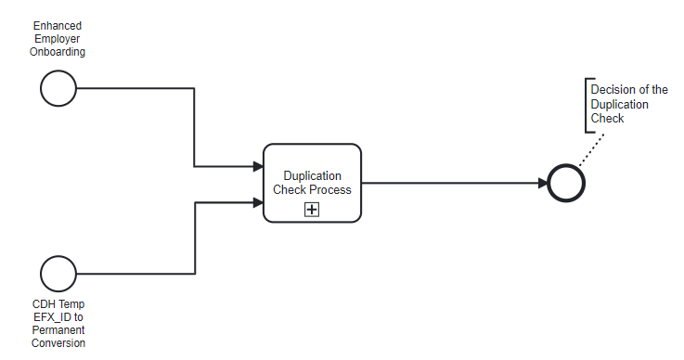
Automate Employer Deduplication Procedures
Process Context
Executive Summary
Target State and Implementation Roadmap
Baseball Card
Process Context
Architecture
Design
Plan
Context
Scenario
Called from “Enhanced Employer Onboarding” process
A potential duplicate can result when a temp EFX_ID is converted to an existing permanent EFX_ID

Slide 69
Automate Employer Deduplication Procedures
Scenario 2 - “Switching Alliances”
Executive Summary
Target State and Implementation Roadmap
Baseball Card
Process Context
Architecture
Design
Plan
Context
Scenario
Covers scenarios of switches from Direct → Alliance, Alliance → Alliance & Alliance → Direct
Employer (Acme Inc)
Alliance (ADP)
Equifax
Alliance Code: 01
Verifier Data
FEIN: 22-2222222
Payroll Record
FEIN: 22-2222222
SSN: 201-10-7777
Record ID: 0001
Alliance Code: 01
Employer ER Code: ER01
Employees
Payroll Record
FEIN: 22-2222222
SSN: 201-10-7777
Record ID: 0001
Sally
Both ERCodes
ER01 & ER02 are active
for Rev Share calculations
Payroll Record
FEIN: 22-2222222
SSN: 201-10-7777
Record ID: 0002
Switch from ADP
Alliance (Ceridian)
Alliance Code: 02
Payroll Record
FEIN: 22-2222222
SSN: 201-10-7777
Record ID: 0002
Alliance Code: 02
Employer ER Code: ER02

Slide 70
Automate Employer Deduplication Procedures
Component Interaction Diagram
Executive Summary
Target State and Implementation Roadmap
Baseball Card
Process Context
Architecture
Design
Plan
<<Process>
Employer Onboarding Process
Process Changes
New
Enhancement
Output Data:
EFX_ID (Temp or Permanent)
Potential Product Duplicate Subscriptions (for reference only)
Automated
3
Sync Response
Salesforce
<<Service>>
Check Duplicate Employer Product Subscription
Temp EFX ID
Merged into
Existing Permanent EFX_ID
<<Component>>
Temp to
Permanent EFX_ID
Event Listener
1
1
Input Data:
EFX_ID (Temp or Permanent)
Alliance Code
Products[] (TWN, I9, UC…)
CDH Temp_EFX_ID to Permanent EFX_ID message event
2
A potential switch is assumed when the EFX_ID has an active product subscription for a different Alliance code.
This Employer is sent for manual review
Potential
Alliance Switch
<< Process>>
Duplicate Product Subscription Review Process
(Manual Review of potential duplicate product registration)
Asynchronous
SIPI Process Team

Slide 71
Automate Employer Deduplication Procedures
Component Description
Executive Summary
Target State and Implementation Roadmap
Baseball Card
Process Context
Architecture
Design
Plan
Component | Implementation Details | Component Mapping | Systems
Check Duplicate Employer Product Subscription | Given an EFX_ID, checks for potential duplicate active product subscriptions for an Employer. Trigger the subprocess “Common Duplicate Product Subscription Review Process” for manual review of potential duplicates | New Service - “Check Duplicate Employer Product Subscription” | Salesforce
Common Duplicate Product Subscription Review Process | A subprocess implemented in Salesforce for manual review of identified potential duplicate product subscriptions. | New Process - Built in Salesforce | Salesforce
Temp to Permanent EFX_ID Event Listener | Processing of potential duplicate product subscriptions resulting from merging multiple EFX_ID’s in CDH. Details covered in next slide | Enhance Existing Component - in Salesforce | Salesforce

Slide 72
Automate Employer Deduplication Procedures
Component - Check Duplicate Employer Product Subscription
Executive Summary
Target State and Implementation Roadmap
Baseball Card
Process Context
Architecture
Design
Plan
Service implemented in Mulesoft and callable from “Enhance Employer Onboarding” process
Service checks if there is an existing active ERCode for a combination of EFX_ID, Alliance Code, Product. The business logic should factor the below ERCode sharing rules to identify an active ERCode
If there exists an active ERCode, send product for manual review and notify service consumer of a potential duplicate.
The service consumer can subscribe to an event for the manual review decision

Slide 73
Automate Employer Deduplication Procedures
Component - Temp to Permanent EFX_ID Event Listener
Executive Summary
Target State and Implementation Roadmap
Baseball Card
Process Context
Architecture
Design
Plan
Problem
The CDH “Temp EFX_ID” to “Permanent EFX_ID” conversion process could map the “Temp EFX_ID” to an existing “Permanent EFX_ID”. The “Permanent EFX_ID” could have an existing active product subscription resulting in a duplicate subscription.
A “Temp EFX_ID” will be received during Employer onboarding in 2 scenarios
The CDH Name Match service did not find a match for the Employer
The CDH Name Match service matched the Employer with an existing “Temp EFX_ID”. This is possible after implementing the new enhancement to include the “Temp EX_ID” in the “Employer Name Match” CDH service
Business Logic
The triggering of a manual review for potential duplicate product subscription will be limited to cases where a “Temp EFX_ID” is mapped to an existing “Permanent EFX_ID” during the conversion process in CDH.
The duplicate subscription check will be performed on all products associated with the “Permanent EFX_ID”

Slide 74
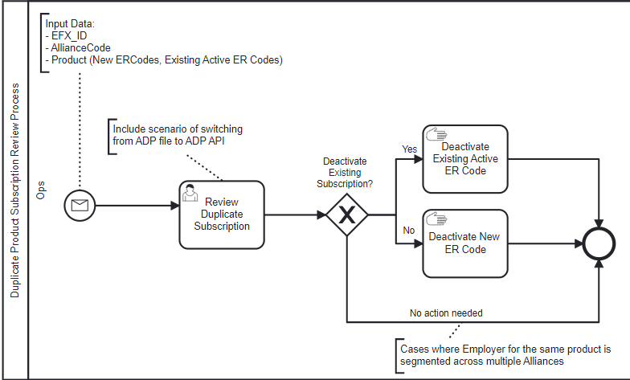
Automate Employer Deduplication Procedures
Duplicate Product Subscription Review SubProcess
Executive Summary
Target State and Implementation Roadmap
Baseball Card
Context Information:
Process Context
Architecture
Design
Plan
Process Changes
Follow current manual process for deactivating ER Codes
New
Automated
Enhancement
Process Start
Send Message
Manual Activity
Offline Manual Activity
Process End
Receive Message
System Integration
If else decision
Parallel activities
Local scripts

Slide 75
Automate Employer Deduplication Procedures
Common Duplicate Product Subscription Review Process - Implementation Details
Executive Summary
Target State and Implementation Roadmap
Baseball Card
Context Information:
Process Context
Architecture
Design
Plan
Process Step | Implementation Details | Component Mapping | Systems
Review Duplicate Subscription | This is a manual review activity to resolve a potential duplicate product subscription request. |  | Salesforce
Deactivate Existing Active ER Code | If the decision is to deactivate the existing active ER Code then If the scenario is an TWN ADP File to ADP API transfer also copy over the active Employees from old ERCode to new ERCode. Deactivate the ER Code in Prod and CA
Deactivate New ER Code | If the New ER Code is setup, then deactivate the new ER Code in Prod and CA
End Message Event | Publish a message of manual review decision. Will be subscribed by Enhanced Employer Onboarding | New message- Message publishing

Slide 76
Automate Employer Deduplication Procedures
Summary of changes/enhancements
Executive Summary
Target State and Implementation Roadmap
Baseball Card
Context Information:
Process Context
Architecture
Design
Plan
Change Details | Change Owner | Effort Estimate (High/Medium/Low) | Estimate in Months
New Service: Check Duplicate Employer Product Subscription Description: Checks if there are potential duplicates active product subscriptions for a EFX_ID. For potential duplicate subscriptions it would trigger the subprocess “Common Duplicate Product Subscription Review Process” | Salesforce
New Process: Common Duplicate Product Subscription Review Process, implemented for manual review of potential duplicate product subscriptions. Also enable triggering this process from outside Salesforce | Salesforce
Enhance Existing Component: Temp to Permanent EFX_ID Event Listener Description: The component which handled processing duplicates resulting from this conversion | Salesforce
New UI/Activity: Review Duplicate Subscription Description: This is a manual activity to make a decision on which ER Code to retain after follow up with the Alliance and/or Employer | Salesforce
New Report: To report on the observed reasons for potential duplicates | Salesforce

Slide 77
Automate Employer Deduplication Procedures
Plan
Executive Summary
Target State and Implementation Roadmap
Baseball Card
Process Context
Architecture
Design
Plan
Q1 | Q2 | Q3 | Q4
Dependencies
1
Availability of an Analytics Platform
New Service: “Check Duplicate Employer Product Subscription" ALL PRODUCTS
New Process: Implement Common Duplicate Product Subscription Review Process. Enable triggering this process from outside Salesforce
Activity Owned by
New UI/Activity: Review Duplicate Subscription
Automate Employer Deduplication Procedures
Employer Boarding
Enhance Existing Component: Temp to Permanent EFX_ID Event Listener
Salesforce
CDH
New Report: Generate Reports, potential duplicate reasons
Ongoing activity with no specific end date
1
Indicates flow of execution before transitioning to the next level of process in the Process Architecture.

Slide 78
Recommended Major Projects
Executive Summary
Target State and Implementation Roadmap
Baseball Card
Process Context
Architecture
Design
Plan
Work in progress
DRAFT
C
Initiative | Improve quality of “Sales Opportunity Data”
Timeframe | 9+ months |  | Resource | High
Recommended Solutions | Modify Salesforce to send Opportunity to Workfront after approval of contract schedule Evaluate implementing additional data validation in Salesforce user interface to capture critical data fields required by the downstream processes Invest in CLM and CPQ to enhance boarding process by improving quality of sales data, automating generation of contract schedule & SoW, and then incrementally expand the platform’s capabilities across other enterprise processes
Category/Theme | Process
Initiative In-Flight? | Yes | Initiative Name and Contact (if applicable) | CPQ Integration
Description | Integrate Salesforce with downstream systems to avoid manual data entry at each milestone of onboarding process
Initiative ID
Benefits
Dependencies/Considerations
Stakeholders
Improved Customer Experience
A smoother product implementation experience with fewer client follow ups, due to availability of required data. For example, delays in setting up the Welcome call due to unavailability of customer implementation contact
Reduce delays in contract schedule approvals due to fewer data entry errors
Cycle time reduction
Improves the quality of data downstream in the process and reduces delays due to Workflow Specialist holding up the process while following up with Sales
Employer Onboarding process availability
Contract Schedule document changes may require legal approval
TBD (Discussion with Stephanie)

Slide 79
Improve quality of “Sales Opportunity Data”
Process Context
Executive Summary
Target State and Implementation Roadmap
Baseball Card
Process Context
Architecture
Design
Plan

Slide 80
Improve quality of “Sales Opportunity Data”
Logical Architecture Context
Executive Summary
Target State and Implementation Roadmap
Baseball Card
Process Context
Architecture
Design
Plan
Direct Customers
EFX Sales
Alliance (I9 Cloud)
Alliance (ADP, UKG, OSV, Paychex….)
Highlights the current focus area
For small business replace Email with Web UI
Allow for product specific payload
Integration
Channel
API Gateway DXS
API Gateway
Web UI
Email
Secure File Share
Data
Acquisition
Services
Salesforce
MCIF File (csv, json)
PDF File
Employer Onboarding/
OffBoarding Services
Employer
Onboarding
Employer
Offboarding
Employer Setup
Lookup EFX_ID (Employer Name Matching & Multiple match Review Process)
Product Duplication Check & Review Process
Setup Employer CDH
Setup Salesforce Account
Get/Create Employer ES Portal
Product Setup - Common
ERCode Generation (support ERCode sharing cross product)
Link ERCode to EFX_ID & Alliance (CDH, Salesforce)
Product Default Config Manager (Alliance/Direct)
Employer Authorization Setup (SSS,AMS)
Product Cancellation - Common
Cancel Product (CDH)
Cancel Product (Salesforce)
Alliance
Setup
Alliance
Setup
Process Visibility Reports
Data Transformers
MCIF Transformer
PDF Transformer
Product Setup - (TWN, I9, UC…..)
UCX “Inhouse Account ID” generation
Product Specific Config Setup
Data Transformers
MCIF Transformer
Product Cancellation - (TWN, I9, UC…..)
Product specific cancellation
Secure Data Extract transfers (I9)
Metrics Reports
Cancellation Report
Systems
Core Systems (Common across products)
Product Platforms
Work Management Platforms
Analytics
TWN
UCX
V5 Config
SSS (Employer Authorization)
AMS (Employer Authorization)
CDH
Salesforce
SSS (ER COde Generation)
Billing
I9 Onprem
I9 Cloud
Workfront
Salesforce

Slide 81
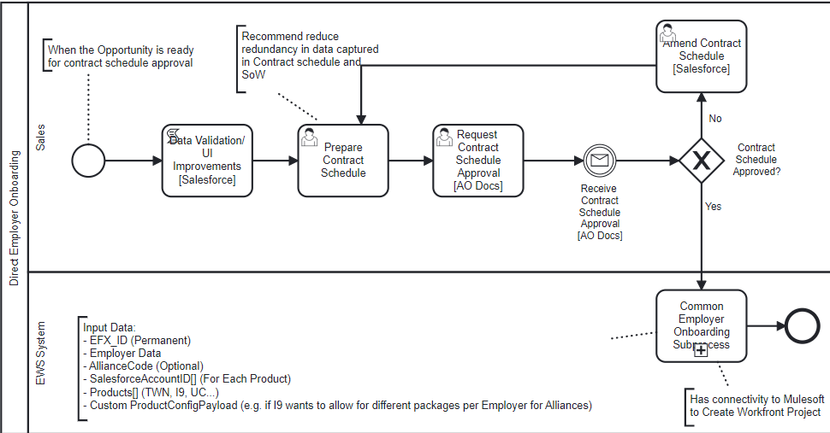
Improve quality of “Sales Opportunity Data”
Proposed Process Changes
Executive Summary
Target State and Implementation Roadmap
Baseball Card
Process Context
Architecture
Design
Plan
Process Changes
New
Salesforce
Automated
Enhancement
Salesforce
CLM
AO DOCS
SPOT
AO DOCS

Slide 82
Improve quality of “Sales Opportunity Data”
Improve Salesforce Data Quality Process - Implementation Details
Executive Summary
Target State and Implementation Roadmap
Baseball Card
Process Context
Architecture
Design
Plan
Process Step | Implementation Details | Component Mapping | Systems
Data Validation/UI Improvements | Perform a field level gap analysis between Opportunity data and data inputs required downstream. For example improve user experience for Workflow Specialist and Implementation Specialist by providing a link to the Contract Schedule in Workfront Define data validation checks and user interface enhancements based on the gap analysis findings. For example, customer implementation contact should be required data for handover to implementation team for product setup | UI Enhancement - Sales Opportunity Data | Salesforce
Prepare Contract Schedule | Align the Salesforce user interface and Contract Schedule verbiage to improve the accuracy of the Opportunity data input by Account Executives Evaluate consolidating the Contract Schedule and SoW documents or avoid duplication of data in both documents Automate the generation of contract schedule using CLM to improve user experience for Account Executives | None | Salesforce CLM
Receive Contract Schedule Approval [AO Docs] | Modify AODocs process to publish an event to Salesforce when the Contract Schedule is approved or rejected Salesforce should subscribe to this Contract Schedule Approval event | Asynchronous Integration - AO Docs to Salesforce Integration | Salesforce AO Docs
Common Employer Onboarding Subprocess | Automate the creation of a product implementation Workfront project, when the contract schedule is approved. Perform a field level gap analysis of Opportunity data and data required by Employer Onboarding Process. | New Asynchronous Integration to Employer Onboarding Description: A message based async interface to start the “Common Employer Onboarding Process” | Salesforce EWS
Process Step | Implementation Details | Component Mapping | Systems
Data Validation/UI Improvements | Perform a field level gap analysis between Opportunity data and data inputs required downstream. For example improve user experience for Workflow Specialist and Implementation Specialist by providing a link to the Contract Schedule in Workfront Define data validation checks and user interface enhancements based on the gap analysis findings. For example, customer implementation contact should be required data for handover to implementation team for product setup | UI Enhancement - Sales Opportunity Data Integration Enhancement - Send data to Workfront for data available in Salesforce | Salesforce
Prepare Contract Schedule | Align the Salesforce user interface and Contract Schedule verbiage to improve the accuracy of the Opportunity data input by Account Executives Evaluate consolidating the Contract Schedule and SoW documents or avoid duplication of data in both documents Automate the generation of contract schedule using CLM to improve user experience for Account Executives | None | Salesforce CLM
Request Contract Schedule Approval | Integration between Salesforce and AO Docs to initiate the AO Docs process Dependent on Security feasibility and POC | New Integration | Salesforce AO Docs
Receive Contract Schedule Approval [AO Docs] | Modify AODocs process to publish an event to Salesforce when the Contract Schedule is approved or rejected Salesforce should subscribe to this Contract Schedule Approval event | Asynchronous Integration - AO Docs to Salesforce Integration | Salesforce AO Docs
Common Employer Onboarding Subprocess | Automate the creation of a product implementation Workfront project, when the contract schedule is approved. Perform a field level gap analysis of Opportunity data and data required by Employer Onboarding Process. | New Asynchronous Integration to Employer Onboarding Description: A message based async interface to start the “Common Employer Onboarding Process” | Salesforce EWS

Slide 83
Improve quality of “Sales Opportunity Data”
Summary of changes/enhancements
Executive Summary
Target State and Implementation Roadmap
Baseball Card
Process Context
Architecture
Design
Plan
Change Details | Change Owner | Effort Estimate (High/Medium/Low) | Estimate in Months
Salesforce UI Enhancements - Perform a field level gap analysis of Opportunity data and data inputs required downstream | Salesforce
Salesforce UI Enhancements - Define data validation checks and user interface enhancements | Salesforce
Contract Schedule document related optimizations - Alignment of verbiage on Salesforce user interface and Contract Schedule document | Salesforce/Business
Contract Schedule document related optimizations - Evaluate consolidating Contract Schedule and SoW documents or avoid duplication of data in both documents | Business
Contract Schedule document related optimizations - Automating the generation of Contract Schedule using CLM | Business
AODocs to Salesforce Integration to automate receiving of Contract Schedule Approval Decision | Salesforce & AODocs
Salesforce triggering Employer Onboarding Process | Salesforce & EWS

Slide 84
Improve quality of “Sales Opportunity Data”
Plan
Executive Summary
Target State and Implementation Roadmap
Baseball Card
Context Information:
Process Context
Architecture
Design
Plan
 | Q1 | Q2 | Q3
Integrating with Employer Onboarding
Salesforce Data validation/UI
Contract Schedule Improvements
AODocs Integration
Dependencies
Salesforce triggers Employer Onboarding when Opportunity is marked “Closed Won”
Salesforce triggers Employer Onboarding, enhance to provide additional fields
1
Dependent on Employer Boarding is ready
1
2
Operations Review & Approval
3
Alignment with the CPQ Initiative
Perform a field level gap analysis of Opportunity data and data inputs required downstream
4
Based on current capacity can start Q2 based on funding
2
Identify & Implement, quick Win fields where data is available in Salesforce but is missing in Workfront
Activity Owned by
Improving Salesforce Data Quality
Define data validation checks and user interface enhancements (Align the Data validation and UI enhancement with the CPQ initiative)
3
Salesforce
Alignment of verbiage on Salesforce user interface and Contract Schedule document
Business/Operations
Evaluate consolidating Contract Schedule and SoW documents or avoid duplication of data in both documents
Ongoing activity with no specific end date
Complete Security Feasibility of integrating Salesforce and AO Docs process
4
Complete POC for Salesforce & AODocs 2 way integration
* AO Docs Submission Page prepopulation metadata, initiate AODocs Process initiation
* 2 way sync between between & receive Approval decision

Slide 85
Recommended Major Projects
Executive Summary
Target State and Implementation Roadmap
Baseball Card
Context Information:
Process Context
Architecture
Design
Plan
D
Initiative | Extend Rev Share Model for Alliances cross product
Timeframe | 6+ months |  | Resource | High
Recommended Solutions | Extend existing TWN Rev share model to support I9 Alliances
Category/Theme | Technology Enhancements
Initiative In-Flight? | No | Initiative Name and Contact (if applicable) | N/A
Description | Establish a consistent approach to capturing data for revenue share calculations for all products
Initiative ID
Benefits
Dependencies/Considerations
Stakeholders
Initiative will enable:
Accurate reconciliation of partner revenue
Identify Revenue Leakage
Provide partners with a consistent user experience across all products
To be aligned to TWN Rev share model to support I9 Alliances
TBD (Discussion with Stephanie)

Slide 86








Rev Share Automated Process
Executive Summary
Target State and Implementation Roadmap
Baseball Card
Context Information:
Process Context
Architecture
Design
Plan
6
Verifier Inquiry
Eliminates ALL spreadsheets, Automates and Simplifies
Processes across multiple departments and platforms
1
CDH data model change may be required if I9 Cloud needs to support a reseller model. Partner model is already supported
Rating & Allocation
Performed by BRM platform
2
Need a gap analysis to be performed by Equifax
1
EWS calculates Partner Switches and Rev Share %
Data Furnishers Reposed &
Non Reposed Data Providers
8
2
9
2
10
2
12
2
(Data Engineering)
SUP
Platform
BRM
Platform
EDH Platform
eCommerce Platform
7
2
Common Data
Model (billing)
Common Data
Model (Billing)
EWS
Fulfilment Events
Rev Share
Eligible Events
External Partners
(ADP, Ceridian, Paychex, etc.)
2
11
EWS
On Boarding Automated
Platform
Rev Share Attribute Events
Internal Users (FP&A and Rev Accounting etc.)
Product Eligibility
for Rev Share
Partner Rev Share
Percentage
EFX_ID
Association
Sr. | Description
1 | Data Furnishers (Partners): ADP, Ceridian etc.
2 | EWS Onboarding platform receives data from data furnishers
3 | MDM (Customer) platform provides EFXID for the partner clients
4 | MDM (Product) platform stores product information. Rev share eligible attribute marked on the product is used by EWS data engineering to identify the rev share eligible products
5 | C2O (Contract Master) stores contract information including rev share % rules
6 | External customer performs verification inquiry
Sr. | Description
7 | EWS Data Engineering enriches the fulfilment event (from step #6) with Customer, Product, Rev Share % including Switches and conforms to CDM billing and rev share events.
8 | SUP receives the event(s) and guarantees delivery to the destination (BRM and EDH), captures and reports on metering events
9 | BRM platform performs rating and allocation.
10 | EDH platform receives rev share eligible events (after rating and allocation) for rev share calculation only
11 | Tableau Server provides internal reporting for FP&A, Rev Accounting, etc.
12 | TBD - Ignite Market Place (integration with Tableau) used to serve rev share dashboards to external partners (ADP, Ceridian, etc.)
3
1
4
2
5
2
CDH
Customer Master
OPH
Product Master
C2O
Contract Master
Customer Data Governance
Product Management and Entry
Partner Contract Entry
SOX Process Controls
Future Capability

Slide 87
Next Steps
Executive Summary
Target State and Implementation Roadmap
Baseball Card
Context Information:
Process Context
Architecture
Design
Plan
Summary of Changes
Draft a solution to support multiple products in CDH without impacting the existing TWN Rev share process.
Evaluate the changes in C2O to support both partner billing and Rev share.
During Alliance onboarding, perform a procedural change for Sales to request set up of alliance in C2O and OPH.
Evaluate overall impact of changes in CDH and C2O and related impact to EWS, SUP, BRM, EDH and other downstream applications.
The Rev share design should account for supporting three types of Alliances: Partners, Referrals and Resellers.

Slide 88
Recommended Major Projects
Executive Summary
Target State and Implementation Roadmap
Baseball Card
Context Information:
Process Context
Architecture
Design
Plan
E
Initiative | Establish Common Interaction Model For Employer Onboarding
Timeframe | 6+ months |  | Resource | High
Recommended Solutions | Introduce a streamlined Interaction model with a cross product responsibility Establish a centralized process documentation repository to maintain current state process documentation and implement versioning to track future iterations of it Design a strategy to optimally establish, capture, and track process metrics and SLAs Establish process controls to track adherence to Process SLAs Evaluate options to automate the promotion of configurations from Customer Acceptance to Production
Category/Theme | Other Observations
Initiative In-Flight? | No | Initiative Name and Contact (if applicable) | N/A
Description
Initiative ID
Benefits
Dependencies/Considerations
Stakeholders
Reduction in Operating Cost Increased automation and addition of capabilities will lower operating costs. For example, improved document management and product set up configuration promotions to Production will reduce manual hours currently spent.
Reduction in Rework A well communicated standardized approach to interaction model will provide enhanced reusability of tools and processes cross products, thus increasing efficiency.
Initiative will enable: Platform to grow along with our revenue growth than behind it. Measurement of future areas to drive more efficiencies. Drive success of this overall project.
TBD (Discussion with Stephanie)

Slide 89
Interaction Model
A cross functional structure where business, operations and technology work closely together
Executive Summary
Target State and Implementation Roadmap
Baseball Card
Context Information:
Process Context
Architecture
Design
Plan
The approach encourages an overall agile development approach that drives collaboration and knowledge sharing across the teams.
Steering Committee
Steering Committee
Set direction and expected outcomes
Decide on organization choice points
Approve org recommendations and timing for implementation
Advisory Council
Design Authority
(Technology & Business)
Program Management
Advisory Council
Oversee and guide day to day the work
Engage critical stakeholders during the transformation
Provide executive leadership for business and IT decisions
Address both technical and functional obstacles
Stress test recommendations against overall solution impact
Evaluate architectural, financial and schedule impacts on any proposed change requests
Guide team on who to engage and how
Delivery Teams
Vertical Market Leaders
Technology
SGI & BE
Operations
Finance
TWN
Core Team
Salesforce
Implementation
Rev Share
Delivery team
Employer Onboarding
Approach is based on a mix of agile and waterfall approach, for implementation of major projects
Delivery teams will be per initiative with Process Governance team proving guard rails for rest of the delivery teams
Onboarding
(I9, CC, WOTC)
Data Exchange
Service
Data Acquisition
Service
M&A Integrations
UC
Support Team
Workflow
Billing
ACA
I9
WOTC
UC
Business Excellence
Compliance Center

Slide 90
Interaction Model
Executive Summary
Target State and Implementation Roadmap
Baseball Card
Context Information:
Process Context
Architecture
Design
Plan
DRAFT
Endorse major Employer Onboarding strategy investment decisions and ensure alignment to the vision and end state objectives
Understand and address changes to the wider Equifax group and it’s business environment
Steering Committee
Act as an escalation point for key decisions that cannot be made at the Delivery Teams level
Agree overall program benefit measures and track progress
Manage Equifax level risks within Employer Onboarding strategy
Prioritize order and recommendations across the programs of work including resourcing/$ commitments
Advisory Council
Design Authority
(Technology & Business)
Program Management
Delivery Teams
Reconcile differences in opinion and approach, and resolve disputes arising from the Delivery Teams
Agree to additional refinements in overall program benefits
Approve the process after testing and approve the overall strategy and process once executed in production
Vertical Market Leaders
Technology
SGI & BE
Operations
Finance
Core Team
Salesforce
Implementation
Rev Share
The core team will work with Advisory Council to develop resource and activities dependencies with SGI &BE, Operations, Finance, Support and VMLs
This includes managing resource requirements and stakeholder communications and reporting
Delivery risks and issues will be escalated to the Employer Onboarding Advisory Council
TWN
Employer Onboarding
Onboarding
(I9, CC, WOTC)
Data Exchange
Service
Data Acquisition
Service
M&A Integrations
UC
Workflow
Billing
Support Team
Business Excellence
ACA
I9
WOTC
UC
Ensuring cross product coordination for business
Configuration, development and delivering of solutions to meet business requirements
Prioritize requirements and implementation based on inter-dependent initiatives
Specialists to provide subject matter expertise in operations and billing aspects of the Onboarding
Next steps
Develop - Detailed plan for Interaction model ramp up and an initial change management plan
Perform - Impact Assessment for the roles impacted. Identify set of dependencies and mitigating actions and track against them
Create - Dashboards and manage risks and issues across the Employer Onboarding Interaction model
Socialize - Preliminary communications plan and kick off communications
Develop - Detailed resource strategy, identifying role best staffed internal versus external. Create relevant JDs and issue requisitions for high priority roles

Slide 91
Communication Strategy
Executive Summary
Target State and Implementation Roadmap
Baseball Card
Context Information:
Process Context
Architecture
Design
Plan
DRAFT
Define Strategy
Build Overall Plan
Individualize Plans
Execute
Improved
Coordination between Business and IT and Joint Business/IT prioritization
Objectives
Build Communication Plan
Vertical Market Leaders
Deliver
Communication
Audience
Objectives
Target Group
Technology
Enable
Objectives and Approach
Proactive Business engagements and improved backlog tracking
Messages
Messages
Communications Principles
Vehicles
SGI & BE
Challenges
Frequency
Accountability
Operations
Achieve
Vehicles
Balanced view of long term/short term views and risks/rewards
Responsibility
Feedback
Priority
Finance
Adoption Curve
Next steps
Distribute - Initiative strategy approach throughout Equifax Employer Onboarding group
Educate - Business leaders and IT stakeholders about the communication strategy and its benefits
Socialize - All participant groups on overall progress
Define - Roles and responsibilities for all the initiative members

Slide 92
Communication Strategy Adoption Curve
Executive Summary
Target State and Implementation Roadmap
Baseball Card
Context Information:
Process Context
Architecture
Design
Plan
DRAFT
Awareness
Understanding
Acceptance
Adoption
Awareness
Understanding
What is the change?
Why are we doing this?
When is this happening? What is the schedule?
Why is the change important?
What will this change mean to me?
How does this work with other initiatives as an integrated whole?
Will everyone be expected to change?
What are all the pieces?
How will this impact the job I do?
What do I think about the change?
Ah, so this is what it is like.
Sounds good, but I’ve heard it before – when can I test drive it?
How do I provide feedback?
What happens if there are problems?
How do I feel about changing?
Acceptance
Adoption
Degree of Support for Change
What will my long-term role be?
How can I help others adapt?
How can I improve my performance?
How can I get involved and impact the next wave of changes?
Time and Participation

Slide 93
Voice of Associates & Operations (feedback)
Executive Summary
Target State and Implementation Roadmap
Baseball Card
Context Information:
Process Context
Architecture
Design
Plan
DRAFT
Establish
Technical Enablement
Improve
An iterative operating model to incorporate feedback
Operational efficiencies by providing more efficient and effective Onboarding experience by capturing and leveraging feedback
Define
Measurement
Journeys (feedback solicitation, collection, actions, and reporting)
Strategy & Design
Drive
Collaboration cross product to address Onboarding pain points by establishing workflows to ‘close the loop’ and reduce loss of deals
Platform
Implement
Configuration
Feedback and action mechanisms - Listen, Analyze, Act and Monitor
Empower
Equifax at all levels to ‘own’ the Onboarding experience by upskilling and providing role-based dashboards for feedback
Process
Report
Optimization & Integration
Scorecards/dashboards with predictive capabilities and customized reports based on products/personas for I9, TWN and UC
Enhance
Brand perception by embedding customer-centricity into culture across all stakeholder groups involved
Value Realization
Next steps
Define - Vision and Align on overall Employer Onboarding initiatives & success criteria by facilitating journey workshops and with key stakeholder groups
Understand - Current state (existing voice of Associates and Operations)
Design - Personas and journey maps (also understand existing pain points)
Finalize - The scope, requirements, and implementation approach/plan by leveraging the Future state roadmap
Prepare - Plans for Feedback program rollout and operationalization

Slide 94
Operational Model with metrics
Executive Summary
Target State and Implementation Roadmap
Baseball Card
Context Information:
Process Context
Architecture
Design
Plan
DRAFT
Establish
KPIs
Key leadership roles are filled by business team members
Remaining roles can be filled by IT (as needed) to ensure rapid establishment and go-live
Business Value
Effectiveness/Productivity
# of new capabilities/features deployed
# of workflows automated
User adoption rate
Employer Service specific KPIs – # of Cases reported/channel, CSAT score
Resource utilization rate
# of defects per capability/feature, % of automated test coverage
Agile metrics - velocity (# of story points delivered), epic/release burndown, cycle time etc.
Transitional
Leadership and key execution roles are transitioned internally
Transition includes on-the-job training, change management planning, and effective onboarding
May require roles to be filled with two resources (temporarily) to ensure effective transition
Support
Engagement
# of issues/incidents reported, # of issues reported by severity
Avg. issue resolution time
Application availability %
# of new ideas generated
# of ideas liked/disliked, # of comments on ideas
Engagement survey scorecards
Operational
Organization establishes a steady state operating model for Employer Onboarding strategy
Vendor resources continue to support execution and project capacity needs
Next steps
Document and Formalize - High level Operating model
Confirm - Roles and Responsibilities, skills and capabilities, KPIs and SLAs
Refine - Transformational backlog and confirm the tooling
Adhere - To established metrics by implementing periodic and real time monitoring, alerting and reporting

Slide 95
Standardized Document Management
Executive Summary
Target State and Implementation Roadmap
Baseball Card
Context Information:
Process Context
Architecture
Design
Plan
DRAFT
Achieved
Document Governance Structure
Document Storage Portals
Tailored to any audience
Reduced waste of duplication of effort and potential manual errors
Content Identification
Single Content Repository
Confluence
G: drive
Hard drive
Email
Onboarding Agent Portal
Increased
Efficiency and Accountability during content creation and content management
Leverage existing tools (Confluence)
Employer Portal
Environment Set up
Salesforce Portal for Document Management
Organized
Old and new content by proper tagging, versioning and archiving
Content Migration and Content Organization
Workday Portal for Document Management
Encompassed
Knowledge Management (KM), Enterprise Content Management (ECM), Digital Asset Management (DAM), and Multi - media Management
Next steps
Establish - Oversight and organization for content creation and management
Formalize - Process and policies to ensure document storage consistency and standardization
Confirm - Content Management vendor selection
Define - Taxonomy and templates, and identify migration worthy content
Perform - Migration where the content is chunked & transformed into modules, versioned, and tagged according to taxonomy

Slide 96
Recommended Major Projects
Executive Summary
Target State and Implementation Roadmap
Baseball Card
Context Information:
Process Context
Architecture
Design
Plan
DRAFT
F
Initiative | Define Common Employer Offboarding Process (Multi-product/Multi-channel)
Timeframe | 3+ months |  | Resource | High
Recommended Solutions | Automate the Cancellation process to support near real time cancellations. Leverage Salesforce to track manual activities for exception processes Provide near real time notification to “Customer Relationship Managers” for Employers who meet the criteria of “Cancellation Save” procedures. Track the activity in Salesforce For I9 Cloud product, automate extraction and sending of Employee data requested by Employer during Cancellation*
Category/Theme | Automation Efficiency
Initiative In-Flight? | No |  | N/A
Description | Establish a common process for cancellations for all product across all channels
Initiative ID
Benefits
Dependencies/Considerations
Stakeholders
Reduced Operating Cost
Eliminate weekly manual bulk processing of cancellations for TWN
Eliminate monthly process to identify TWN cancellations to initiate save procedures.
Limit manual activities to exceptions only.
Cycle time reduction
Initiate save procedures closer to cancellation event, instead of 1 month later.
Reduced errors due to manual data entry
Reduce data risk by automating the extraction and sending of data to Employer
Reduce Development Cost
A common Employer Offboarding process for Alliance and Direct Channels.
TBD (Discussion with Stephanie)

Slide 97
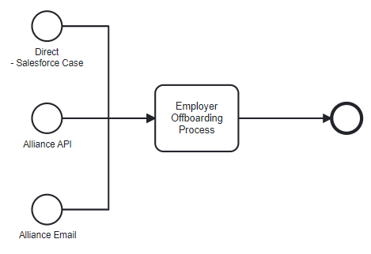
Enhance Employer Offboarding Process
Process Context
Executive Summary
Target State and Implementation Roadmap
Baseball Card
Process Context
Architecture
Design
Plan
DRAFT

Slide 98
Enhance Employer Offboarding Process
Logical Architecture
Executive Summary
Target State and Implementation Roadmap
Baseball Card
Process Context
Architecture
Design
Plan
DRAFT
Direct Customers
EFX Sales
Alliance (I9 Cloud)
Alliance (ADP, UKG, OSV, Paychex….)
Highlights the current focus area
For small business replace Email with Web UI
Allow for product specific payload
Integration
Channel
API Gateway
DXS
API Gateway
Web UI
Email
Secure File Share
Data
Acquisition
Services
Salesforce
MCIF File (csv, json)
PDF File (UC)
Employer Onboarding/
OffBoarding Services
Employer
Onboarding
Employer
Offboarding
Employer Setup
Lookup EFX_ID (Employer Name Matching & Multiple match Review Process)
Duplication Check & Review Process
Setup Employer CDH
Setup Salesforce Account
Get/Create Customer Commerce Account
Get/Create Employer ES Portal
Product Setup - Common
ERCode Generation (support ERCode sharing cross product)
Link ERCode to EFX_ID & Alliance (CDH, Salesforce)
Product Default Config Manager (Alliance/Direct)
Employer Authorization Setup (SSS,AMS)
Product Cancellation - Common
Cancel Product (CDH)
Cancel Product (Salesforce)
Reports
Alliance
Setup
Alliance
Setup
Process Visibility Reports
Data Transformers
MCIF Transformer
PDF Transformer
Product Setup - (TWN, I9, UC…..)
UCX “Inhouse Account ID” generation
Product Specific Config Setup
Product Cancellation - (TWN, I9, UC…..)
Product specific cancellation
Secure Data Extract transfers (I9)
Metrics Reports
Cancellation Report
Admin UI
Admin UI
Systems
Core Systems (Common across products)
Product Platforms
Work Management Platforms
Analytics
CDH
Salesforce
SSS (ER COde Generation)
Billing
TWN
UCX
V5 Config
SSS (Employer Authorization)
AMS (Employer Authorization)
I9 Cloud
Workfront
Salesforce

Slide 99
Enhance Employer Offboarding Process
Logical Architecture - Information Flow Diagram for Direct Offboarding (TWN, I9 Cloud, UC Data, UCX)
Executive Summary
Target State and Implementation Roadmap
Baseball Card
Process Context
Architecture
Design
Plan
Information Flow Diagram
AO Docs
5
Process Improvements by Process Role
1
2
Cancellation Approved
Account Executive
Eliminates emails to WSS team requesting for cancellations
WSS Team
Most manual activities have been automated. Manual checks will be limited to exception processing
For e.g.
Bad Data checks for TWN
eVerify Account Deactivation for I9.
Salesforce Case
6
Close Case
Case Creation/Approval (Cancellation)
3
Employer
Offboarding
Product Cancellation - Common
Cancel Product (CDH)
5
Salesforce/ Mulesoft
Create Project in Workfront for reporting only
Product Cancellation - (TWN, I9, UC…..)
4
TWN/I9/UC Data/UCX Cancel Product
Product specific cancellation
Secure Data Extract transfers (I9)

Slide 100
Enhance Employer Offboarding Process
Logical Architecture - Information Flow Diagram for Alliance Offboarding
Executive Summary
Target State and Implementation Roadmap
Baseball Card
Process Context
Architecture
Design
Plan
Information Flow Diagram
Web UI (EFX Operations*)
API Gateway
4
Process Improvements by Process Role
* Web UI enablement for Alliance for future consideration
CRM (TWN) - Processing Cancellations
Automatic identification of Employers who are candidates for “Save Procedures”
Tracking of “Save Procedure Tasks” in Salesforce. Eliminate use of spreadsheets for tracking.
Web UI - is available during transition from Email to API integration to request cancellations.
WSS Team
Most manual activities have been automated. Manual checks will be limited to exceptions. For e.g. the Bad Data checks for TWN
Salesforce Case
1
Implement an approval process
1
2
Employer
Offboarding
Product Cancellation - Common
Cancel Product (CDH)
Cancel Product (Salesforce)
4
Salesforce/ Mulesoft
Create Project in Workfront for reporting only
Product Cancellation - (TWN, I9, UC…..)
3
TWN/I9/UC Data/UCX Cancel Product
Product specific cancellation
Secure Data Extract transfers (I9)

Slide 101
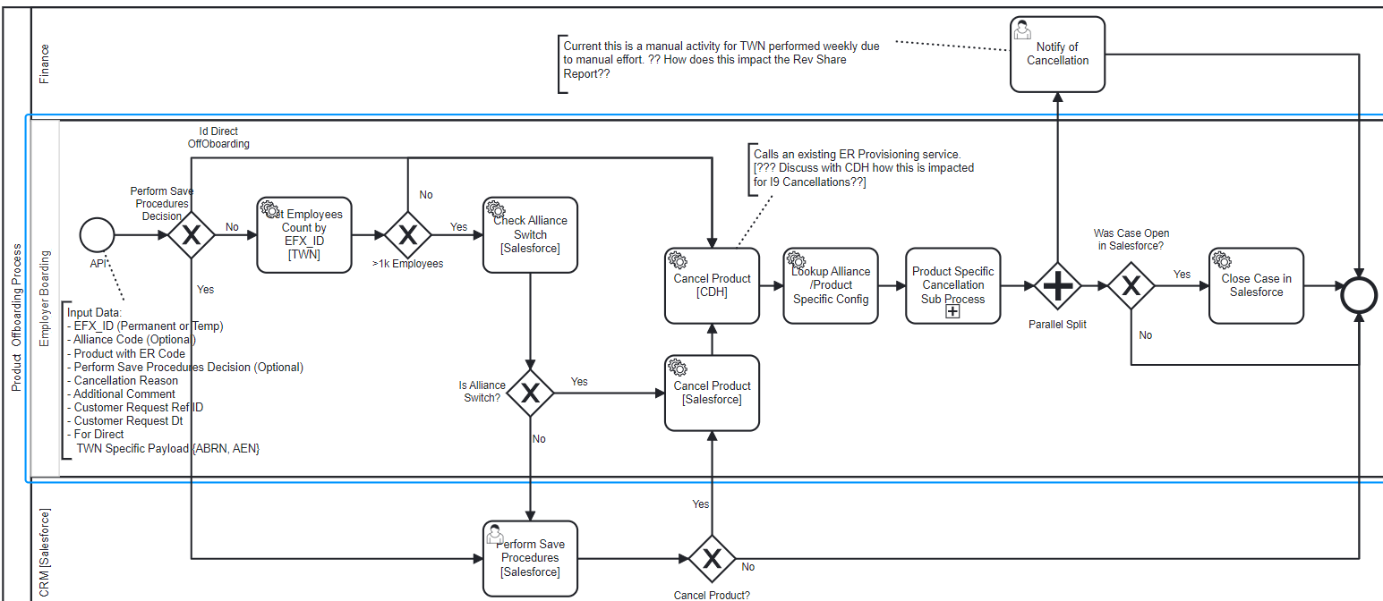
Enhance Employer Offboarding Process
Main Process
Executive Summary
Target State and Implementation Roadmap
Baseball Card
Process Context
Architecture
Design
Plan
Main Process
TWN Subprocess
I9 Subprocess
Summary of Changes
DRAFT
Process Changes
New
Automated
Enhancement
TWN
Salesforce
CDH
Salesforce
Salesforce

Slide 102
Enhance Employer Offboarding Process
Main Process - Implementation Details
Executive Summary
Target State and Implementation Roadmap
Baseball Card
Process Context
Architecture
Design
Plan
Main Process
TWN Subprocess
I9 Subprocess
Summary of Changes
DRAFT
Process Step | Implementation Details | Component Mapping | Systems
Process Start | For Direct - Trigger the process flow when the case is created by Account Exec in Salesforce For Alliance (API) - Called by Alliance For Alliance (Email) - Switch implementation to either use API or use the Web UI | New Service - Cancel Product | Employer Boarding
Get Employees Count by EFX_ID | Fetch a count of active employees for a EFX_ID from the TWN | New Service - Get Employees Count by EFX_I | TWN
Check Alliance Switch | Given an EFX_ID, Product and ERCode will determine if the cancellation request is due to a switch in Alliance | New Service - Check Alliance Switch | Salesforce
Perform Save Procedures | Manual task to track and perform save procedures for the limited set of Employers identified by the process. Employer Onboarding will call Salesforce to create the task | New Service - Create Task “Perform Save Procedures” New UI:For Save Procedures Task New Functionality: Send Save Procedure Decision to Employer Onboarding | Salesforce
Cancel Product [Salesforce] | Cancel the product in Salesforce | Existing Service: Cancel Product | Salesforce
Cancel Product [CDH] | Currently CDH polls Employer Onboarding service for cancellation. Recommend moving to a generic approach of invoking a CDH service from Employer Offboarding for all products. | New Service: Cancel Product | CDH
Lookup Direct/Alliance Config | Maintain a config of the cancellation flags for Alliance/Direct. Use these defaults if not specified in the cancellation request. Extend the service built for Employer Onboarding | Service Enhancement: Alliance/Product Config Service | Employer Boarding
Product Specific Cancellation Subprocess | Trigger the cancellation sub process specific to each product. | New Subprocess - Dynamic triggering of product specific subprocess | Employer Boarding
Notify Cancellation | ?? Need clarity on why Finance receives the email today and impact for all products??
Close Case | Auto close the case in Salesforce on completion of cancellation activities | New Service: Close Case | Salesforce
*Note - Alliances (ADP API specifically) will need to support additional product specified fields in process input to support a multi-product cancellation process
“Save Procedure” - refers to the process to contact client to save the business post cancellation.

Slide 103
Enhance Employer Offboarding Process
Main Process - Implementation Details (Open Items)
Executive Summary
Target State and Implementation Roadmap
Baseball Card
Process Context
Architecture
Design
Plan
Main Process
TWN Subprocess
I9 Subprocess
Summary of Changes
DRAFT
Additional follow up items for Equifax team
Process Step | Open Item | Contact
Perform Save Procedures | Check if “Cancellation Save Procedures” are performed, by Nathan’s team, for TWN Cancellations processed through the ADP API | Nathan Lavin
Notify Cancellation | Currently this is a manual activity for TWN performed weekly due to manual effort. Follow up to understand the impact of automation on the Rev Share report | Terry Hunt Jeremy Novak Nathan Levin
Cancel Product [CDH] | CDH polls an existing service exposed by Employer Onboarding team to get the list of cancellations. Discuss with CDH the impact for supporting product cancellations for all products] | CDH Team & Sarah

Slide 104
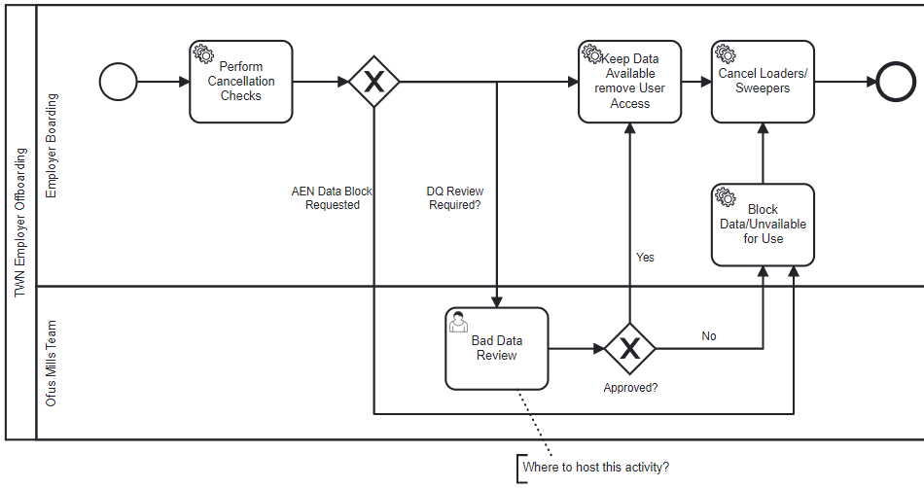
Enhance Employer Offboarding Process
TWN Cancellation Subprocess
Executive Summary
Target State and Implementation Roadmap
Baseball Card
Process Context
Architecture
Design
Plan
Main Process
TWN Subprocess
I9 Subprocess
Summary of Changes
DRAFT
Process Changes
New
Automated
TWN
TWN
V5 Conflig
Enhancement
TWN

Slide 105
Enhance Employer Offboarding Process
TWN Cancellation Subprocess - Implementation Details
Executive Summary
Target State and Implementation Roadmap
Baseball Card
Process Context
Architecture
Design
Plan
Main Process
TWN Subprocess
I9 Subprocess
Summary of Changes
DRAFT
Process Step | Implementation Details | Component Mapping | Systems
Process Start | Start of a subprocess
Perform Cancellation Checks | Review TWN Flags to determine if “Bad Data Review” is required. | New Service: Perform Cancellation Checks | TWN
Bad Data Review | A manual task to complete bad data review. The task will be hosted in Salesforce | New UI: Bad Data Review | Salesforce
Keep Data Available Remove User Access | Reuse the existing service called from the Offboarding API |  | TWN
Block Data/Unavailable for Use | Service to block access and use of data by verifiers |  | TWN
Cancel Loaders/Sweepers | Service to disable existing TWN sweeper jobs for the Employer. Send a notification to Data Load team to disable sweeper rules | Future State - Send notification to Data Load team. The turning of sweeper rule will be manual | Data Load team

Slide 106
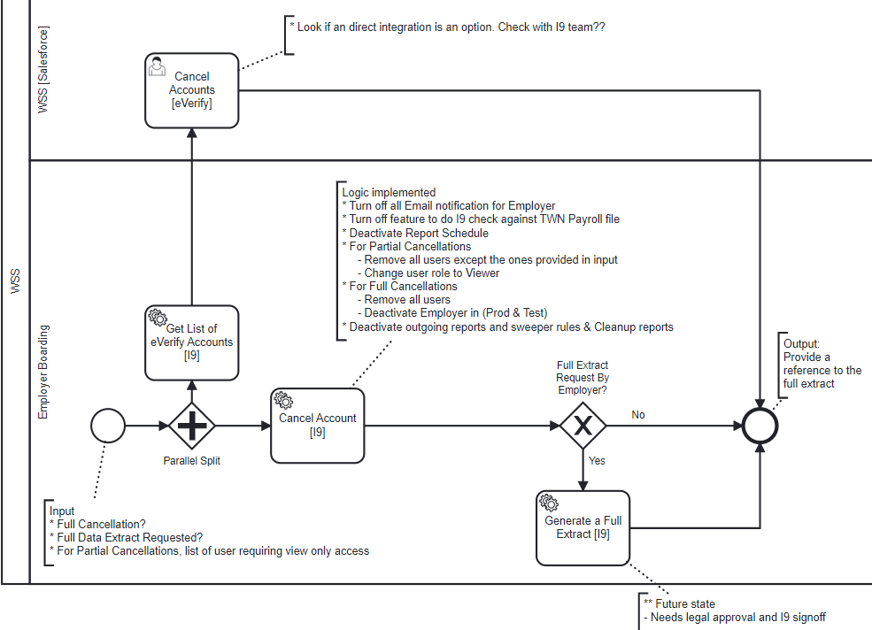
Enhance Employer Offboarding Process
I9 Cloud Cancellation Subprocess
Executive Summary
Target State and Implementation Roadmap
Baseball Card
Process Context
Architecture
Design
Plan
Main Process
TWN Subprocess
I9 Subprocess
Summary of Changes
DRAFT
Process Changes
New
Automated
eVerify
Enhancement
I9
I9
I9

Slide 107
Enhance Employer Offboarding Process
TWN Cancellation Subprocess - Implementation Details
Executive Summary
Target State and Implementation Roadmap
Baseball Card
Process Context
Architecture
Design
Plan
Main Process
TWN Subprocess
I9 Subprocess
Summary of Changes
DRAFT
Process Step | Implementation Details | Component Mapping | Systems
Process Start | Start of a subprocess
Get List of eVerify Accounts | Given an EFX_ID get the list of active eVerify accounts for an Employer | New Service: Get List of eVerify Accounts | 19
Cancel Accounts [eVerify] | Create a manual task in Salesforce for WSS team to cancel eVerify accounts Future Recommendation Review options to integration with eVerify to eliminate manual task | New UI: Cancel Accounts eVerify | Salesforce
Cancel Account I9 | Cancels the account in I9 | New Service: Cancel Accounts | 19
Generate a Full Extract [I9] | ** Future state service To generate an extract of Employer data when it is requested by Employer |  | 19

Slide 108
Enhance Employer Offboarding Process
Summary of changes/enhancements
Executive Summary
Target State and Implementation Roadmap
Baseball Card
Process Context
Architecture
Design
Plan
Main Process
TWN Subprocess
I9 Subprocess
Summary of Changes
Change Details | Change Owner | Effort Estimate (High/Medium/Low) | Estimate in Months
Process Start - Cancel Product | Employer Boarding
Process Start - Trigger this process from Salesforce | Salesforce
New Service: Get Employees Count by EFX_ID | TWN
New Service: Check Alliance Switch | Salesforce
New Functionality: Create Task “Perform Save Procedures” | Salesforce
New UI:For Save Procedures Task | Salesforce
New Functionality: Cancel Product | Salesforce
New Functionality: Send Save Procedure Decision to Employer Offboarding | Salesforce
New Service: Close Case | Salesforce
New Service: Cancel Product | CDH
Service Enhancement: Alliance Config Service | Employer Boarding
New Subprocess - TWN Cancellation (consolidated all TWN related cancellation activities - subprocess “TWN Cloud Cancellation Process) | TWN
New Subprocess - TWN Cancellation | Employer Boarding
New Subprocess - I9 Cancellation (consolidated all I9 related cancellation activities - subprocess “I9 Cloud Cancellation Process”) | I9
New Subprocess - I9 Cancellation | Employer Boarding
New Functionality- Close Case in Salesforce | Employer Boarding

Slide 109
Enhance Employer Offboarding Process
Plan
Executive Summary
Target State and Implementation Roadmap
Baseball Card
Process Context
Architecture
Design
Plan
 | Q1 | Q2 | Q3 | Q4
Enable Cancellation for TWN
Dependencies
New Service: Get Employees Count by EFX_ID
1
Dependent on availability of Salesforce, CDH and TWN Services
New Service: Check Alliance Switch
New Functionality: Create Task “Perform Save Procedures”
New UI:For Save Procedures Task
New Task:TWN Bad Data Checks
New Functionality: Cancel Product
New Service: Close Case
Activity Owned by
Enhanced Employer Onboarding Process
Employer Boarding
New Service: Cancel Product
Salesforce
New Subprocess - TWN Cancellation
CDH
I9 Cloud
TWN
Process Start - Develop Cancel Product service
Process Start - Trigger process for Direct
Ongoing activity with no specific end date
Service Enhancement: Alliance Config Service
End to End testing for Alliance
New Subprocess - Dynamic triggering of product specific subprocess
New Subprocess - TWN Cancellation subprocess orchestration
New Process - End to End Setup
1

Slide 110
Enhance Employer Offboarding Process
Plan
Executive Summary
Target State and Implementation Roadmap
Baseball Card
Process Context
Architecture
Design
Plan
 | Q1 | Q2 | Q3 | Q4
Extend to I9
Report
Dependencies
New Task: eVerify Cancellation
2
Availability of an Analytics Platform
New Subprocess - I9 Cancellation
Enhancements Subprocess - Dynamic triggering of product specific subprocess
New Subprocess - I9 Cancellation subprocess orchestration
End to End testing - I9 Cancellation integration for Alliance
Process Start - Trigger process for Direct
Activity Owned by
Enhanced Employer Onboarding Process
Employer Boarding
Salesforce
CDH
I9 Cloud
Ongoing activity with no specific end date
Define Metrics to capture
New Service: Generate Cancellation Reports
2

Slide 111
Implementation Roadmap
DRAFT

Slide 112
Initiative Roadmap
From successful execution of similar engagements with other clients, our proposed timeline reflects our learnings to deliver on Equifax’s objectives
Start of the program
Milestones
Initiative | Q1 | Q2 | Q3 | Q4
Enhance Employer Onboarding Process - Multi-product/Multi-channel
Automate Employer Deduplication Procedures
Improve quality of “Sales Opportunity Data”
Extend Rev Share Model for Alliances cross product
Establish Common Interaction Model For Employer Onboarding
Define Common Employer Offboarding Process - Multi-product/Multi-channel
1
CDH & Salesforce changes complete
2
TWN Onboarding enabled
1
2
3
4
3
I9 Cloud Onboarding enabled
Process Reporting enabled
CDH Temp EFX ID, Salesforce Service
Availability of product (TWN, I9….) specific services
Analytics platform availability
Billing platform Rev share support for I9
UC removed 5 digit ER Code constraint
4
UC Onboarding enabled
5
6
5
Duplicate check enablement for all products
6
Duplicate check enablement for CDH EFX_ID merges
7
8
9
7
Salesforce Triggering Employer jOnboarding with quick win data quality improvements
8
Salesforce & AO Docs integration enabled
Additional data quality improvements
CPQ & CLM Program alignment
9
CPQ & CLM related ongoing improvements
Plan for cross product support
C2O/EWS/BRM/SUP
10
CDH & Salesforce changes complete
10
11
12
11
TWN Offboarding enabled
12
I9 Cloud Offboarding enabled
Process reporting enabled
Availability of Salesforce, CDH and product specific services
Analytics platform availability
Legend:
Dependency
Duration
Ongoing program
1
Milestones

Slide 113
Appendix A:
Current State Assessment
DRAFT
Process Maps for I9, TWN and UC detailing sequential steps
Pain points & Opportunities
Root Cause Analysis
Potential Solutions

Slide 114
Current State -TWN Alliance Employer Onboarding Platform
Process Map
 | Data Acquisition | Provisioning
Alliance
Employer Boarding
Corporate Services
Send MCIF Data file
Employer Boarding Service Endpoint
Receive Data
(ER Code)
API
API
callback
Fetch Data
Copy file to Alliance specific folder
Pick up File
Get
EFX_ID
Reserve
ER Code
Setup Employer & Authorization
Send
Data (ERCode) to Alliance
MDM/CDH Microservice
SSS Microservice
SSS Microservice
MCIF
Setup Employer
Setup V5 Config for
Data Loader
Send ERCode for Employer
Send Employer & ERCode
TWN Microservice
V5 Microservice
MDM/CDH Microservice
Salesforce (API)
Setup Account
Setup Employer for Billing Events
Salesforce
CDH
Process Start
Automated Process Step
Automated Transition
Manual process
Pain Points
Requires Coordination between Employer, Employer Vendors & Sales
Review/Rework

Slide 115
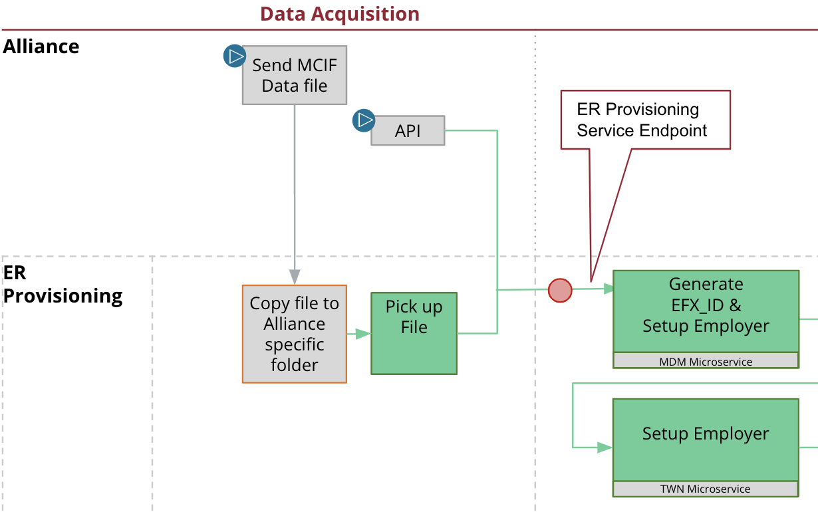
Alliance New Employer Onboarding (TWN)
Pain points & Root Cause
Current State Assessment
DRAFT
 | Pain Points | Root Cause
 | De Duplication check for bulk onboard of Employers is performed post onboarding. Impact: Multiple active TWN subscriptions result due to Employer switching Alliances. A manual SIPI process is used to perform a deduplication check for all new onboardings post Employer Onboarding. The SIPI process is unable to sustain the volume of bulk onboardings. The scalability concern will grow as more Alliances bulk onboard Employers. | This check is missing in the current TWN service automation. The issue is primarily for ADP Bulk Onboarded Employers.
Potential Solutions
ER Code Duplication Check for Alliances
Option 1: Implement a scheduled batch job to detect any duplicates. This will also identify existing duplicates
Option 2: Incorporate a real time check in the Employer Boarding API to detect duplicate active product subscriptions
For both options, a manual process will be needed to support the resolution of duplicates identified.
To be determined - if the duplicate check will be performed against Salesforce or CDH

Slide 116
Alliance New Employer Onboarding (TWN)
Pain points & Root Cause
Current State Assessment
DRAFT
 | Pain Points | Root Cause
 | During EFX_ID generation, the process of converting a temporary EFX_ID to a permanent EFX_ID takes 2+ weeks. Impact: The 2+ weeks delay could result in generation of multiple temp EFX_IDs for single Employer. The multiple temp_EFXIDs introduces added overhead in the manual duplicate checking activities. | CDH maintains a subset of the Corporate Entities in MDS. CDH generates a temp EFX_ID when there is no match in CDH. Due to scalability issues with MDS, CDH consolidates all of the temp EFX_ID over a period of 2 weeks and submits a bulk match request to MDS. In MDS if the Employer, Exists - then the temp EFX_ID is replaced with an existing EFX_ID from MDS Does not exist - The temp EFX_ID is reclassified as a permanent EFX_ID If a human decision is needed - an exception process is initiated
Potential Solutions
Enhance CDH Employer Match to Include Temp_EFXID’s
CDH Account Search currently does not include the temp EFX_ID as part of its matching rules. Proposal is to include temp EFX_ID as part of its matching rules, to avoid generating multiple temp EFX_ID for the same Employer. This will help with the automation of ER Dup checks
To improve the match use the Employer domain name in the match rules
Alternative consideration - Store Employer FEIN in MDS and improve the MDS search latency. The security concern around FEIN can be addressed by storing a one way hash value instead of the FEIN itself.

Slide 117
Alliance (UKG/OSV) New Employer Onboarding (TWN)
Process Map
Current State Assessment
DRAFT
 | Receive Request | Pre - Provisioning (Test Env) | Provisioning | Client Testing | Prod Readiness
OSV/UKG
Employer
Sales
CRM
Costa Rica
MCIF Admin
Workflow Specialist
Implementation Specialist
Send Task Order form PDF file
Email
Forward Email
Identify Alliance from Email
ER Code DeDuplication
Request New ER Code
Prepare MCIF file - Coordinate with Sales and CRM team
Email
Salesforce and searches
SOMA
Send file
Copy MCIF file to share
Get Employer EFX_ID
Create Account & Opportunity
Email
Mulesoft
Salesforce
Start Project
Email
MDM
Workfront
Enter Project details
Assign Implementation Manager
Receive provisioning task
Complete Welcome call - Coordinate with Employer & Sales
Create Employer
Account Manager UI
Test & Resolve issues - Coordinate with Employer
Push configuration to Production
Client Training - Coordinate with Employer
Service Now
TWN
Setup sweeper rules (Optional)
Schedule Welcome call - Coordinate with Employer & Sales
SSS
V5 Configuration (Setup)
MFT
Schedule testing date - Coordinate with Employer and Sales
Go Live - Coordinate with Employer
End date
V5
Process Start
Automated Process Step
Automated Transition
Manual process
Pain Points
Requires Coordination between Employer, Employer Vendors & Sales
Manual Processes

Slide 118
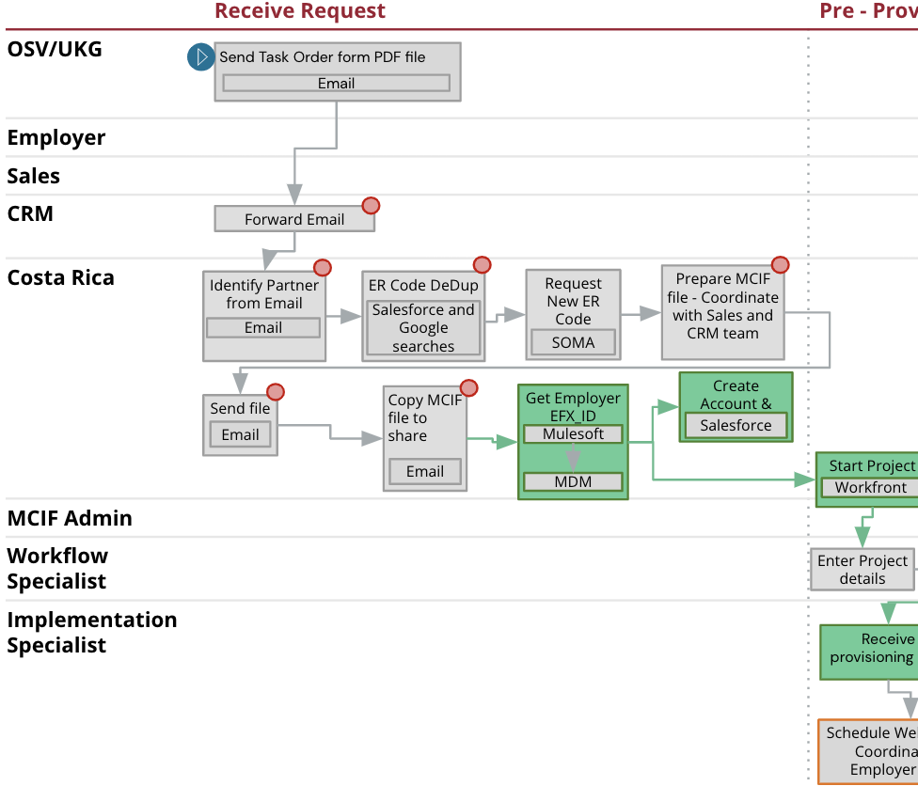
Alliance (UKG/OSV) New Employer Onboarding (TWN)
Pain points & Root Cause
Current State Assessment
DRAFT
 | Pain Points | Root Cause
 | Low value activity by CRM team, to monitor a mailbox and forward Task Order form to Costa Rica team. Impact: Risk of delays due to this additional hop with no value add. Not a scalable model. | Carry over of a legacy process for TWN & UC processing for OSV & UKG Side Note: For UC processing, Costa Rica team team reverts back to CRM with an ER Code and UCX Inhouse Id. CRM team then sets up a “Welcome call” with Employer to complete the SIF and Pinnacle Setup forms.
 | Manual Preparation of a non-MCIF by Costa Rica using the Task Order pdf received from OSV/UKG. Impact: Not a scalable model for bulk onboarding. | The document (Task Order Form) received from UKG/OSV is a pdf form which needs to be transformed to an excel MCIF to load the data to Salesforce and Workfront.
Potential Solutions
UKG/OSV Alliances Onboarding Redesign
Clients send an MCIF file or call an API
Use the Employer Boarding API to Onboarding Employer data
Enhance Employer Boarding API to support configuration of Alliance specific defaults
Short term - Workfront will continue to be used by Implementation Specialist to complete Employer specific connectivity setup
Long term - Review options to provision the Employer connectivity without human intervention

Slide 119
Alliance (UKG/OSV) New Employer Onboarding (TWN)
Pain points & Root Cause
Current State Assessment
DRAFT
 | Pain Points | Root Cause
 | Manual activity to detect duplicate Employer/ER Codes using a Employer Name and address. In some instances Costa Rica team also does Google searches. Impact: Not a scalable model for bulk onboarding. | The "Task Order Form" only contains the name of the Employer name and address. The user has to manually lookup the "Employer" by name and perform checks against the Employer's address etc.to accurately determine if the Employer exists in Salesforce or is new. If the Employer exists in Salesforce, they also need to confirm that the Employer is not already subscribing to this service with a different Alliance or through direct channel.
Potential Solutions
ER Code Duplication Check for Bulk Onboarding
Enhance the Employer Boarding API to perform ER Code DeDuplication checks. This functionality can be utilized for bulk onboarding of Employers, cross product.
(Has a dependency on Temp EFX_ID generation logic changes)

Slide 120
Direct New Employer Onboarding (TWN)
Process Map
Current State Assessment
DRAFT
 | Contract Negotiations | Pre-Provisioning | Provisioning (Test Env) | Client Testing (Test Env) | Production Readiness
Employer
Sales
Workflow Specialist
Implementation Specialist
Start - Receive Opportunity
Start Project
Mark opportunity “Closed Won”
Workfront
Upload signed documents
Adobe Sign
Enter Project details - Coordinate with Sales
Request new ER code
SOMA
Send ER code
Assign Implementation Manager
Salesforce
Complete Welcome call - Coordinate with Employer & Sales
Create Employer
Account Manager UI
Test & Resolve issues - Coordinate with Employer
Create Employer
Client Training - Coordinate with Employer
Go Live - Coordinate with Employer
Receive provisioning task
TWN
Setup sweeper rules (Optional)
Ready for Go Live
Service Now
Service Now
End date
SSS
MFT
Schedule testing date - Coordinate with Employer and Sales
SSS
V5 Configuration (Setup)
Schedule Welcome call - Coordinate with Employer & Sales
V5 Configuration (Setup)
Account Manager UI
V5
TWN
V5
Process Start
Automated Process Step
Automated Transition
Manual process
Pain Points
Requires Coordination between Employer, Employer Vendors & Sales
Manual Processes

Slide 121
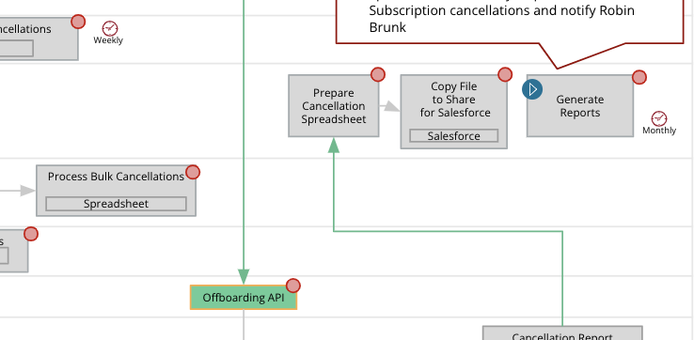
Alliance Cancellations (TWN)
Pain points & Root Cause
Current State Assessment
DRAFT
 | Pain Points | Root Cause
 | The Employer Boarding Offboarding API does not update Salesforce. Impact: Workaround requires manual preparation of a data file to update Salesforce. | ADP feed does not provide a cancellation reason. The cancellation reason is gathered as part of the “Employer Save Procedures” by CRM Salesforce is not processing the cancellation feed file generated by the Offboarding API.
Potential Solutions
Alliance TWN Bulk Cancellations (Process Automation) - Salesforce Update
Request Alliances to provide a cancellation reason as an optional field.
Setup Salesforce to consume the feed file generated by the Offboarding API. Use a temporary cancellation reason if the reason is unavailable
The “Employer Save Procedures” can update the cancellation reason on completion of their process

Slide 122
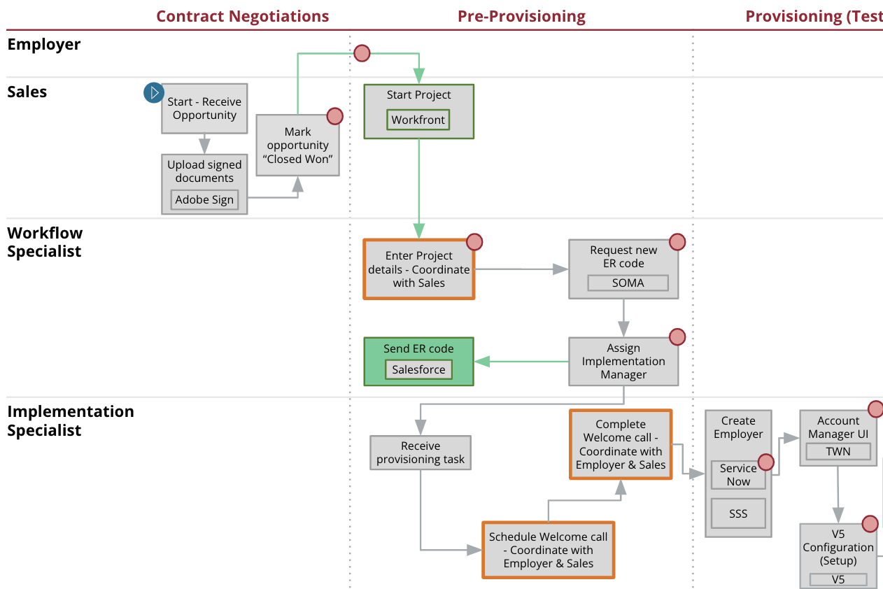
Direct New Employer Onboarding (TWN)
Pain points & Root Cause
Current State Assessment
DRAFT
 | Pain Points | Root Cause
 | Update of SSS, for Authorization, requires submission of ServiceNow Incident. The SNOW ticket resolution requires manual execution of scripts. Impact: Due to backlogs in ticket resolution, the ETA can exceed 2 weeks. 2 separate SNOW tickets are needed, one for Test and repeated in Prod during Go Live. | There is no integration between AM UI’s and SSS.
Potential Solutions
Automate SSS Update for Direct Onboarding
Reuse Employer Boarding API to automate the SSS update functionality for Direct Onboarding of TWN, UC and I9 On prem
Update SSS process upstream before start of “Implementation Specialist” activities.
To be determined: Implementation of SSS update in Test and Prod.

Slide 123
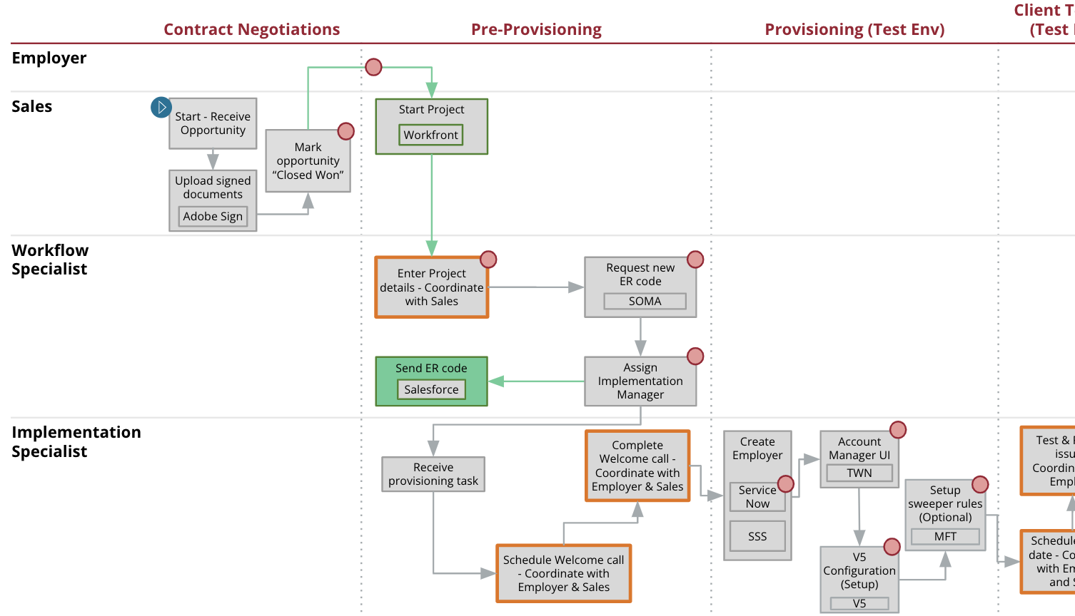
Direct New Employer Onboarding (TWN)
Pain points & Root Cause
Current State Assessment
DRAFT
 | Pain Points | Root Cause
 | Requires review of data from multiple sources, Contract Schedule, SOW, Salesforce to complete Workflow Specialist and Implementation Specialist Activities. Impact: Overhead of manual data entry. | Not all data is digitized and centrally available. Discrepancies between Opportunity Data and Contract Schedule/SOW.
 | Double data entry into product Specific tools like TWN AM UI, V5 Config. Impact: Overhead of manual data entry. | Workfront and Product Specific configuration tools like V5, Account Manager UI are not integrated.
Potential Solutions
Reduce Manual Data Entry by Workflow Specialist & Implementation Specialist
Enhance Employer Boarding Onboarding API to preload Opportunity data in TWN, I9, UC etc., to reduce manual data entry for “Implementation Specialist” during Provisioning. The data can be categorized as:
Standard data elements like Company names, EFX_ID, ER Code etc.
Employer Product Specific Configuration Data like TWN Flags, I9 Default setups etc.
Salesforce invokes the Enhanced Employer Boarding Onboarding API before creating a project in Workfront
Send all Opportunity data needed to complete the “Enter Project Details” activity in Workfront, from Salesforce

Slide 124
Direct New Employer Onboarding (TWN)
Pain points & Root Cause
Current State Assessment
DRAFT
 | Pain Points | Root Cause
 | The contract schedule incorrectly specified the service as SSV instead of GSV. Impact: Delays due to rework. | Human error during setup of Opportunity. This error is identified downstream either due to mismatch in Contract schedule or during Welcome call.
 | On an I9 contract schedule, SSO information is missing. Impact: Delays due to rework.
 | On an I9 contract schedule, Account Executive incorrectly specified the type of sale as New instead of UpSell. Impact: Delays due to rework.
 | Payroll provider missing in the Opportunity Data. Impact: The payroll provider is required to determine whether the client is eligible for onboarding through connector. Request processing is put on hold.
 | Client's payroll provider has an API eligible for onboarding through connector but the Opportunity refers to a file build instead of an API. Impact: Request processing is put on hold.
Potential Solutions
Reduce errors in Services selection in Opportunity
Use Salesforce CPQ (Configure, Price and Quote) to help reduce these errors [Planned for Q3 2022]

Slide 125
Direct New Employer Onboarding (TWN)
Pain points & Root Cause
Current State Assessment
DRAFT
 | Pain Points | Root Cause
 | Opportunity marked "Closed Won" but missing Signatures in Contract Schedule. Impact: Additional overhead for Workflow Specialist. | Some Account Executives are closing the Opportunity as “Closed Won” before “Contract Ops” & Billing approves the contract schedule.
 | Opportunity marked "Closed Won" without Contract Schedule. Impact: Additional overhead for Workflow Specialist.
 | Opportunity marked "Closed Won" but Contract Schedule is Rejected by “Contract Operations”. Impact: Additional overhead for Workflow Specialist.
 | “Contract Ops” approves a contract schedule but Account Executive missed marking the Opportunity as “Closed Won”. Workflow Operations reviews daily reports to identify such Opportunities. Impact: Process delays and additional overhead for Workflow Specialist. | Some Account Executive miss closing an Opportunity as “Closed Won” after “Contract Ops” & Billing approves the contract schedule.
Potential Solutions
Contract Schedule Approval Triggers Employer Onboarding Process in Workfront
In Salesforce, prevent an Account Executive from marking an Opportunity as “Closed Won”
Systemically close an Opportunity as “Closed Won”, on approval of contract schedule by “Contract Ops & Billing”

Slide 126
Direct New Employer Onboarding (TWN)
Pain points & Root Cause
Current State Assessment
DRAFT
 | Pain Points | Root Cause
 | Discrepancy in services listed in Contract Schedule and SOW. Impact: Contract Ops does not review SOW and the discrepancy is identified by Workflow Specialist. The delays are more when the Account Executives waits for Contract Schedule approval before marking Opportunity as “Closed Won”. | Separate manual data entry in Contract Schedule and SOW by Account Executives. Account Executes are manually downloading templates from SPOT. In some instances local copies of outdated templates are used.
 | The Opportunity specified a TWN Onboarding Contract Schedule but “Contract Ops” approved a “Verification Contract”. Impact: Request on hold till this is rectified.
 | Effective date is missing on contract Schedule Client Contact is missing in Workfront. Impact: Contract Ops rejects the contract Schedule causing delays. | Effective date is an optional field and not required to mark the opportunity as “Closed Won”.
Potential Solutions
Avoid Double Data Entry in Contract Schedule and SOW Preparation
Make effective date a required field in Salesforce Opportunity before sending the Contract Schedule for approval
Pass the implementation client contact from Salesforce to Workfront
Automate generation of SOW and Contract Schedule using Opportunity data to avoid data discrepancy between Opportunity, Contract Schedule & SOW.
Short term - Leverage PDF templates merge capabilities to generate Contract Schedule & SOW. Continue to use Adobe Sign to coordinate document approvals
Long term - Use CLM(Contract Lifecycle Management) to manage the Contract life cycle including contract renewals
Contract Ops suggested consolidating the Contract and SOW into a single document for approval to reduce process risk

Slide 127
Direct New Employer Onboarding (TWN)
Pain points & Root Cause
Current State Assessment
DRAFT
 | Pain Points | Root Cause
 | Manual activity to detect duplicate Employer/ER Codes (Applicable for TWN, I9, UC). Impact: The impact is higher for bulk onboarding. Currently this is a manual process. | There is no automated check in place. The Workflow specialist logs into Salesforce to perform duplicate checks manually.
Potential Solutions
ER Dup Check for Direct Onboarding
Short term - For Direct Onboarding ER Code deduplication check should be done manually while processing the Opportunity by the Account Executives
Alternative Solutions
Solution # 1 - Implement a systemic check in Salesforce, which would help speed up resolution of the issue
Solution #2 (Beneficial for Alliance Onboarding) - Enhance the Employer Boarding API to perform a ER Code DeDuplication check. This functionality can be utilized for bulk onboarding of Employers, cross product

Slide 128
Direct New Employer Onboarding (TWN)
Pain points & Root Cause
Current State Assessment
DRAFT
 | Pain Points | Root Cause
 | The Alliance referrals received from Salesforce are not linked with the Employer in Billing. Impact: Billing has issues with calculating Rev Share for Referral Alliances. | Salesforce Opportunity has a field to capture Referral Alliance, This data is currently not flowing down to billing.
Potential Solutions
Propagating Alliance Referrals to Billing for Direct Onboarding
Descope after discussions with Terry, Lon & Stephanie for the following reasons:
For TWN, no plan to continue support of Referrals model for new Alliances
UKG/OSV is moving away from Referral model
Not enough business justification to implement platform changes to support existing Alliances with established Referral agreements.
For non-TWN products, do not use the EWS platform for Rev Share calculations. [To be determined - Should this be addressed as part of Extending TWN Rev Share model?]

Slide 129
Direct New Employer Onboarding (TWN)
Pain points & Root Cause
Current State Assessment
DRAFT
 | Pain Points | Root Cause
 | Process of determining “Implementation Specialist” Workload Is manual process of matching “Implementation Specialist” skill sets and workload. Dependent on manual maintenance of specialist availability by managers in a shared spreadsheet 2 different approaches followed for TWN and I9 Direct Onboarding to determine “Implementation Specialist” workload. Impact: The current process is not accurately tracking “Implementation Specialist” workload. | The “Implementation Specialist” availability is tracked manually in a shared spreadsheet maintained by the manager. TWN Workflow Specialist does A skillset match Goes by the number of requests processed by IS.This does not accurately reflect IS workload I9 Workflow Specialist uses the shared spreadsheet to: Do a skill set match Check if "Implementation Specialist" is marked as available by their manager (Manual process by the Manager) Narrow down the IS with the least workload by looking at the statuses of in progress projects for each “Implementation Specialist”
Potential Solutions
“Implementation Specialist” Assignment Recommendation Service
Develop an “Implementation Specialist” recommendation service for Workflow Specialist. The service will recommend an “Implementation Specialist” based on
Skillset matching
Automatic tracking of availability of the “Implementation specialist” without manual updates from “Implementation Specialist” Manager

Slide 130
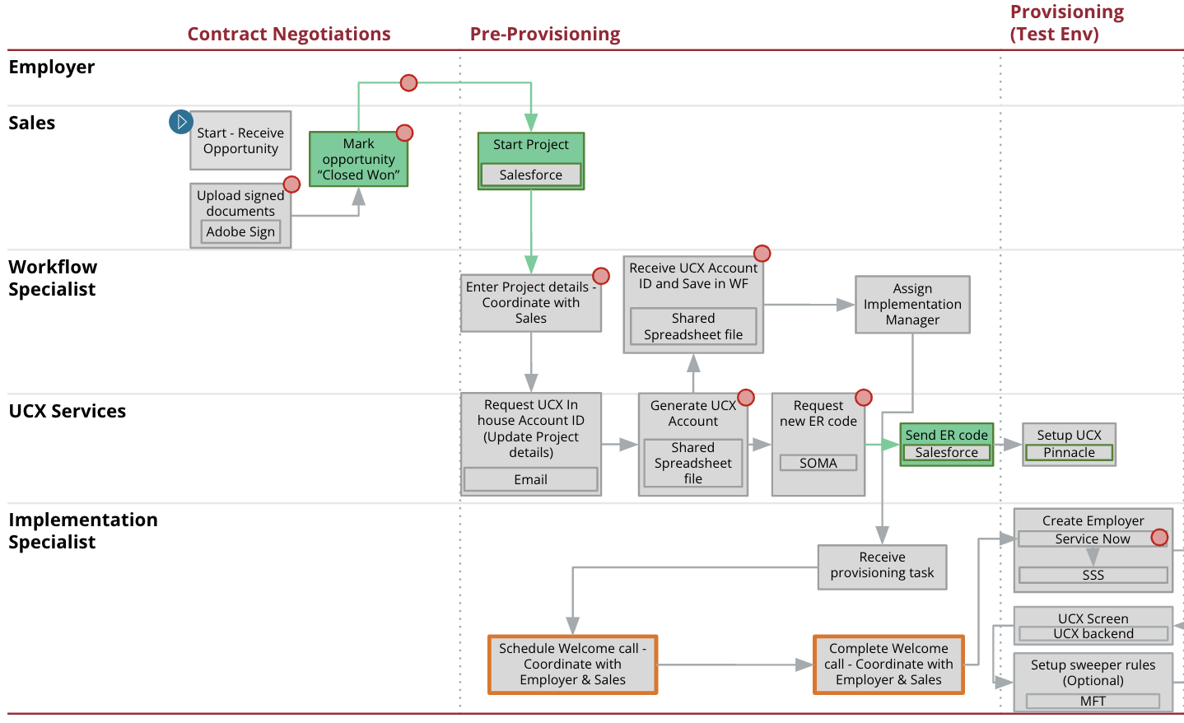
Direct New Employer Onboarding (UC Only)
Pain points & Root Cause
Current State Assessment
DRAFT
 | Pain Points | Root Cause
 | An email is sent to UC Services to Request UCX Inhouse Acct Id. Impact: The process can take 1-2 business days. | The UCX team manages the unique list of UCX ID using a shared spreadsheet.
 | UCX Services currently do not get a notification till Workflow Services contacts them. Impact: The UCX team monitor AO Docs for new documents and create a Workfront project when new docs are seen. | Workfront activity is only created for Workflow services.
Potential Solutions
UCX Inhouse ID Generation and Setup Optimizations
Automate the generation of the UCX Inhouse Account Id
Automate the generation of the ER Code for UCX
Create a Workfront project for both Workflow Specialist and UCX Inhouse team
Send the UCX Inhouse to both projects
Send the UCX ER Code to the UCX project.

Slide 131
Alliance Cancellations (TWN)
Process Map
Current State Assessment
DRAFT
Alliance (non-ADP)
Alliance (ADP)
Alliance (ADP-SBS)
CRM Team (Dedicated)
Sean Connors (Team name TBD)
Nathan Lavin (Team name TBD)
WSS
Finance
Employer Boarding
Team/System Name TBD
Send Request
Send Request
Email
Email
Cancellation Report
Weekly
Email
Send Request
Prepare a list of cancelled Employers with > 1K Employees to initiate save procedures.
Contacts CRM Team for save procedures
Reconcile ADP Dashboard Report & Cancellation Spreadsheet to identify required API Subscription cancellations and notify Robin Brunk
API
Track Cancellation
Shared Spreadsheet
Track Cancellation
Consolidate Cancellations
Shared Spreadsheet
Email
Weekly
Filter Employers to requiring cancellation
Send Spreadsheet
Prepare
Cancellation Spreadsheet
Copy File
to Share
for Salesforce
Generate
Reports
Nathan’s Spreadsheet, Salesforce
Email
Salesforce
Monthly
Process Bulk Cancellations
Spreadsheet
Process Cancellations
Spreadsheet
Offboarding API
Cancellation Report
ADP-SPS
Email
Monthly
Process Start
Automated Process Step
Automated Transition
Manual process
Pain Points
Requires Coordination between Employer, Employer Vendors & Sales
Manual Processes

Slide 132
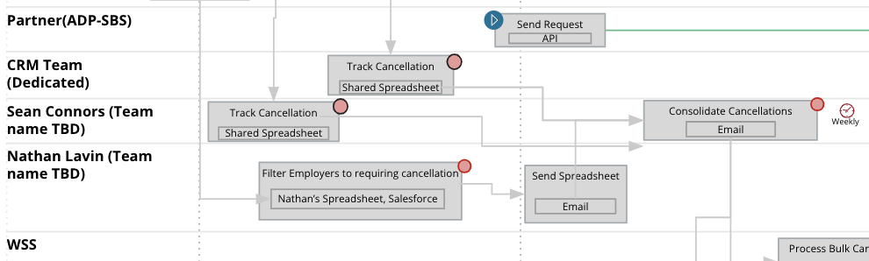
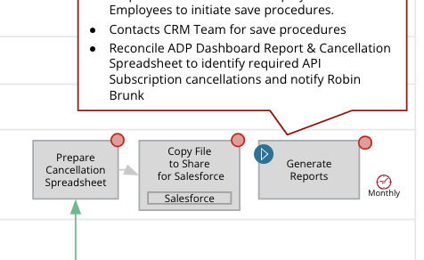
Alliance Cancellations (TWN)
Pain points & Root Cause
Current State Assessment
DRAFT
 | Pain Points | Root Cause
 | Tracking cancellations in multiple spreadsheets and email communications Impact: Manual repetitive error prone work. Delays of >1 week. | Cancellation request received by emails from Alliances No central platform to manage the work.
 | Manual reconciliation across spreadsheets and reports to identify Employers for save procedures. Limit Employers with > 1K employees and exclude those switching Alliance. Impact: Performed once a month due to manual effort. | Information is scattered and tracked by manual means. Additional follows needed with Costa Rica- Why is the API Subscription cancellation done monthly? Who send you the Salesforce cancellation list monthly? Why does ADP Send a separate Weekly report?
Potential Solutions
Alliance TWN Bulk Cancellations (Process Automation)
Use a BPMS Platform to automate, track and manage requests.
Generalize the existing Employer Boarding Onboarding API
Support Alliance integrations via API and MCIF. Also support email as required, automate the processing of emails
Automate process to identify Employers for save procedures (exclude Employers with Alliance Switches)
Initiate a business process for saves before finalizing the cancellation
Review options with Alliance’s to accurately capture the reason for cancellation

Slide 133
Alliance Cancellations (TWN)
Pain points & Root Cause
Current State Assessment
DRAFT
 | Pain Points | Root Cause
 | The update for Finance is done manually via email reconciliations Impact: TBD after follow up | TBD after follow up with Finance team
Potential Solutions
Alliance TWN Bulk Cancellations (Update Finance/Accounting)
TBD after follow up with finance team

Slide 134
Direct Cancellations (TWN)
Process Map
Current State Assessment
DRAFT
 |  | Contract Review | Cancellation
Employer
Sales
AO Contracts Team
WSS (TWN)
Ofus Mills Team
Request Cancellation
Attempt Opportunity Save - Coordinate with Employer
Yes
Submit Request to AO Docs
Receive Cancel Completion Notification
Cancel?
AODocs Process
Cancellations approved
AODocs Process
Yes
Receive Email with cancellation Docs
Create
Case
Perform Cancellation Checks
AEN Block Data?
Block data/ Unavailable for use
Cancel Loaders/Sweepers
Close Case
Send Notification
SOP Document
TWN AM UI
V5
Salesforce
Email
Email
Salesforce
TWN AM UI
Keep data available/Remove user access
No`
Yes
TWN AM UI
Data Quality
Review
Send Approval Decision
Bad Data?
No
Email
Process Start
Automated Process Step
Automated Transition
Manual process
Pain Points
Requires Coordination between Employer, Employer Vendors & Sales
Manual Processes
PROPRIETARY |
134

Slide 135
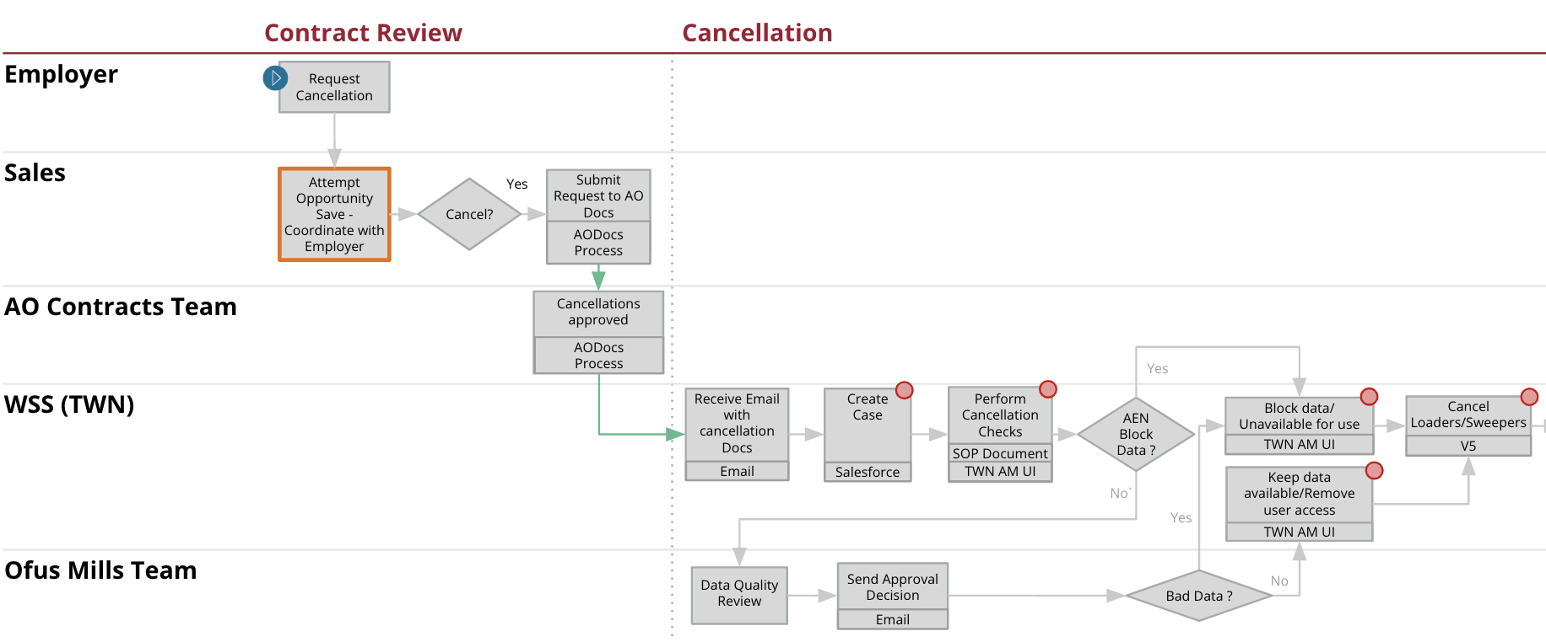
Direct Cancellations (TWN)
Pain points & Root Cause
Current State Assessment
DRAFT
 | Pain Points | Root Cause
 | Work managed via emails and business rules are checked manually. Impact: Potential for delays and human errors. | Existing manual process.
Potential Solutions
Direct TWN Cancellations (Automate)
Automate the business rule checks performed. Enhance existing Employer Boarding Offboarding API to implement the automation
Limit manual activities only for exceptions requiring human intervention
Use a BPMS platform for end to end process visibility of manual activities

Slide 136
Direct Cancellations (I9 On-prem)
Process Map
Current State Assessment
DRAFT
 | Cancellation
Sales
WSS (I9)
IT
Data Load
Employer
Re-confirm Cancellation
Email
Receive Cancellation Docs
Create
Case
Get eVerify Acct List
Cancel Accts
Turn off all Email notification for Employer
Turn off feature to do I9 check against TWN Payroll file
Deactivate Report Scheduled
Deactivate Employer
(Prod & Test)
Open a case - Deactivate outgoing reports and sweeper rules
Send Notification to AE
Close Case
Full Cancellation?
No
Full Cancellation?
Yes
Email
Email
Yes
I9 AM
eVerify
I9 AM
I9 AM
I9 AM
I9 AM
Email
Salesforce
Digital Media Requested?
No
< 30 mins
No
Salesforce
Extract Too Large?
No
Upload To Share Location
Notify Data Load Team
Send Credentials
Turn off data intact (File)
Yes
V5 Config
Get Users retain historical access
Remove users outside the list of users
Change role to Viewer for remaining active users
Extract Data
???
???
Use Utility
Yes
Req Extract
Pick up File
Turn of scheduling integrations
Service Now
Remote Desktop`
Field Print
I9 AM
I9 AM
I9 AM
PAN
Trendsource
Extract Data
Upload File
Create Access Credentials
The entire process is manual
and has potential data risk
MFT
MFT
Receive Credentials
Use Credentials to Download File
Process Start
Automated Process Step
Automated Transition
Manual process
Pain Points
Requires Coordination between Employer, Employer Vendors & Sales
Manual Processes

Slide 137
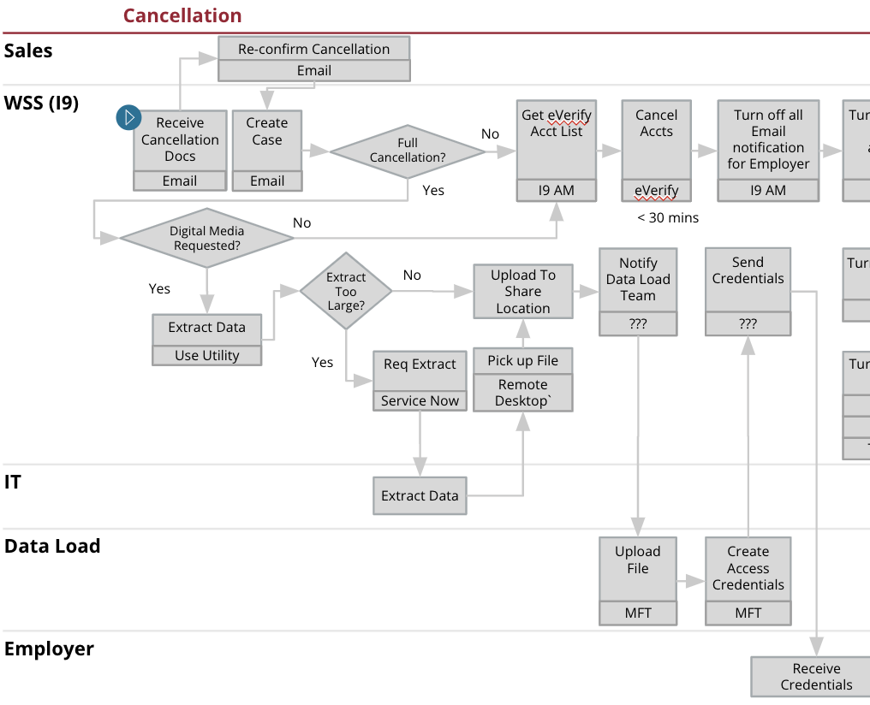
Direct Cancellations (I9 On-prem)
Pain points & Root Cause
Current State Assessment
DRAFT
 | Pain Points | Root Cause
 | The process of extracting the data and sending it to the Employer is manual. Impact: Potential data risk due to manual handling of extract by multiple Equifax personnel Potential risk in the process of sending credentials to Employer to download extract. | Manual process.
Potential Solutions
Sending Data Extract to Employers (I9)
Establish a standard and secure mechanism to extract the data for Employers
Minimize the interaction with the extracted data by Equifax personnel
Allow Employers to submit requests for their data via ES Portal and provide a time sensitive option to securely download the data

Slide 138
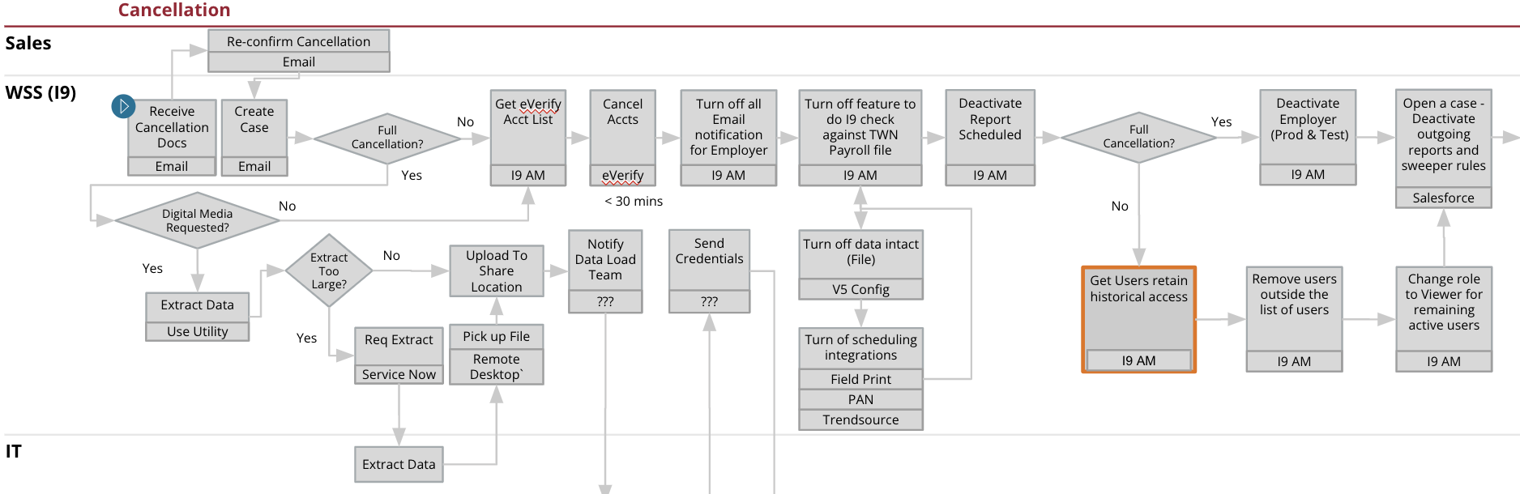
Direct Cancellations (I9 On-prem)
Pain points & Root Cause
Current State Assessment
DRAFT
 | Pain Points | Root Cause
 | Multiple manual activities with the need to coordinate with other team and processes. Impact: The risk of delays due to the manual coordination between teams. | Manual process.
Potential Solutions
I9 Manual processing of cancellations
Consider expanding the Employer Boarding Onboarding API to standardize the process of cancellations across products
Use a BPMS platform to support process level integrations with other teams requiring manual touch points

Slide 139
Process Governance
Current State Assessment
DRAFT
Pain Points | Root Cause
Current state process map documentation unavailable Limited process metrics captured for analysis Impact: No centralized view of the process and its opportunities No reuse of capabilities across processes | Different product teams operate in silos There are no defined Process Owners It’s difficult to capture a Centralized metrics. A lot of work is managed via spreadsheets, emails and ad hoc processes/requests
Potential Solutions
Process Governance Model
Accurate Current state view
Ownership of solutioning to shared objectives cross products
Establish a set of process controls to meet process objectives
Capture of metrics to measure alignment and for root cause analysis

Slide 140
Appendix B:
Solution Prioritization
DRAFT
Prioritizing Potential Solutions

Slide 141
Prioritization Framework
Solution Prioritization
DRAFT
“Level of Benefit” versus “Level of Effort” scatter plot of solution value.
Benefit - Effort Matrix
 | H (3) | M (2) | L (1)
Benefit Inputs
Delay Caused by Root Cause | > 1 week | 1-6 day | < 1 day
Frequency of Problem | Observed in most of the requests | Not most requests but often enough to be a concern | Limited to few requests
Operational Overhead | Need additional risk mitigation processes | Time consuming, Low value, high touch activities | All other activities
End User Impact | Directly noticeable by users or customers | Indirectly observed by users or customers | Not noticeable impact to user or customers
Level of Effort Inputs
Resource Requirements | Multiple systems/teams dependencies | Self contained but complex requirements | Self contained and simple requirements
Time Taken for Implementation | Estimate > 3 months | Estimate 1-3 months | Estimate < 1 month
12
Quick Wins
Major
Projects
Benefit of Gap Resolution
6.5
Incremental
Wins
Low Value
1
3.5
6
Solution Level of Effort
Tie Breaker Rules for Benefit
VH (0.5) | H (0.4) | M (0.3) | L (0.2) | VL (0.1)
Solves 2+ critical pain points | Solves 1 critical pain point | Solves 3+ pain points | Solves 2 pain points | Solves 1 pain point

Slide 142
Potential Solutions
Solution Prioritization
DRAFT
# | Potential Solutions | Description | Level of Effort |  |  | Level Of Benefit |  |  |  |  | Initiative
 |  |  | Resource | Time | Effort Score | Delay Caused | Problem Frequency | Operational Overhead | End User Impact | Benefit Score
1 | Implement process controls solution around the PII data to support a secure manual review of the potential duplicate | Overhead of performing a manual duplicate check to avoid multiple active subscriptions for a product when an Employer switches Alliances. This check is missing in the current TWN service automation. The issue is primarily for ADP Bulk Onboarded Employers. |  |  | 5.0 |  |  |  |  | 9.0 | Automate Employer Deduplication Procedures
2 | Enhance onboarding process by implementing a product agnostic automated Deduplication check before initiating Employer set up to enhance review quality and decrease cycle time | CDH maintains a subset of the Corporate Entities in MDS. CDH generates a temp EFX_ID when there is no match in CDH. This is required to accurately perform an Employer subscription duplicate check. |  |  | 6.0 |  |  |  |  | 8.0 | Automate Employer Deduplication Procedures
 | Enhance onboarding process by implementing a product agnostic automated Deduplication check before initiating Employer set up to enhance review quality and decrease cycle time | Data discrepancy between Contract Schedule, SOW & Opportunity. Short term solution - to address the immediate issue of double data entry Long term solution - to leverage CLM for a board use case of contract Schedule management. |  |  | 4.0 |  |  |  |  | 11.0 | Automate Employer Deduplication Procedures
3 | Implement process controls solution around the PII data to support a secure manual review of the potential duplicate | Reduce the probability of the potential PII data leak risk that is associated with the process of extracting employee data |  |  | 6.0 |  |  |  |  | 11.0 | Automate Employer Deduplication Procedures
* A higher Level of Effort represents a higher amount of effort needed to implement the Potential Solution. A higher Level of Benefit represents a higher severity of pain point being resolved.
High
Medium
Low

Slide 143
Potential Solutions
Solution Prioritization
DRAFT
# | Potential Solutions | Description | Level of Effort |  |  | Level Of Benefit |  |  |  |  | Initiative
 |  |  | Resource | Time | Effort Score | Delay Caused | Problem Frequency | Operational Overhead | End User Impact | Benefit Score
6 | Extend existing platform to support all Employer products to set up authorization roles in SSS | Replace the existing ServiceNow ticket process for performing this update. |  |  | 2.0 |  |  |  |  | 10.0 | Enhanced Employer Onboarding Process (Multi-product/Multi-
7 | Modify Salesforce to send Opportunity to Workfront after approval of contract schedule | Replace the existing ServiceNow ticket process for performing this update. |  |  | 6.0 |  |  |  |  | 9.0 | “Sales Opportunity” data quality Improvements
8 | Invest in CLM and CPQ to enhance boarding process by improving quality of sales data, automating generation of contract schedule & SoW, and then incrementally expand the platform’s capabilities across other enterprise processes | Improve the accuracy of the services specified in the Opportunity using CPQ integration. |  |  | 6.0 |  |  |  |  | 11.0 | “Sales Opportunity” data quality Improvements
* A higher Level of Effort represents a higher amount of effort needed to implement the Potential Solution. A higher Level of Benefit represents a higher severity of pain point being resolved.
High
Medium
Low

Slide 144
Potential Solutions
Solution Prioritization
DRAFT
# | Potential Solutions | Description | Level of Effort |  |  | Level Of Benefit |  |  |  |  | Initiative
 |  |  | Resource | Time | Effort Score | Delay Caused | Problem Frequency | Operational Overhead | End User Impact | Benefit Score
9 | Redesign existing Employer Onboarding API to support process orchestration based on Alliance and product specific parameters (beyond TWN) | Carry over of a legacy process for New Employer Onboarding of TWN & UC for OSV & UKG. The current process will not scale for bulk loading of Employers. Short term - Workfront will be used for completing Employer specific onboarding. Long term - Review options to provision these Employers without human intervention. |  |  | 5.0 |  |  |  |  | 11.0 | Enhanced Employer Onboarding Process (Multi- product/Multi-channel)
11 | Reuse the existing Employer Boarding SSS microservice to generate ER Codes. In addition, adopt an expanded ER code (beyond the current five digit constraint) for UC and I9 | Currently is a manual check performed by Workflow specialist in Workfront. |  |  | 2.0 |  |  |  |  | 8.0 | Enhanced Employer Onboarding Process (Multi-product/Multi-channel)
12 | Automate setup of default product configurations for a direct employer to reduce manual data entry by Implementation Specialist during product setup | Opportunity received by Workflow specialist before Contract Ops Approval. |  |  | 4.0 |  |  |  |  | 10.0 | Enhanced Employer Onboarding Process (Multi-product/Multi-channel)
* A higher Level of Effort represents a higher amount of effort needed to implement the Potential Solution. A higher Level of Benefit represents a higher severity of pain point being resolved.
High
Medium
Low

Slide 145
Potential Solutions
Solution Prioritization
DRAFT
# | Potential Solutions | Description | Level of Effort |  |  | Level Of Benefit |  |  |  |  | Initiative
 |  |  | Resource | Time | Effort Score | Delay Caused | Problem Frequency | Operational Overhead | End User Impact | Benefit Score
13 | Extend existing TWN Rev share model to support I9 Alliances | Referral Alliance is currently not flowing to Billing. |  |  | 5.0 |  |  |  |  | 11.0 | Extend Rev Share Model for Alliances cross product
14 | Introduce a streamlined Interaction model with a cross product responsibility to replace current organization matrix | The current process of assignment is managed using spreadsheets and does not accurately reflect workload. |  |  | 4.0 |  |  |  |  | 6.0 | Common Process Governance Model For Employer Onboarding
15 | Implement an API-led solution for generation of UCX “Inhouse Account ID” | Account ID generation managed via Spreadsheet UCX Team does not have a Workfront project created for them. |  |  | 2.0 |  |  |  |  | 8.0 | Common Employer Onboarding Process (Multi-product/Multi-channel)
16 | Establish a centralized process documentation repository to maintain current state process documentation and implement versioning to track future iterations of it | Establish a Process Governance cross product, cross channel. |  |  | 6.0 |  |  |  |  | 12.0 | Establish Common Interaction Model For Employer Onboarding
* A higher Level of Effort represents a higher amount of effort needed to implement the Potential Solution. A higher Level of Benefit represents a higher severity of pain point being resolved.
High
Medium
Low

Slide 146
Potential Solutions
Solution Prioritization
DRAFT
# | Potential Solutions | Description | Level of Effort |  |  | Level Of Benefit |  |  |  |  | Initiative
 |  |  | Resource | Time | Effort Score | Delay Caused | Problem Frequency | Operational Overhead | End User Impact | Benefit Score
14 | Design a strategy to optimally establish, capture, and track process metrics and SLAs Establish process controls to track adherence to Process SLAs | The current process of assignment is managed using spreadsheets and does not accurately reflect workload. |  |  | 4.0 |  |  |  |  | 6.0 | Common Process Governance Model For Employer Onboarding
16 | Evaluate options to automate the promotion of configurations from Customer Acceptance to Production | Establish a Process Governance cross product, cross channel. |  |  | 6.0 |  |  |  |  | 12.0 | Establish Common Interaction Model For Employer Onboarding
* A higher Level of Effort represents a higher amount of effort needed to implement the Potential Solution. A higher Level of Benefit represents a higher severity of pain point being resolved.
High
Medium
Low

Slide 147
Potential Solutions
Solution Prioritization
DRAFT
# | Potential Solutions | Description | Level of Effort |  |  | Level Of Benefit |  |  |  |  | Initiative
 |  |  | Resource | Time | Effort Score | Delay Caused | Problem Frequency | Operational Overhead | End User Impact | Benefit Score
17 | Automate the Cancellation process to support near real time cancellations. Leverage Workfront or Salesforce to track manual activities for exception processes | Cancellation requests are tracked using spreadsheets and there is weekly and monthly manual processes to process cancellations and initiate save procedures. |  |  | 6.0 |  |  |  |  | 10.0 | Define Common Employer Offboarding Process (Multi-product/Multi-channel)
18 | Provide near real time notification to “Customer Relationship Managers” for Employers who meet the criteria of “Cancellation Save” procedures. Track the activity in Workfront or Salesforce | The process of updating Salesforce is manual. |  |  | 3.0 |  |  |  |  | 10.0
19 | For I9 Cloud product, automate extraction and sending of Employee data requested by Employer during Cancellation* | Automate the manual process by enhancing Employer Boarding Offboarding API. |  |  | 4.0 |  |  |  |  | 7.0
* A higher Level of Effort represents a higher amount of effort needed to implement the Potential Solution. A higher Level of Benefit represents a higher severity of pain point being resolved.
High
Medium
Low

Slide 148
Potential Solutions Prioritization
Solution Prioritization
DRAFT
Quick Wins
Major Projects
Initiative Legend
12
Propagating Alliance Referrals to Billing for Direct Onboarding
E
Process Governance
F
A
Improve quality of “Sales Opportunity Data”
Automate SSS Update for Direct Onboarding
C
UKG/OSV Alliance Onboarding Redesign (Short term)
C
UKG/OSV Alliance Onboarding Redesign (Long term)
C
Avoid Double Data Entry in Contract Schedule and SOW Preparation (Short term)
A
**Reduce errors in Services selection in Opportunity
A
ER Dup Check for Direct Onboarding (Option 1)
B
A
B
Automate Employer Deduplication Procedures
Contract Schedule Approval Triggers Employer Onboarding Process in Workfront
A
Avoid Double Data Entry in Contract Schedule and SOW Preparation (Long term)
UCX Inhouse ID Generation and Setup Optimizations
C
ER Code Dup Check for Alliance (Option 1 - Batch Process)
Sending Data Extract to Employers (I9)
D
Alliance TWN Bulk Cancellations (Salesforce Update)
D
B
D
Alliance TWN Bulk Cancellations (Process Automation)
C
Enhanced Employer Onboarding Process (Multi-product/ Multi-channel)
Enhance CDH Employer Match to Include Temp_EFXID’s
B
Reduce Manual Data Entry by Workflow Specilaist & Implementation Specialist
C
Direct TWN Cancellations (Automate)
D
ER Code Dup Check for Alliance (Option 2 - Real Time)
B
Benefit of Gap Resolution
I9 Manual processing of cancellations
D
D
Define Common Employer Offboarding Process (Multi-product/ Multi-channel)
6.5
“Implementation Specialist” Assignment Recommendation Service
F
E
Extend Rev Share Model for Alliances cross product
F
Establish Common Process Governance Model For Employer Onboarding
Incremental Wins
Low Value
1
3.5
6
Solution Level of Effort
** CPQ Integration targeted to be completed Q3/Q4 2022
1

Slide 149
Employer Onboarding Cost Estimation
Solution Prioritization
Initiative | Total Hours* | Total Amount ($)*
Enhance Employer Onboarding Process - Multi-product/Multi-channel | 15,482 | $3,638,270
Automate Employer Duplication Check Procedures | 5,000 | $1,175,000
Improve quality of “Sales Opportunity Data” | 5,977 | $1,404,595
Extend Rev Share Model for Alliances Cross Product | TBD | TBD
Establish and Operationalize Common Interaction Model For Employer Onboarding | 5,831 | $563,500
Define Common Employer Offboarding Process - Multi-product/Multi-channel | 7,458 | $1,752,630
* Cost estimates do not include run rate and are based on the information during workshops provided by each Employer Onboarding product team, and the assumptions from PwC from relevant experience. A change in assumptions or scope will directly impact the estimates.
* While no two large-scale programs are same because of scope and complexity factors, based on the information during workshops provided by each Employer Onboarding product team, and the assumptions from PwC from relevant experience, the estimation results from the estimation model indicates a build cost of ~$8.5 M* (+/- 50%), assuming a blended rate of $235/hr. The model cost includes design, build, testing and infrastructure (taken as-is).

Slide 150
Appendix C:
Approach
DRAFT
High Level Approach

Slide 151
Assessment Approach
(TWN, I9 and UC for Direct & Alliance)
DRAFT
Process Mapping and Pain Point Identification
Root Cause Analysis and Potential Solutions
Solutions and Roadmap
1
2
3
Document current state process maps
Source pain points via interviews, questionnaires and workshops with emphasis on:
Delay caused
Frequency of Problem
End User Impact
Classify pain points into key themes, and focus areas
Brainstorm potential solutions
Prioritize based on Benefit-Effort Matrix
Finalize solutions
Re-prioritize solutions based on “Benefit-Effort” matrix
Define implementation roadmap
Activities Performed
Activities Performed
Activities to be Performed
20+ interviews with Contract Ops, Workflow Solution Ops, Billing, & Technology teams
15+ solutioning workshops conducted with Contract Ops, Workflow Solution Ops, Billing, Technology teams
Document Solutions and define implementation roadmap
25+ unique pain points across Employer onboarding & cancellations Pain points consolidated into 3 primary themes
6 initiatives and 20 key solutions developed
Prioritized Initiatives, Roadmap and Interaction Model

Slide 152
Focus Areas and Key Participants
DRAFT
We conducted interviews, had solutioning workshops and reviewed existing processes to help with our findings and recommendations
Focus Areas
Participants
Technology:
Stephanie Warren, Data Principal (C&D Enablement)
Srini Sayana (Employer Boarding)
Sreekanth Sreeperunbuduru (Employer Boarding)
Sarah Iberg (Employer Boarding)
Patricio Seguel (Employer Boarding)
Operations:
Karen Eaton, Implementation Leader
Kristen Silas, Operations Workflow Specialist)
Meghan Waeckerle, Operations Workflow Specialist)
Scott Wozniak, Implementations Direct (TWN)
Chris Drachnik, Implementations, Employer Services
Lisa Roberts - Implementation Lead, TWN Partners
Jake Schnare, Implementation Lead
Dave Worseck - UC Workflow Specialist
I9 Technology:
Todd Campbell, SME Simplify I9, Paychex
Pablo Monge- Masis, Data Exchange Services
WOTC Technology:
Arvind Bansal, PEL
Salesforce
Lohn Yoder, Execution Leader
Simon Fonseka, Technical lead
Corporate
Sunil Reddy (MDM)
Cornelia Herman(ECP)
Finance
Terri Hunt, VS
Elena Bennett, ES
Alliances
Nathan Lavin - CRM and CR Team
Tony Gaebler, onboarding products
Process
Channel
Products
TWN
UC
I9 On-prem
Direct
Employer Onboarding
SIPI Process
M & A *
TWN (API Driven, UKG/OSV, Other)
UC (UKG/OSV)
I9 Cloud *
Alliance
TWN
I9 On-prem
Direct
Cancellations
TWN (API Driven, UKG/OSV, Other)
I9 Cloud *
Alliance
WOTC - Moved out scope.
WOTC is in the midst of integrating HireTech with Equifax platform. The integration is targeted for Sept. 2022. The current state should be based on the Sept version of WOTC platform.
*Additional Interviewees are referenced in the appendix

Slide 153
Risks and Mitigation
DRAFT
Risks have been outlined as part of potential transition from current state to target state i.e. technical and operational risks, unpredictable costs, scheduling concerns, skills and change management issues. High level mitigation steps have been proposed to alleviate outlined risks; further investigation will be required to assess risks and measure enterprise impact
Risks | Execution Impact | Proposed Mitigation steps
Potential latency in decision-making to execute target state due to lack of funding for a comprehensive business case | High | Determine the technical scope for the business case to justify the incremental costs and evaluate implementation risk
Delayed target state evaluation and implementation timelines due to lack of resources and other significant staff bandwidth issues of current system resources | High | Hire, contract or realign staff to fulfill additional technology team and supporting interaction model. Define governance strategy and operating model to increase coordination between stakeholders; create common goals and success criteria.
Currently planned Initiative timelines may be impacted due to target state enhancement changes | Medium | Conduct a quick dependency mapping and feasibility assessment exercise to implement recommendations based on risk/benefit ratio
Insufficient or delayed funding for other major projects like CLM and CPQ etc. could adversely impact delivery of proposed solutions & their timeline | Medium | Conduct an executive roadshow to showcase intersection of major projects with this initiative and work collaboratively to enhance their business case as needed
Delay implementing in proof-of-concept as part of enhancements for the existing Automation infrastructure capabilities | Medium | Implement a streamlined interaction model (as depicted earlier)to identify, assess and expedite Employer Onboarding process enhancements

Slide 154
Employer Onboarding Cost Estimation Breakdown
Initiative: Enhance Employer Onboarding Process - Multi-product/Multi-channel
Systems: 8
Workflows / Guided Procedures: 2
Reports: 2
APIs: 8
Enhancements: 11
Design: $527,340
Construct: $1,178,525
Testing: $869,265
Implement: $1,063,140
Total Hours: 15,482
Total Amount: $3,638,270
Initiative: Automate Employer Duplication Check Procedures
Workflows / Guided Procedures: 1
Reports: 1
APIs: 1
Enhancements: 1
Web Portal: 1
Design: $146,640
Construct: $407,020
Testing: $188,000
Implement: $433,340
Total Hours: 5,000
Total Amount: $1,175,000
Initiative: Improve quality of “Sales Opportunity Data”
Systems: 2
Workflows / Guided Procedures: 1
Reports: 0
APIs: 1
Enhancements: 2
Web Portal: 1
Design: $138,180
Construct: $294,220
Testing: $259,205
Implement: $712,990
Total Hours: 5,977
Total Amount: $1,404,595
* Cost estimates do not include run rate and are based on the information during workshops provided by each Employer Onboarding product team, and the assumptions from PwC from relevant experience. A change in assumptions or scope will directly impact the estimates.
* While no two large-scale programs are same because of scope and complexity factors, based on the information during workshops provided by each Employer Onboarding product team, and the assumptions from PwC from relevant experience, the estimation results from the estimation model indicates a build cost of ~$8.5 M* (+/- 50%), assuming a blended rate of $235/hr. The model cost includes design, build, testing and infrastructure (taken as-is).

Slide 155
Employer Onboarding Cost Estimation Breakdown
Initiative: Extend Rev Share Model for Alliances Cross Product
Systems: TBD
Workflows / Guided Procedures: TBD
Reports: TBD
APIs: TBD
Enhancements: TBD
Design: TBD
Construct: TBD
Testing: TBD
Implement: TBD
Total Hours: TBD
Total Amount: $ TBD
Initiative: Establish Common Interaction Model For Employer Onboarding
N/A
Design: $156,480
Implement/Execute: $407,020
Total Duration: 16 weeks
Total Amount: $563,500
Initiative: Define Common Employer Offboarding Process - Multi-product/Multi-channel
APIs: 7
Enhancements: 1
Workflows / Guided Procedures: 2
Web Portal: 1
Design: $246,985
Construct: $469,530
Testing: $389,395
Implement: $646,720
Total Hours: 7,458
Total Amount: $1,752,630
* Cost estimates do not include run rate and are based on the information during workshops provided by each Employer Onboarding product team, and the assumptions from PwC from relevant experience. A change in assumptions or scope will directly impact the estimates.
* While no two large-scale programs are same because of scope and complexity factors, based on the information during workshops provided by each Employer Onboarding product team, and the assumptions from PwC from relevant experience, the estimation results from the estimation model indicates a build cost of ~$8.5 M* (+/- 50%), assuming a blended rate of $235/hr. The model cost includes design, build, testing and infrastructure (taken as-is).

Slide 156
Employer Onboarding Components Complexity details
Initiative: Enhance Employer Onboarding Process - Multi-product/Multi-channel
Object Type | Complexity | # | Design | Construct | Testing | Implement, Deploy, Hypercare and Change Management
Reports | High | 0 | 2244 | 5015 | 3699 | 4524
Reports | Medium | 1
Reports | Low | 1
Systems | Very High | 0
Systems | High | 2
Systems | Medium | 2
Systems | Low | 4
APIs | High | 1
APIs | Medium | 2
APIs | Low | 5
Enhancements | Very High | 0
Enhancements | High | 2
Enhancements | Medium | 3
Enhancements | Low | 6
Workflow / Guided Procedures | High | 0
Workflow / Guided Procedures | Medium | 1
Workflow / Guided Procedures | Low | 1
(hours)
(hours)
(hours)
(hours)

Slide 157
Employer Onboarding Components Complexity details
Initiative: Automate Employer Duplication Check Procedures
Object Type | Complexity | # | Design | Construct | Testing | Implement, Deploy, Hypercare and Change Management
Reports | High | 0 | 624 | 1732 | 800 | 1844
Reports | Medium | 0
Reports | Low | 1
Systems | Very High | 0
Systems | High | 0
Systems | Medium | 0
Systems | Low | 0
APIs | High | 0
APIs | Medium | 1
APIs | Low | 0
Enhancements | Very High | 0
Enhancements | High | 0
Enhancements | Medium | 1
Enhancements | Low | 0
Workflow / Guided Procedures | High | 0
Workflow / Guided Procedures | Medium | 1
Workflow / Guided Procedures | Low | 0
Web Portal | Very High | 0
(hours)
(hours)
(hours)
(hours)

Slide 158
Employer Onboarding Components Complexity details
Initiative: Improve quality of “Sales Opportunity Data”
Object Type | Complexity | # | Design | Construct | Testing | Implement, Deploy, Hypercare and Change Management
Systems | Very High | 0 | 588 | 1252 | 1103 | 3034
Systems | High | 0
Systems | Medium | 1
Systems | Low | 1
APIs | High | 0
APIs | Medium | 1
APIs | Low | 0
Enhancements | Very High | 0
Enhancements | High | 0
Enhancements | Medium | 1
Enhancements | Low | 1
Workflow / Guided Procedures | High | 0
Workflow / Guided Procedures | Medium | 1
Workflow / Guided Procedures | Low | 0
Web Portal | Very High | 0
Web Portal | High | 0
Web Portal | Medium | 1
Web Portal | Low | 0
(hours)
(hours)
(hours)
(hours)

Slide 159
Employer Onboarding Execution details
Initiative: Establish Common Interaction Model For Employer Onboarding
Phase | Week 1 - 2 | Week 3-4 | Week 5-6 | Week 7-8 | Week 9-10 | Week 11-12 | Week 13-14 | Week 15-16
Design | 666
Implement/Execute |  |  |  | 1732

Slide 160
Employer Onboarding Components Complexity details
Initiative: Define Common Employer Offboarding Process - Multi-product/Multi-channel
Object Type | Complexity | # | Design | Construct | Testing | Implement, Deploy, Hypercare and Change Management
APIs | High | 0 | 1051 | 1998 | 1657 | 2752
APIs | Medium | 2
APIs | Low | 5
Enhancements | Very High | 0
Enhancements | High | 0
Enhancements | Medium | 0
Enhancements | Low | 1
Workflow / Guided Procedures | High | 0
Workflow / Guided Procedures | Medium | 0
Workflow / Guided Procedures | Low | 2
Web Portal | Very High | 0
Web Portal | High | 0
Web Portal | Medium | 0
Web Portal | Low | 1
(hours)
(hours)
(hours)
(hours)

Slide 161
Appendix D:
Glossary
DRAFT

Slide 162
Glossary
DRAFT
Term | Definition
TWN | The Work Number is the solution provided by Equifax for pre-employment verification for new hires
I9 | I9 is the solution provided by Equifax to manage end to end process of I9 for new hires
UC | Unemployment Cost Management solution for managing the unemployment claim for the new hires
Direct | Direct channel is a method of sale when Employer is Onboarded Directly without Any middlemen
Alliance | Alliance Channel is a method of sale when Equifax onboard Employers of a 3rd Party Vendor or Partner
Deduplication | DeDuplication is an exercise performed during the implementation workflow to remove multiple active ER codes for a single product for an Employer
CDH | Customer Data Hub
MDM | Master Data Management
Term | Definition
IS | Implementation Specialist
MCIF | Multi Channel Information File is the file template in which 3rd party partners provide Employer data
SIPI | Switch Identification Post Implementation
UKG | Ultimate Kronos Group is the 3rd party partner which provides Employer data to Equifax
OSV | One Source Virtual is the 3rd party partner which provides Employer data to Equifax
AM | Account Manager
ER Code | Employer Code to identify Employer in
EFX Id | Global Identification Id for an Employer in MDM
BPMS | Business Process Management Solution

Slide 163
Thank you

Slide 164
ER Code Design Considerations
The below recommendation are based on the understanding of the ER Code requirements described in the table below
Product | Business Rules & ER Code Usage Rules
TWN | The decision to maintain one or more ERCodes for an Employer is driven by Employer specific requirements or based on Equifax internal requirements Some of the rules are:
 | Employer (for a single FEIN) requests multiple ERCodes to meet their requirements for segmenting payroll data Equifax requirement to segment the payroll data for Alliances, Employer & Product for Revenue Share calculations Support a combination of both the above requirements
I9 | I9 Cloud implementation does not need an ERCode. The ERCode will probably be limited to billing and revenue share calculations
UC | UC uses ERCode only for authorization in Web Manager. UC does not always share an ER Code with TWN Need addition follow up by Equifax tech team on - If the TWN requirements for Employer data segmentation applies to UC
WOTC | Need addition follow up by Equifax tech team on - Need follow on ERCode requirements
Note: ADP does not allow sharing of TWN ERCode
Recommendation
Base Assumption: ER Code is currently not consistently shared across products and the setup works for the majority of the existing requirements
Future state solution recommendation
Establish a common understanding that ERCode does not uniquely identify an Employer
For TWN, it is a field used to segment data for
Employer - it segments the data for a Product based on Employer specified criteria
Equifax - it segments the data for a combination of Employer, Product and Alliance
For other products, like I9 it serves as unique identifier for a combination of Employer, Product and Alliance
From a data model design perspective maintain a clear separation of approach to segment data to meet Employer requirements from Equifax internal requirements
Proposed future change based on the above assumptions are:
Create a new ERCode for each product onboarding to meet the Employer data segmentation requirements
For Equifax internal requirements, consider maintaining a table of relationships between ERCodes cross products. Maintain this data only for specific products as required.
Benefits
The rules to check for duplicate product onboardings is simple
The rules for generating ERCode is simple
Limit the impact of the change to specific areas for example UC data loader
Next Steps
Elaborate on the ER Code business rules/usage table above for all products
Perform an impact analysis of proposed solution to all downstream processes and applications

